Slide 1
Figure S1
A
B
C
100
100
15
80
80
12
60
60
9
Reward preference
(% of 10 trials per block)
Large-reward
Omission rate
(% of 10 trials per block)
Latency to choose
(sec)
40
Small-reward
40
6
20
20
3
0
0
25
50
75
100
0
0
25
50
75
100
0
0
25
50
75
100
% ‘Shock-probability’ (no shock given)
(10-trial-blocks)
% ‘Shock-probability’ (no shock given)
(10-trial-blocks)
% ‘Shock-probability’ (no shock given)
(10-trial-blocks)

Slide 2
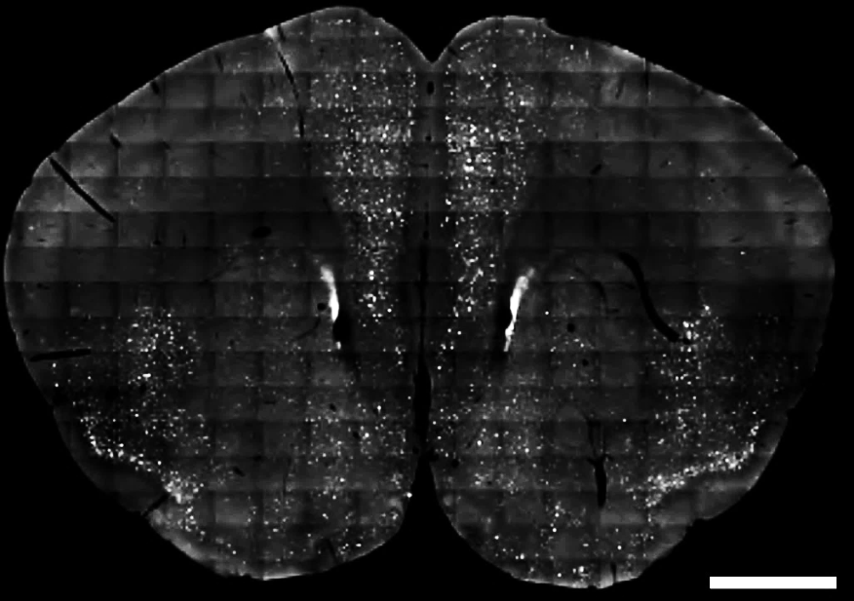
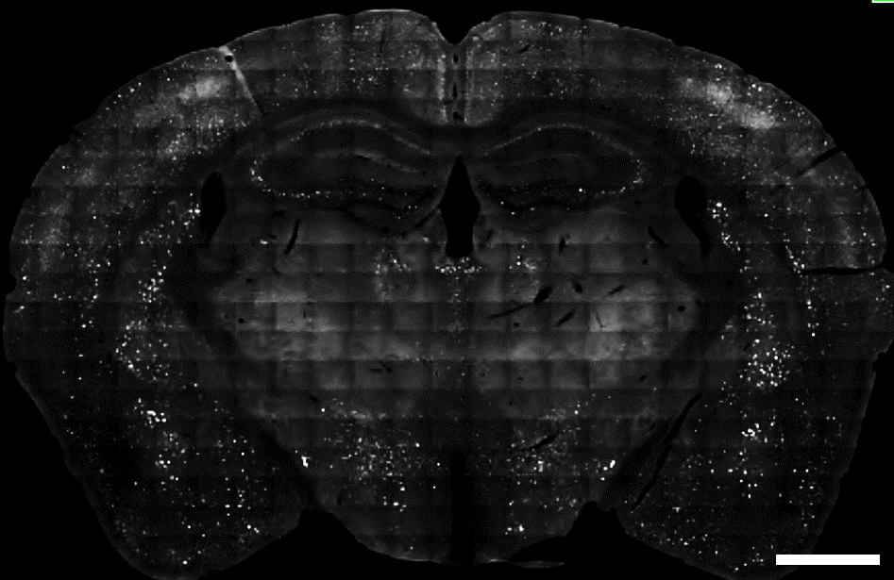
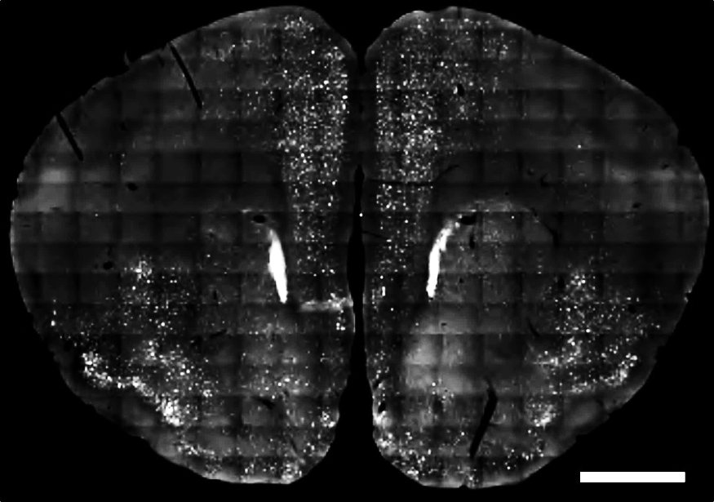
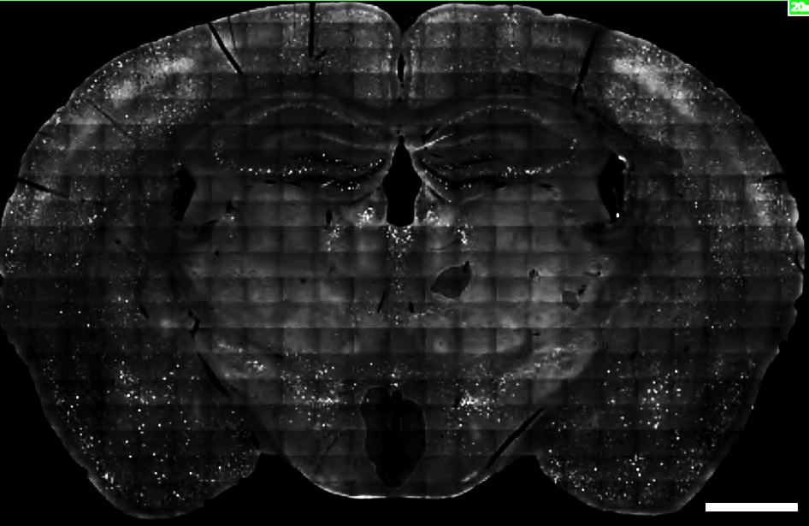
Figure S2
A
B
C
D
E
F
500
500
400
400
300
300
Hippocampal DG
c-fos+ cells per mm²
Hippocampal CA3
c-fos+ cells per mm²
200
200
100
100
0
NS
RDT
0
NS
RDT

