Slide 1
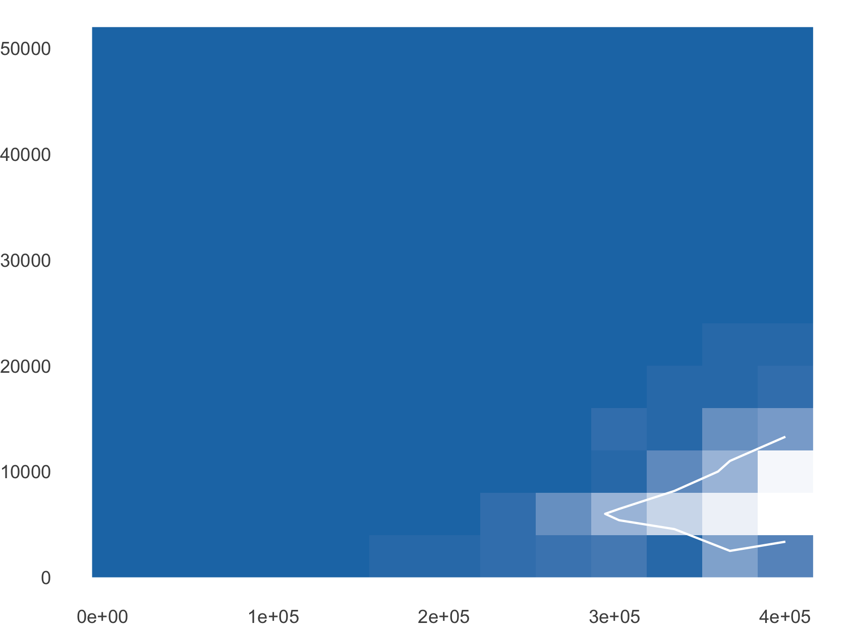
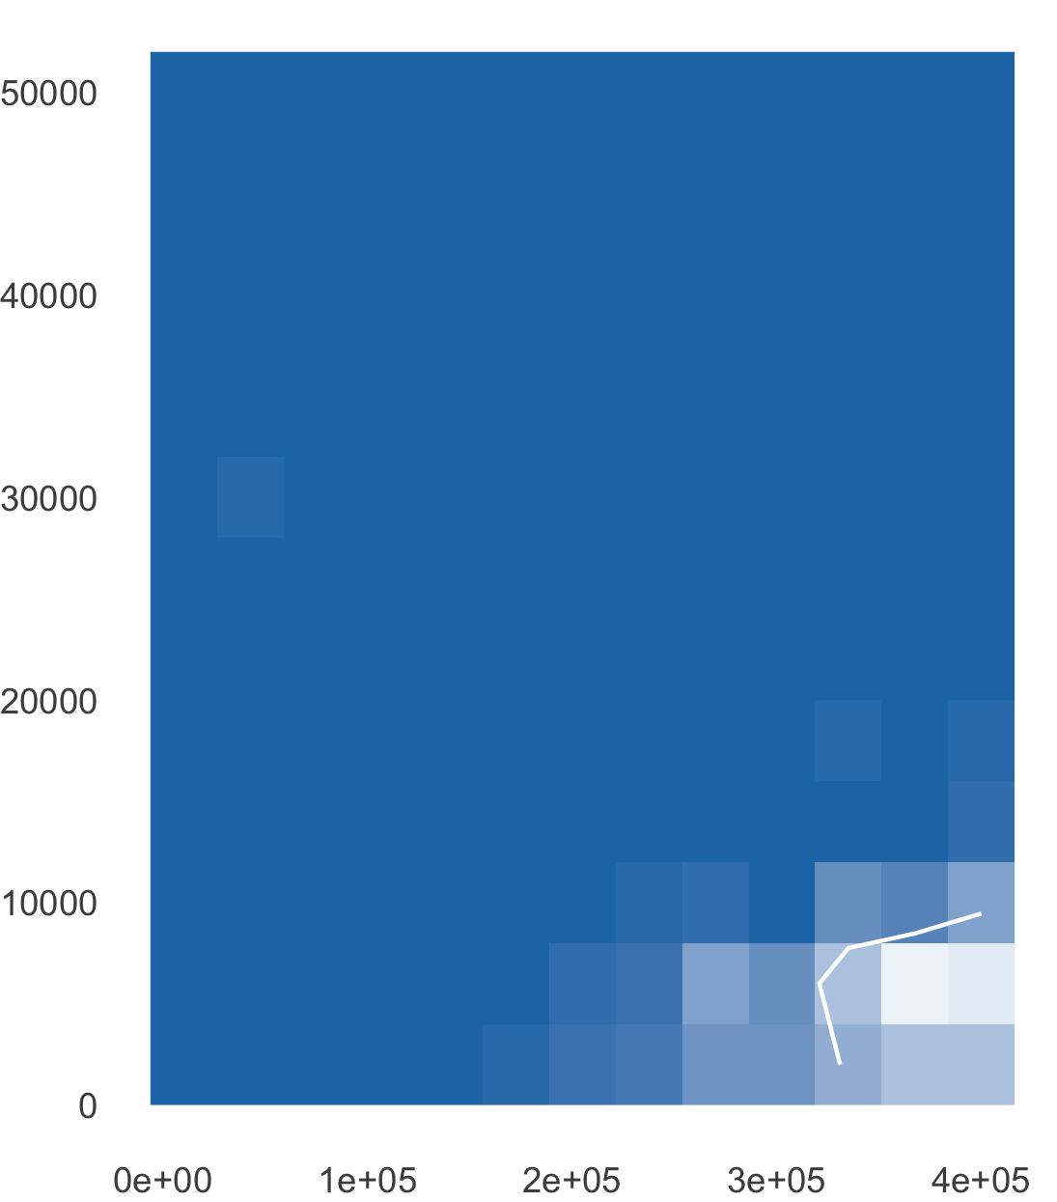
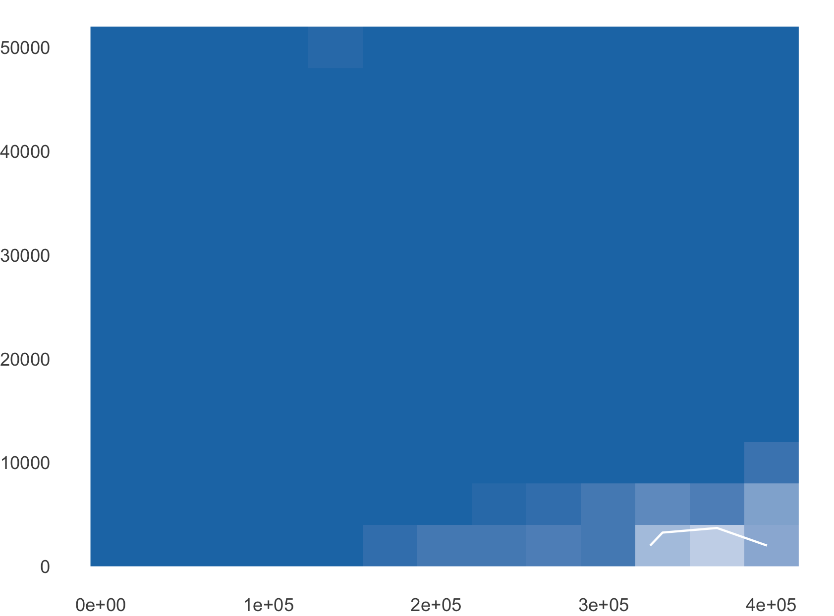
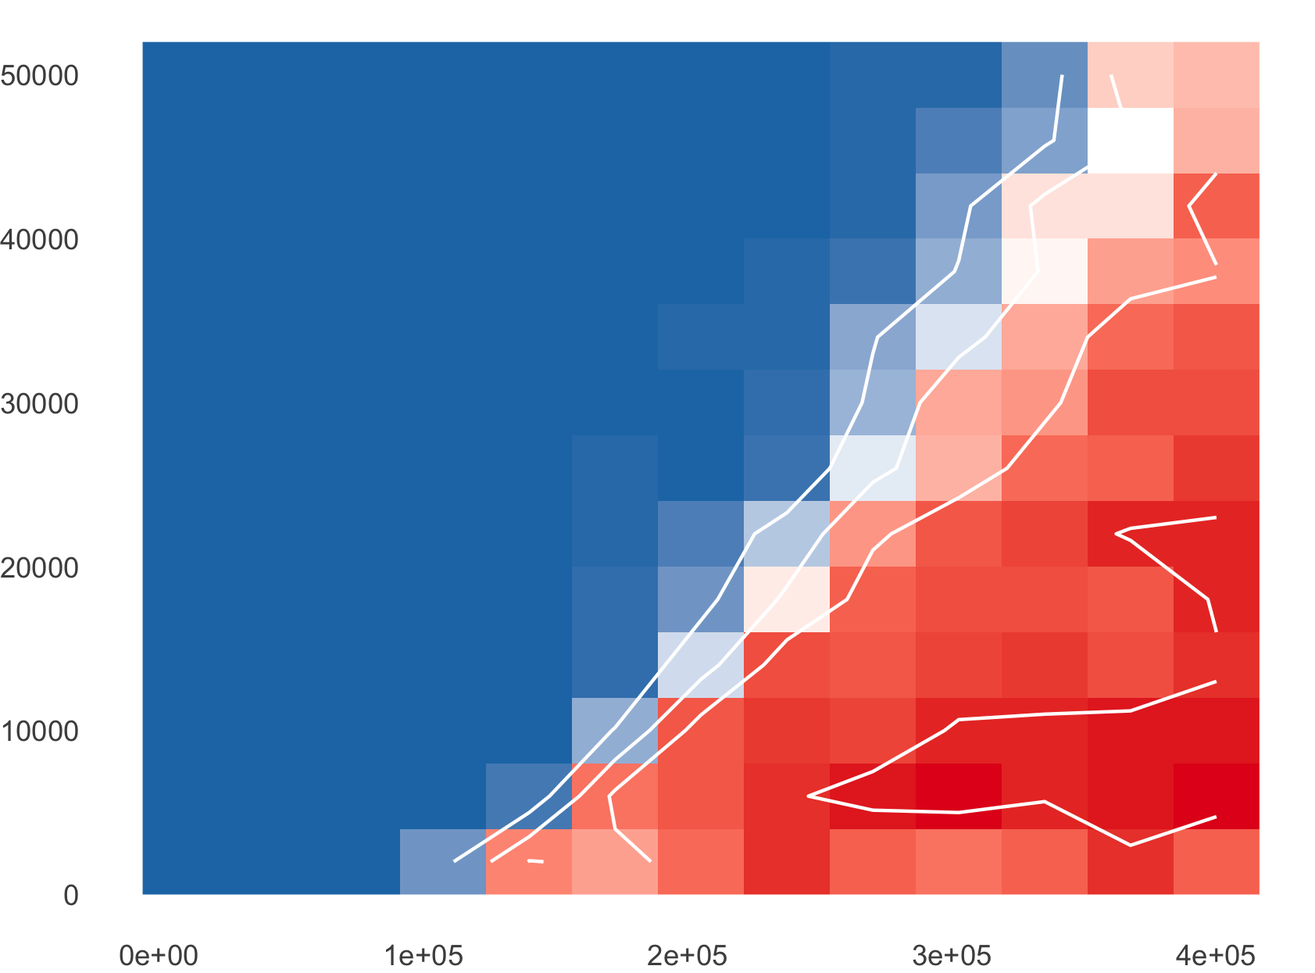
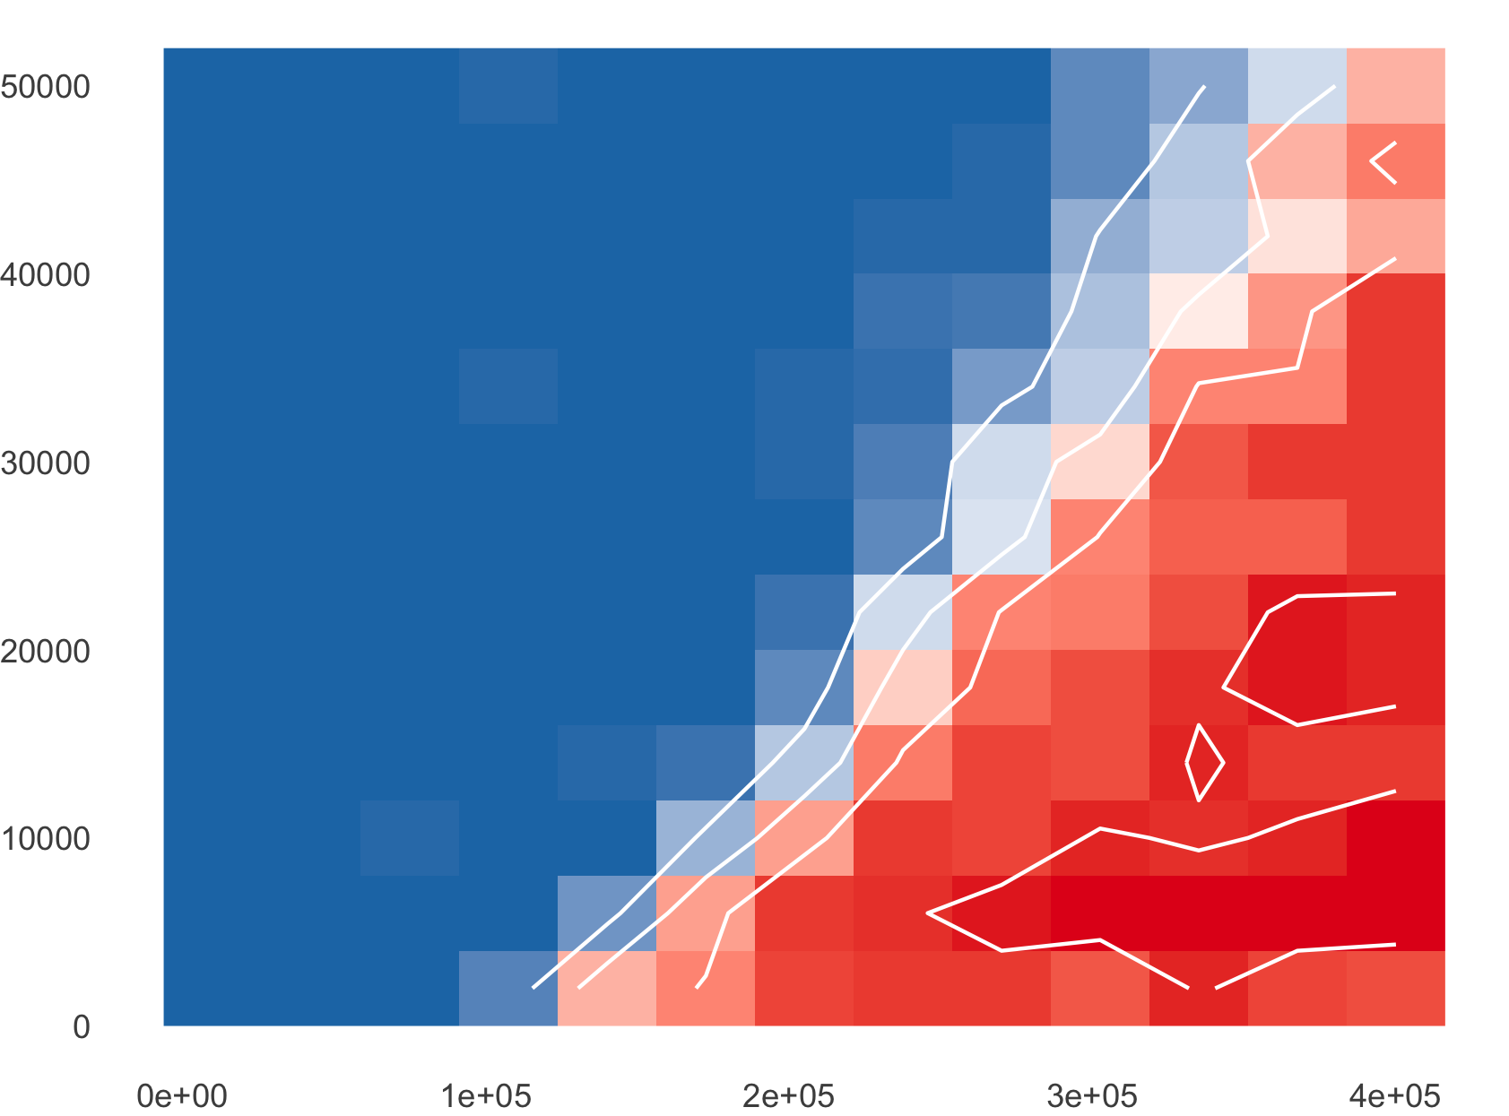
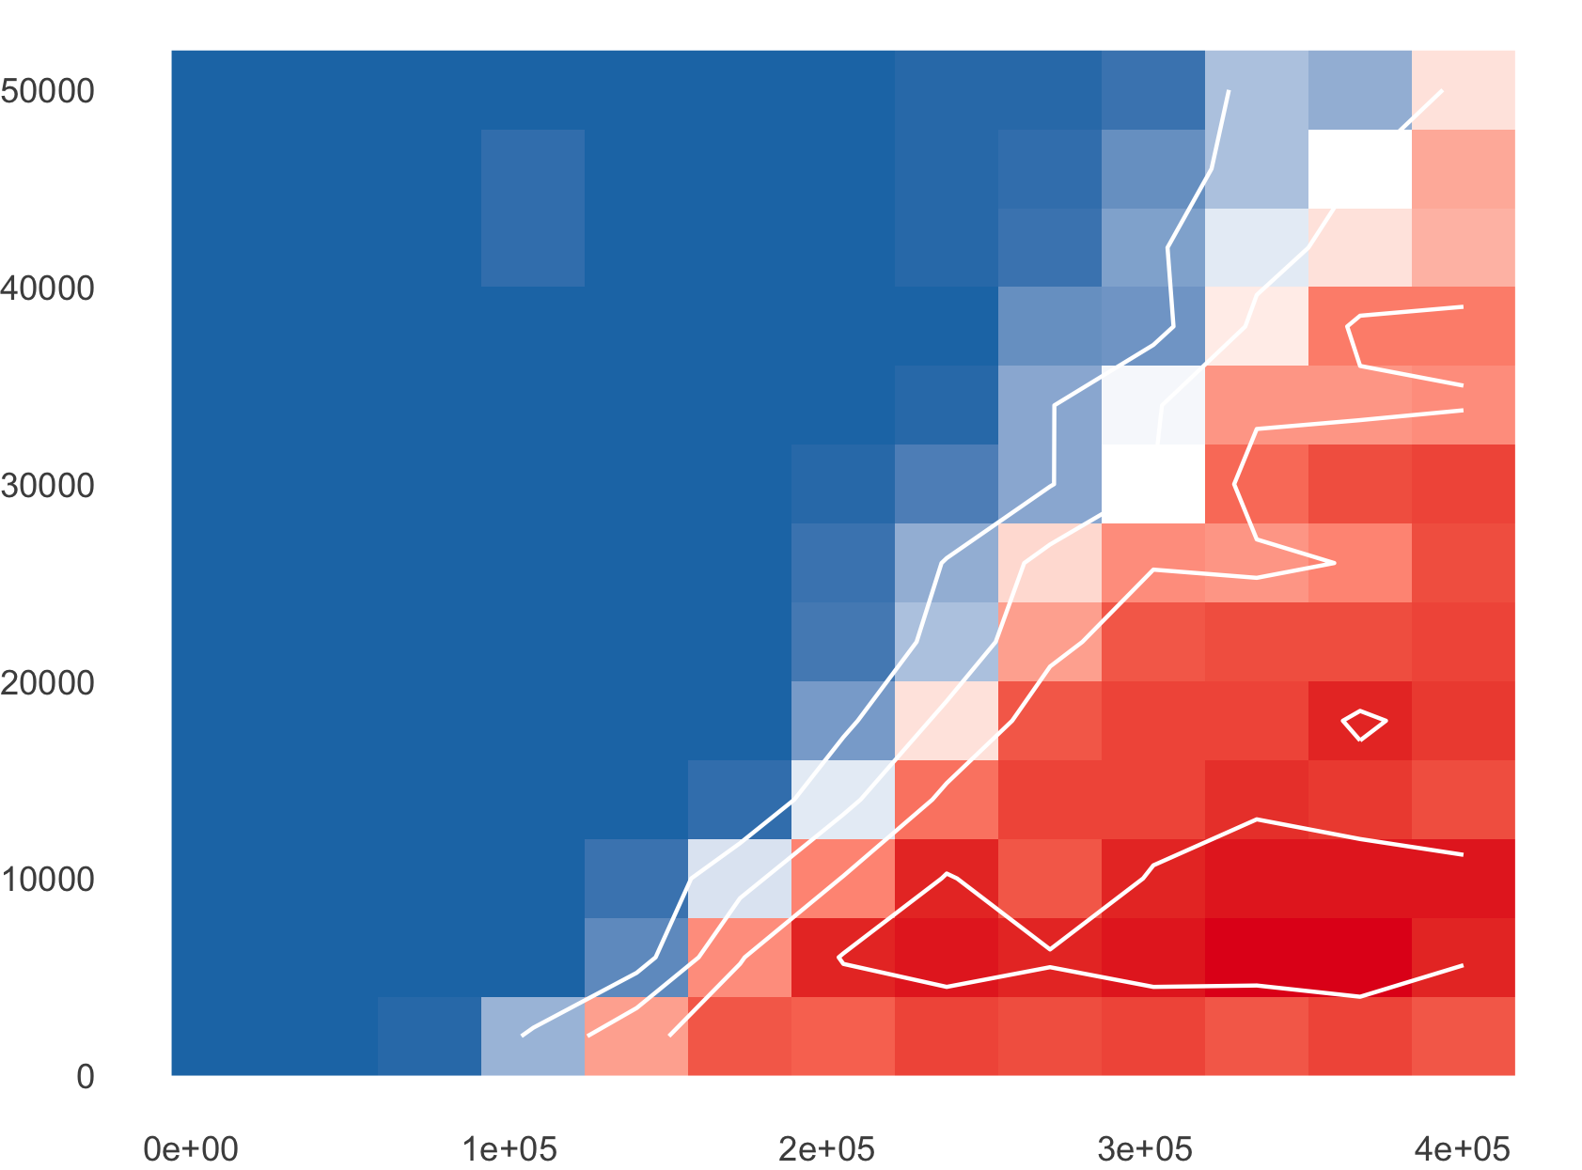
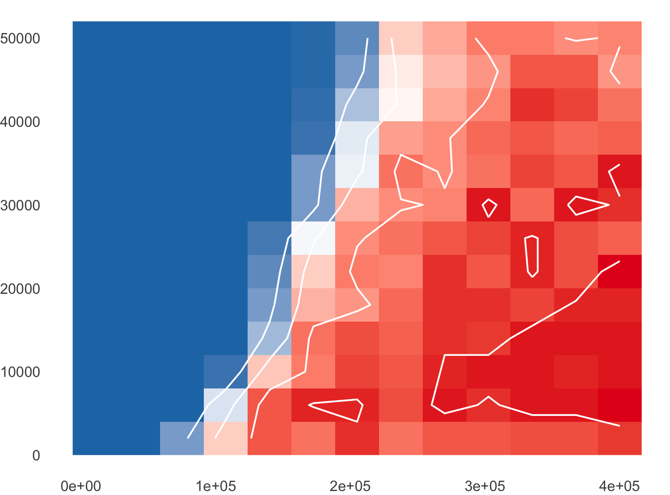
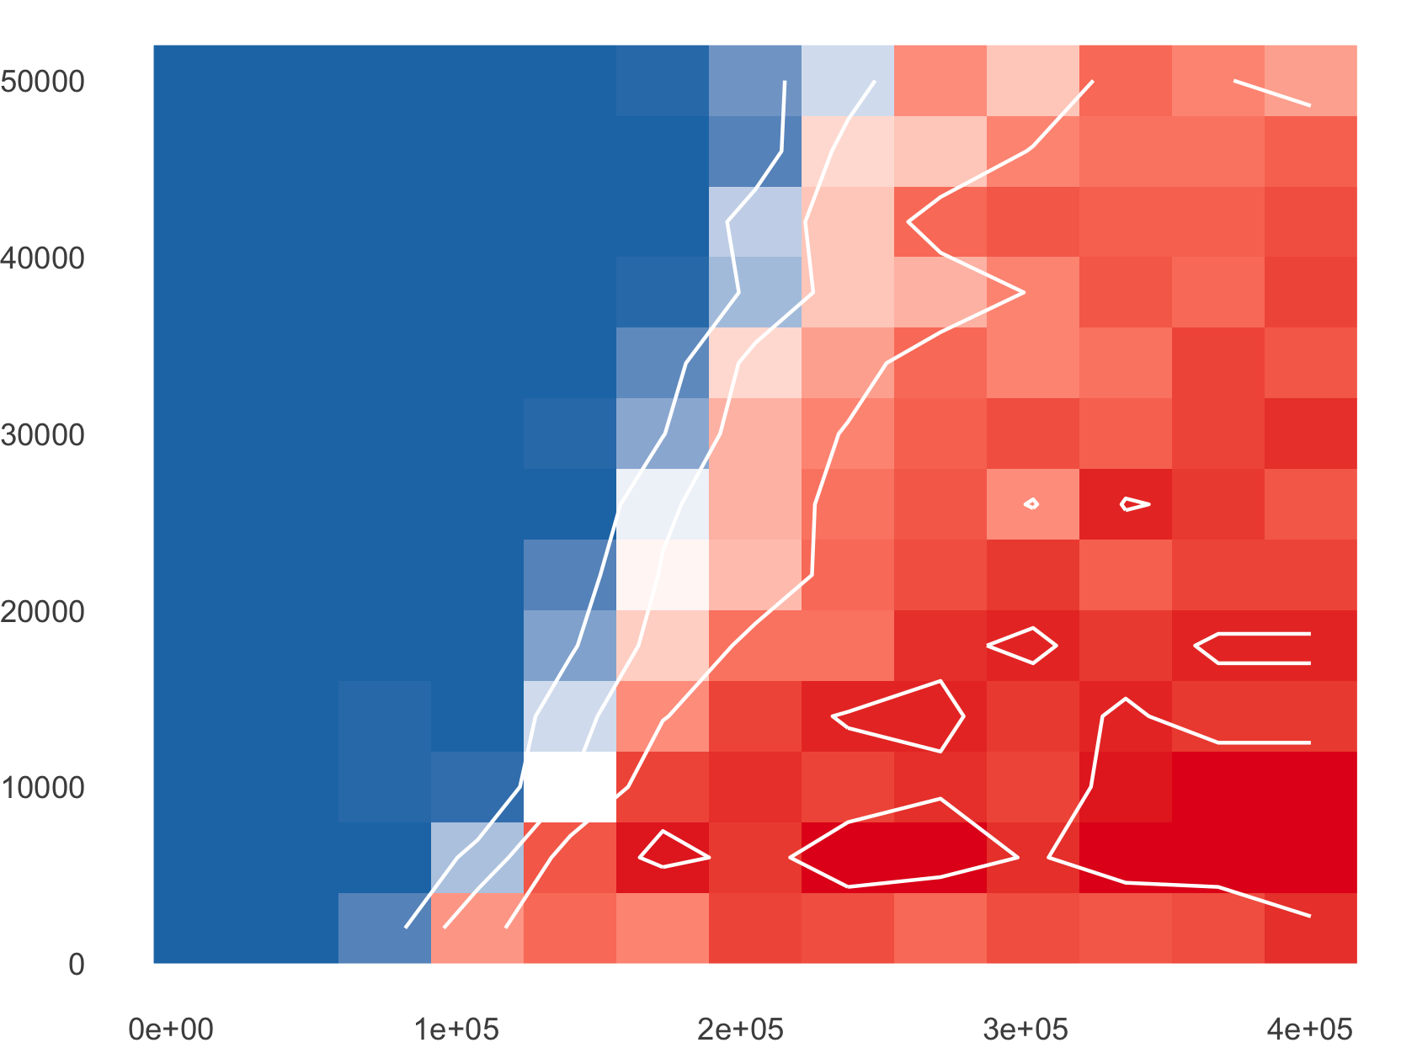
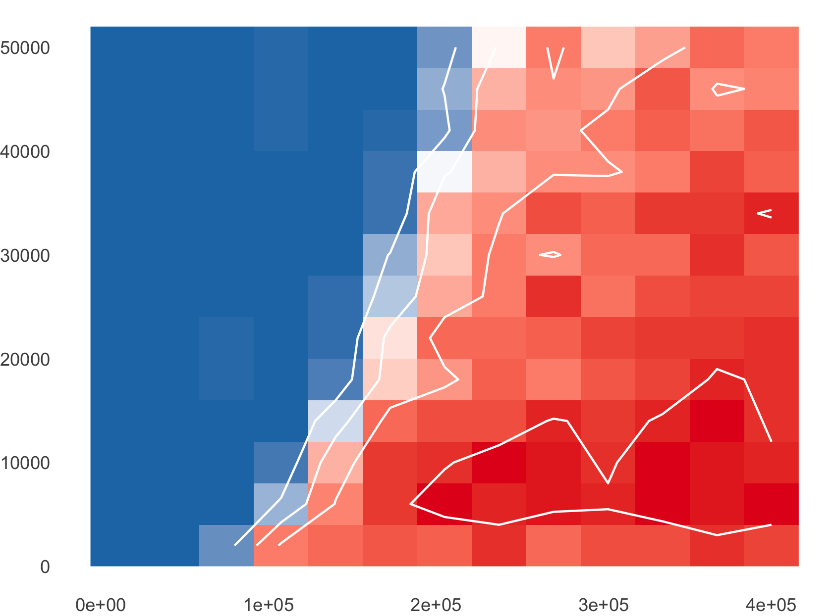

EIP = 2 days
EIP = 7 days
EIP = 10 days
50
Mosquito lifespan
40
30
7 days
20
10
50
40
30
14 days
20
Number of primates (1000s)
10
50
40
30
21 days
20
10
100
200
300
400
100
200
300
400
100
200
300
400
Number of mosquitoes (1000s)
Probability of enzootic establishment (proportion of simulations that persisted)
0.00
0.25
0.50
0.75
1.00

