Slide 1

19KDa
Cleaved caspase-9
S1_Raw_Fig 1
Notes:
S1_Raw_Fig1. Raw Western blot image of Cleaved caspase-9 (correspond to Figure 4A).

Slide 2
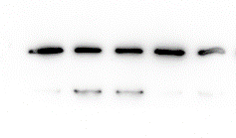
35KDa
Caspase-3
S1_Raw_Fig 2
Notes:
S1_Raw_Fig2. Raw Western blot image of Caspase-3 (correspond to Figure 4A).

Slide 3

28KDa
Bcl-2
S1_Raw_Fig 3
Notes:
S1_Raw_Fig3. Raw Western blot image of Bcl-2 (correspond to Figure 4A).

Slide 4
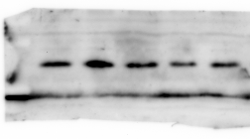
20KDa
Bax
S1_Raw_Fig 4
Notes:
S1_Raw_Fig4. Raw Western blot image of Bax (correspond to Figure 4A).

Slide 5
43KDa
β-actin
S1_Raw_Fig 5
Notes:
S1_Raw_Fig5. Raw Western blot image of β-actin (correspond to Figure 4A).

Slide 6

14KDa
Cytochrome C (mitochondria)
S1_Raw_Fig 6
Notes:
S1_Raw_Fig6. Raw Western blot image of Cytochrome C (mitochondria) (correspond to Figure 8A).

Slide 7
15KDa
COX Ⅳ
S1_Raw_Fig 7
Notes:
S1_Raw_Fig7. Raw Western blot image of COX Ⅳ (correspond to Figure 8A).

Slide 8

14KDa
Cytochrome C (cytosol)
S1_Raw_Fig 8
Notes:
S1_Raw_Fig8. Raw Western blot image of Cytochrome C (cytosol) (correspond to Figure 8A).

