Slide 1
A
B
400
**
NS
800
***
300
600
Murine TNFα levels (pg/ml)
Human TNFα levels (pg/ml)
WT (8-m)
200
400
WT (24-m)
100
200
TNF-Tg (8-m)
NS
0
0
Supplementary Figure 1. Serum TNFα levels of adult WT and TNF-Tg mice and aged WT mice. ELISA tests of (A) murine TNFα and (B) human TNFα protein levels in serum from adult (8-m-old) WT and TNF-Tg mice and old (24-m-old) WT mice. Mean ± SD (n = 6 mice; **p < 0.01; ***p < 0.001). All analyses done using one-way ANOVA with Tukey’s post-hoc test.

Slide 2
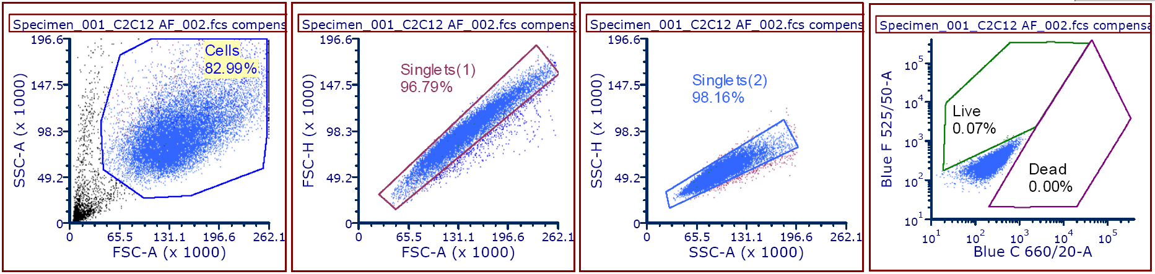
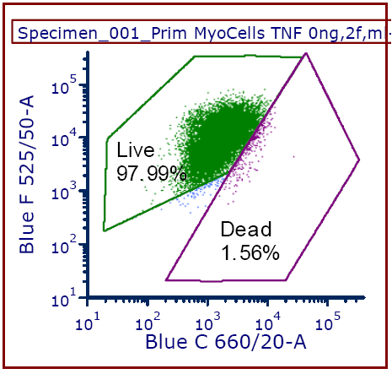
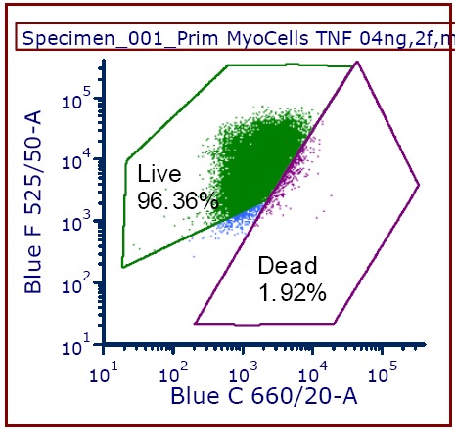
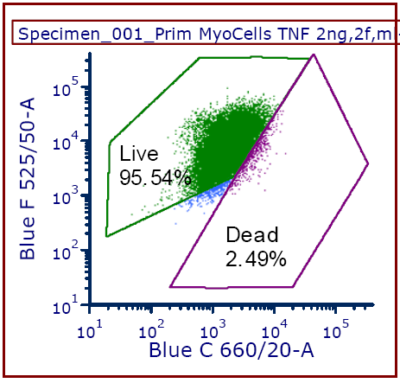
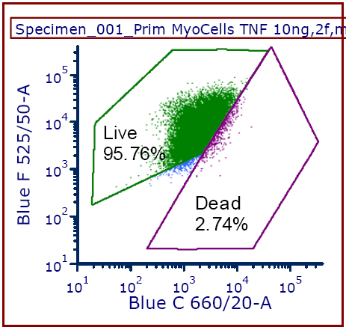
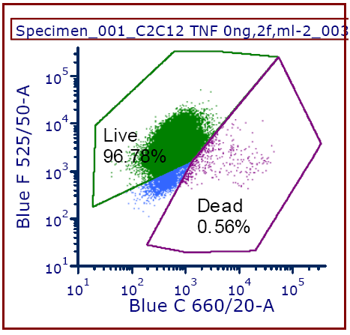
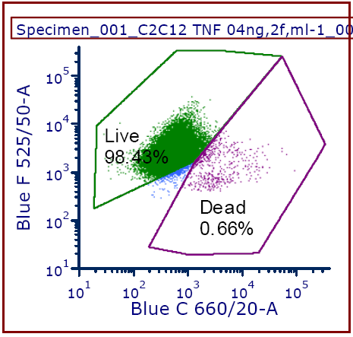
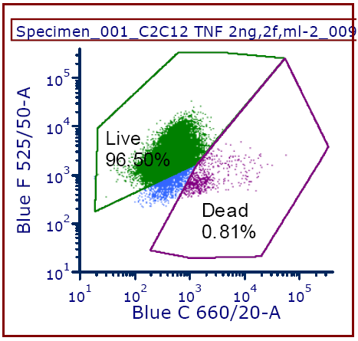

A
Gates for singlets
Unstained control
Vehicle
0.4 ng/ml
2 ng/ml
10 ng/ml
Primary myogenic cells
B
Vehicle
0.4 ng/ml
2 ng/ml
10 ng/ml
C2C12 cells
Supplementary Figure 2. Viability of primary myogenic cells and C2C12 cells in response to TNFα. (A) Cellular viability test of primary myogenic cells (CD45⁻CD31⁻CD11b⁻Sca1⁻) isolated from skeletal muscles of young (3-m-old) C57B6 mice after TNFα treatment for 48 h. Mean ± SD (n = 3 samples; **p < 0.01). (B) Cellular viability test of C2C12 cells treated with TNFα for 48 h. Mean ± SD (n = 3 samples). All analyses done using one-way ANOVA with Tukey’s post-hoc test.

Slide 3
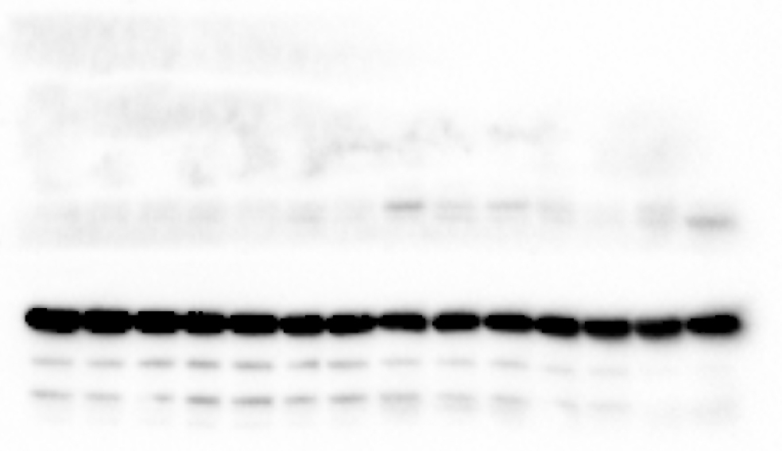
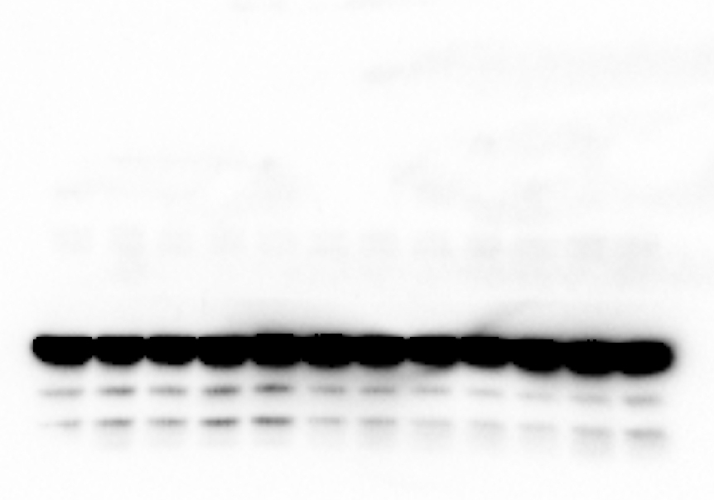
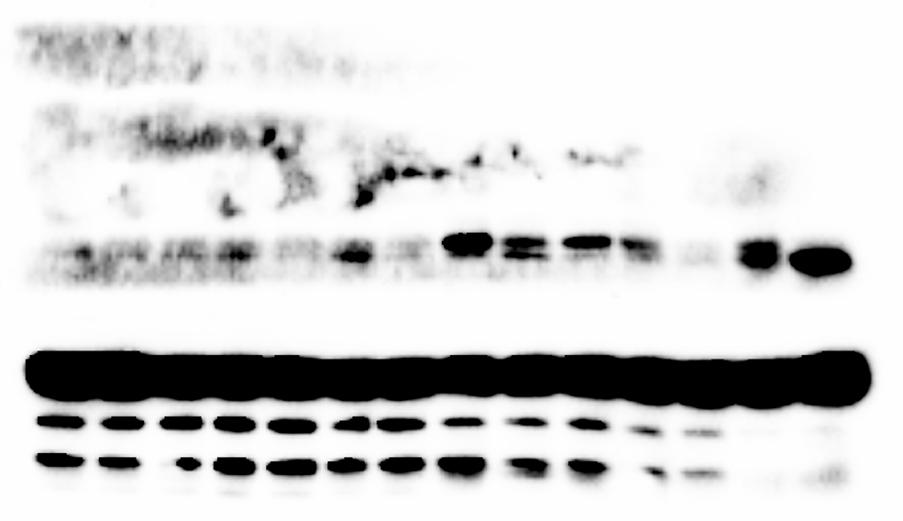
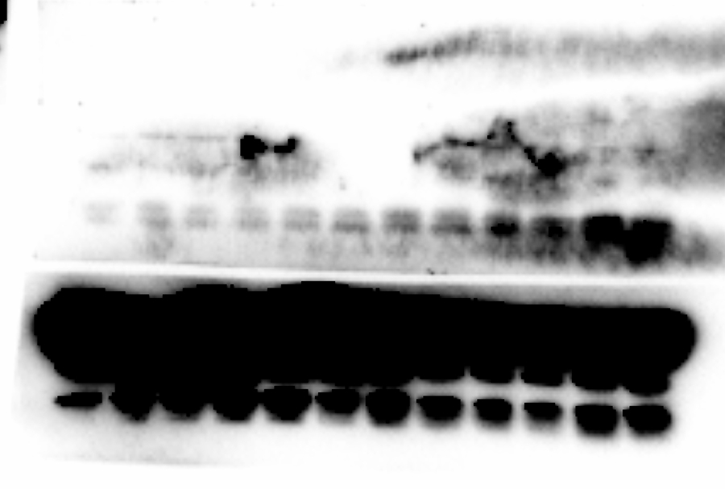
A
0.8s
B
1s
Young (3-m-old)
Old (22-m-old)
WT
TNF-Tg
TRAF6
TRAF6
GAPDH
GAPDH
5s
8s
TRAF6
TRAF6
GAPDH
GAPDH
Supplementary Figure 3. Uncropped Western blots of TRAF6 expression in protein lysates of gastrocnemius muscles. (A) WBs of TRAF6 and GAPDH proteins in lysates of gastrocnemius muscles from young and old male C57B6 mice. Expression of TRAF6 and GAPDH was tested on the same transferred nitrocellulose membrane and imaged at 0.8 (upper) and 5 (lower) seconds exposure time. n = 7 mice. (B) WBs of TRAF6 and GAPDH proteins in lysates of gastrocnemius muscles from 8-m-old WT and TNF-Tg male mice. Expression of TRAF6 and GAPDH was tested on the same transferred nitrocellulose membrane and imaged at 1 (upper) and 8 (lower) seconds exposure time. n = 6 mice.

