Slide 1
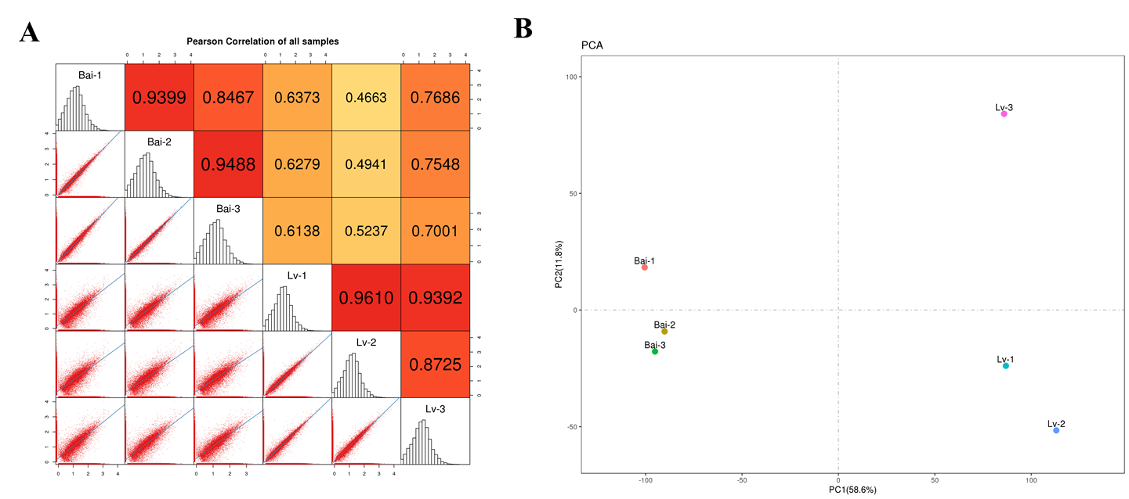
Figure S2. The correlation analysis and principal component analysis (PCA) in Lv and Bai fruit.

