Slide 1
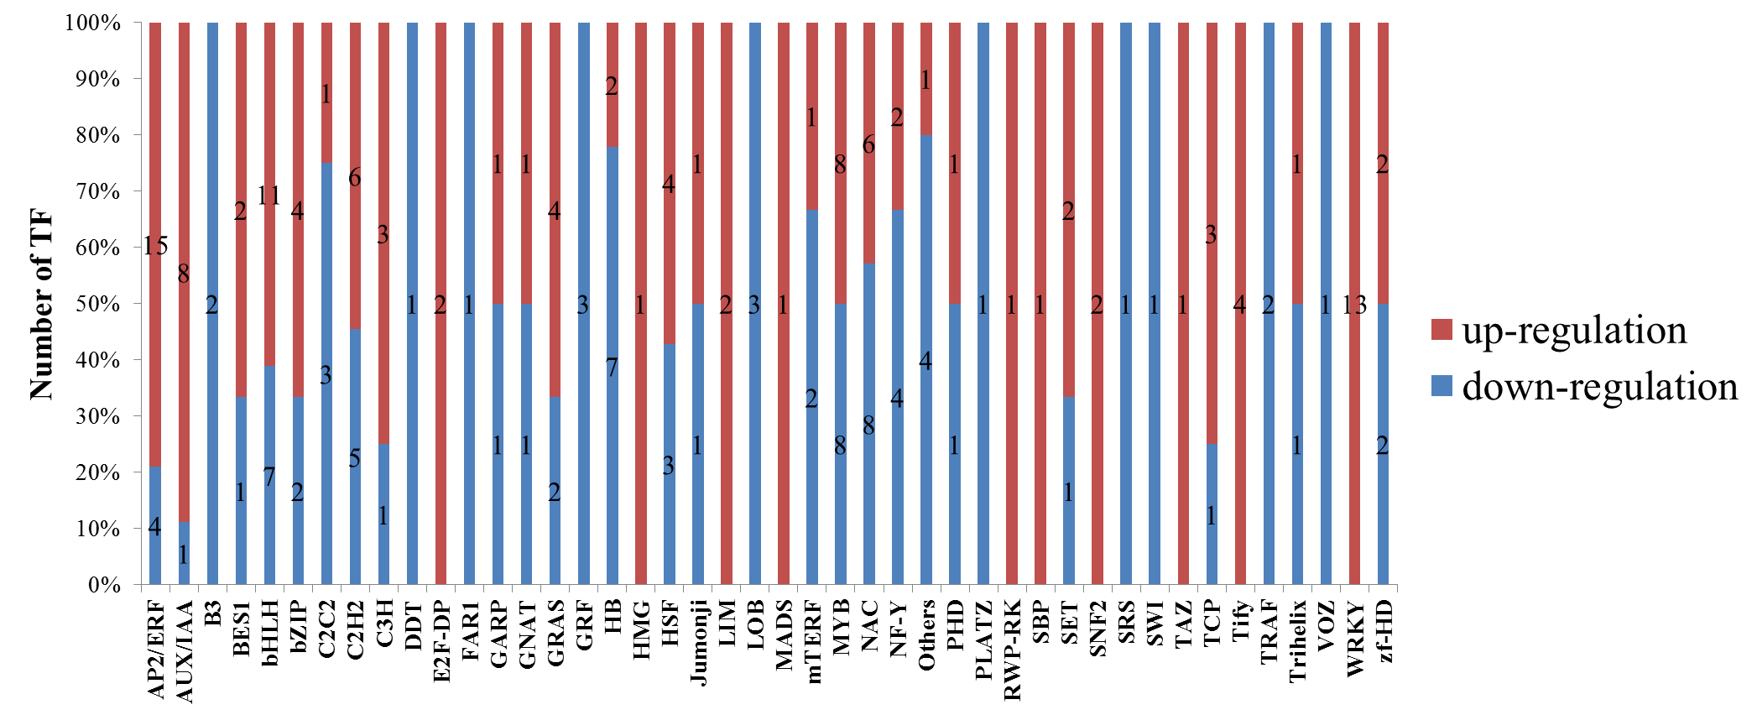
Figure S3. The number of DEGs belonging to different transcription factor families detected in Lv and Bai.

