Slide 1
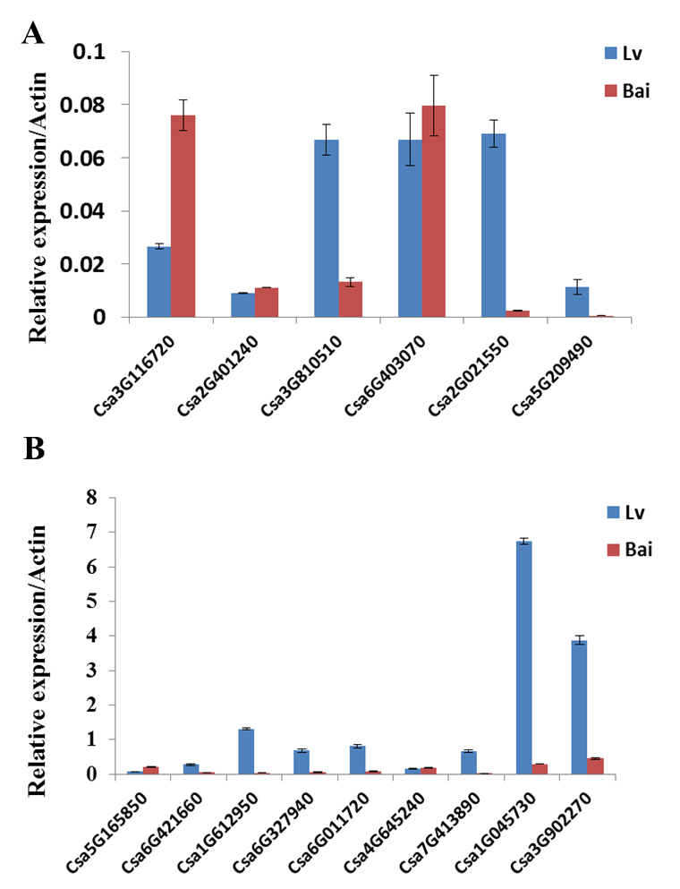
Figure S4. Relative expression of genes related to transcriptional factors. Data is presented as the mean ± standard deviation (n = 9).

