Slide 1
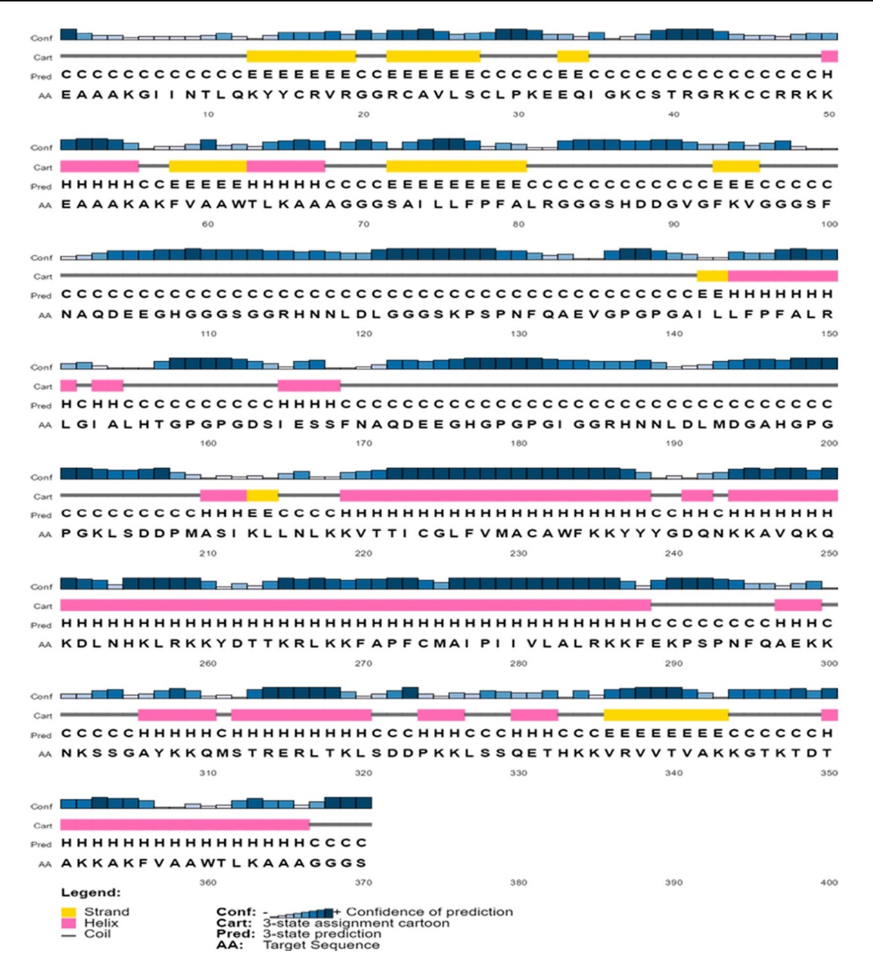
S3 Fig. Secondary structure prediction of constructed vaccine protein V1 using PESIPRED server.

