Slide 1
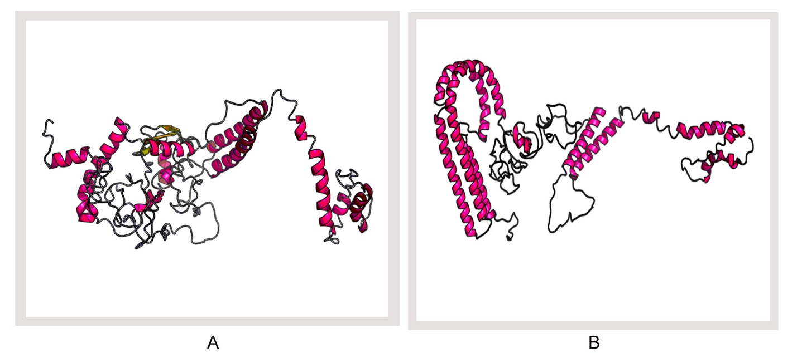
S4 Fig. 3D modeled structure of vaccine protein. (A) V2 and (B) V3 generated via RaptorX server.

