Slide 1
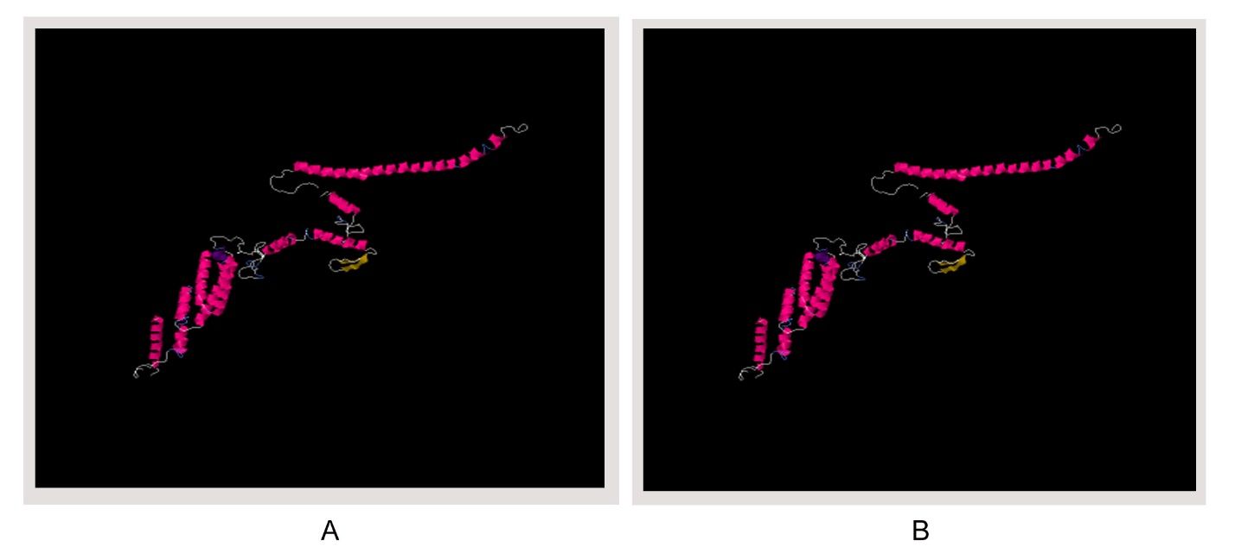
S5 Fig. Disulfide engineering of vaccine protein V1. (A) Initial form, (B) Mutant form.

