Slide 1
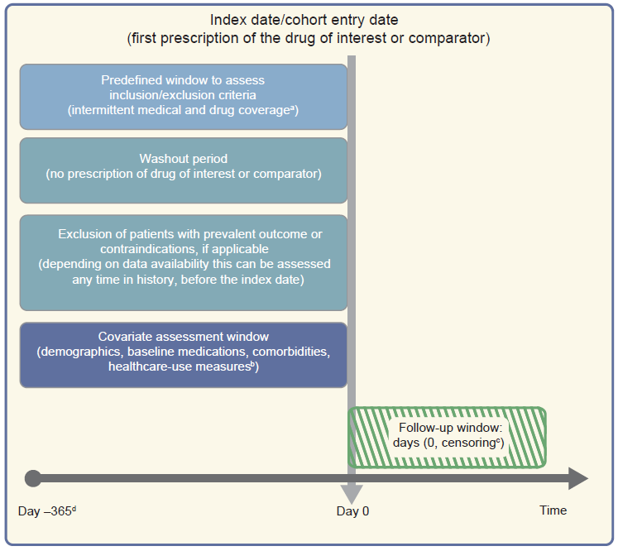
Framework for a cohort study using an administrative claims or electronic medical record database
Gokhale et al (2020) Diabetologia DOI 10.1007/s00125-020-05217-1
© Springer-Verlag GmbH Germany, part of Springer Nature 2020
Template from www.repeatinitiative.org/projects.html, which is licensed under a CC BY 3.0 (Attribution 3.0 Unported) License

Slide 2
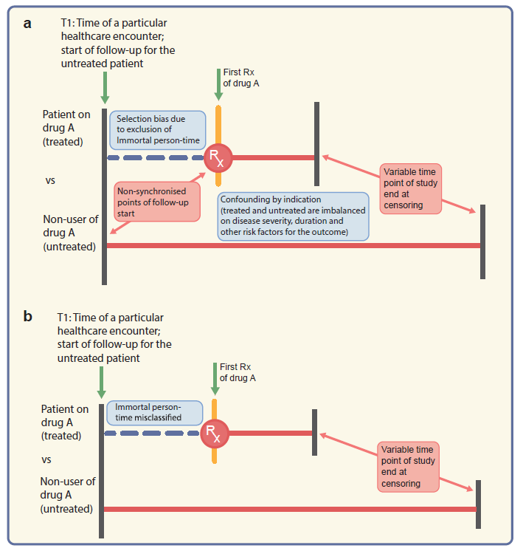
Depiction of problems encountered when comparing treated vs untreated (not using active comparator) patients
Gokhale et al (2020) Diabetologia DOI 10.1007/s00125-020-05217-1
© Springer-Verlag GmbH Germany, part of Springer Nature 2020

Slide 3
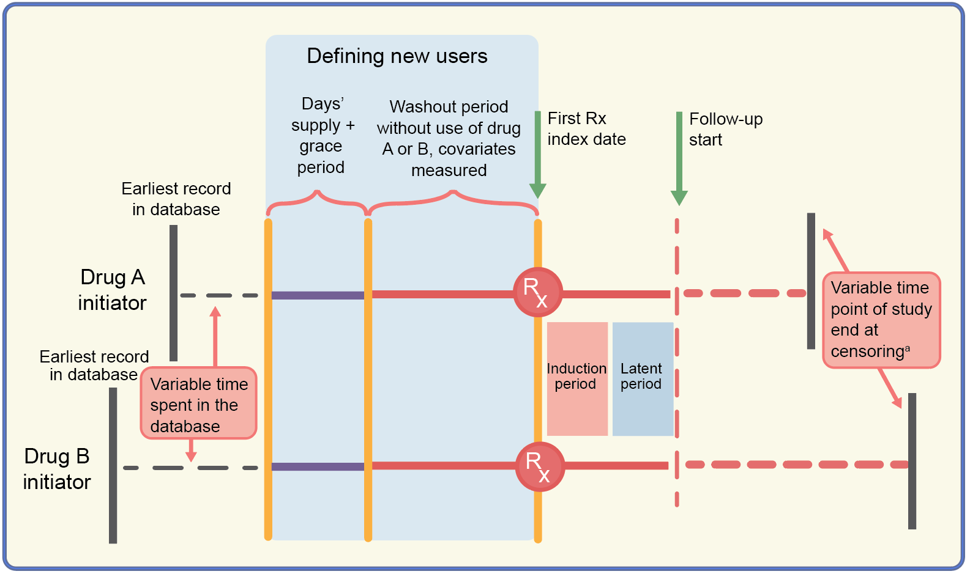
Schematic diagram of the active comparator new-user design comparing two glucose-lowering drugs
Gokhale et al (2020) Diabetologia DOI 10.1007/s00125-020-05217-1
© Springer-Verlag GmbH Germany, part of Springer Nature 2020

