Slide 1
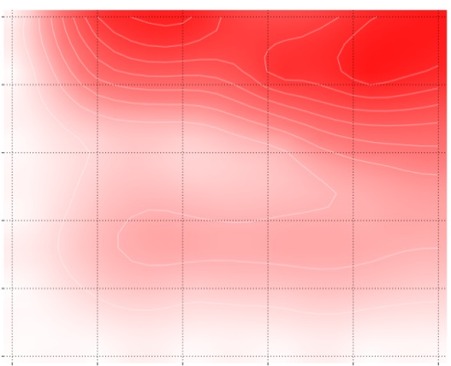
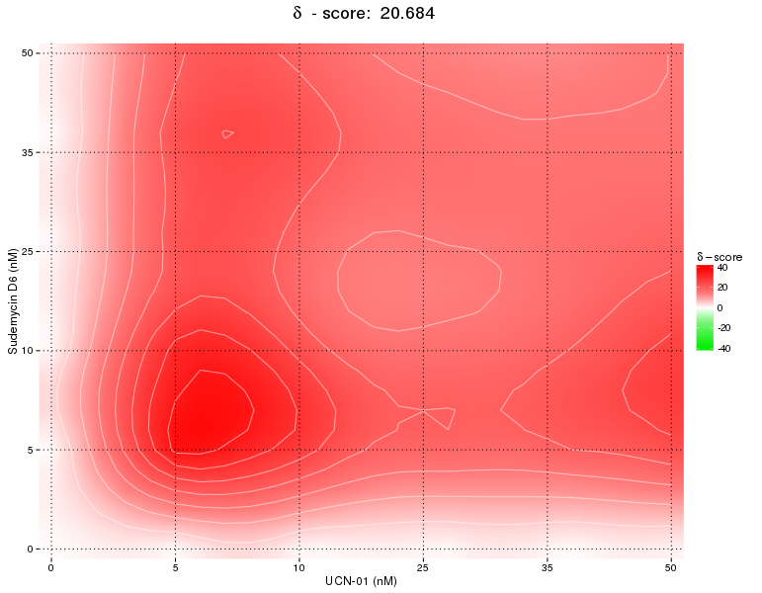

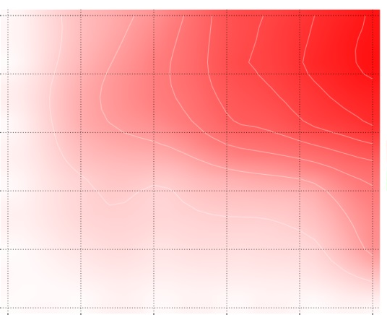
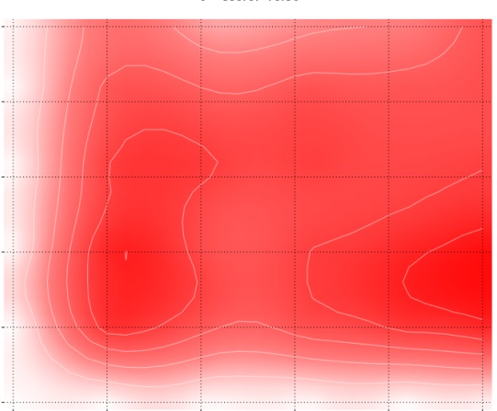


Fig S7
A
B
SF3B1^{K700K}
δ – score: 7.694
SF3B1^{K700E}
δ – score: 20.684
50
50
35
35
25
25
Sudemycin D6 (nM)
Sudemycin D6 (nM)
10
10
5
5
0
0
0
5
10
25
35
50
0
5
10
25
35
50
UCN-01 (nM)
UCN-01 (nM)
C
D
SF3B1^{K700K}
δ – score: 14.612
SF3B1^{K700E}
δ – score: 18.36
50
50
35
35
25
25
Sudemycin D6 (nM)
Sudemycin D6 (nM)
10
10
5
5
0
2
3
5
6
0
3
5
6
8
0
8
0
2
VE-821 (μM)
VE-821 (μM)

