Slide 1
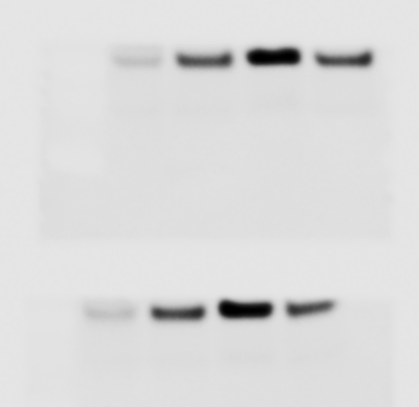
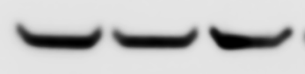
Fig S4
SF3B1
^{K700E-RNaseH-WT}
SF3B1^{K700K-EV}
SF3B1^{K700E-EV}
γH2AX
β -actin

