Slide 1
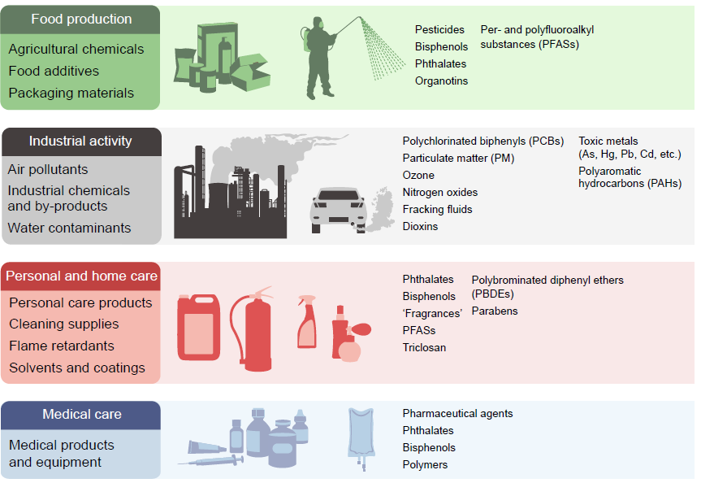
Sources of endocrine disrupting chemicals
Sargis and Simmons (2019) Diabetologia DOI 10.1007/s00125-019-4940-z
© Springer-Verlag GmbH Germany, part of Springer Nature 2019

Slide 2
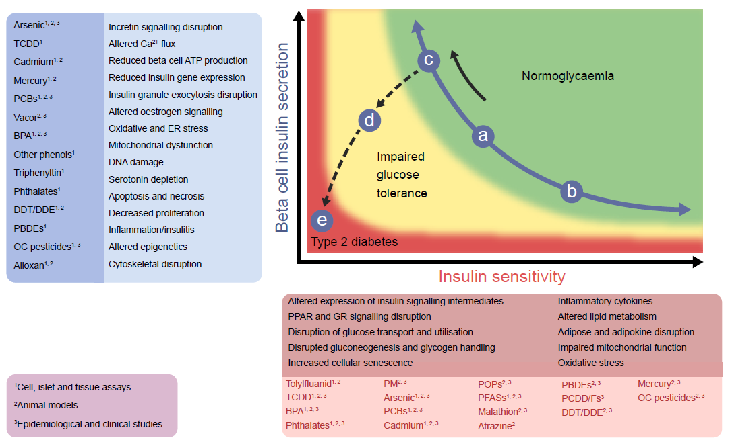
Endocrine disrupting chemicals associated with type 2 diabetes pathogenesis and their proposed mechanisms of action
Sargis and Simmons (2019) Diabetologia DOI 10.1007/s00125-019-4940-z
© 2006 Nature Publishing Group/Springer Nature. Adapted by permission from Kahn et al

Slide 3
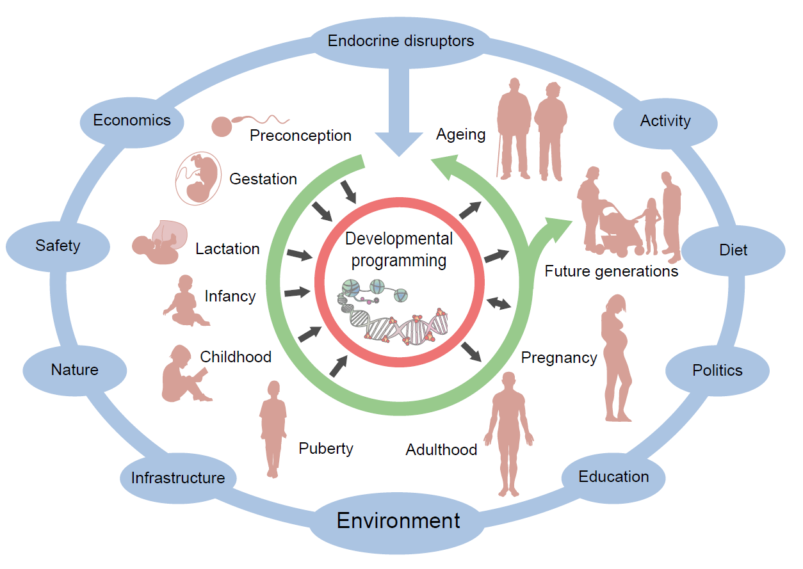
Influence of endocrine disrupting chemicals across the lifespan
Sargis and Simmons (2019) Diabetologia DOI 10.1007/s00125-019-4940-z
© Springer-Verlag GmbH Germany, part of Springer Nature 2019

