Slide 1
Comparison of in vitro toxicity of aerosolized engineered nanomaterials using air-liquid interface mono-culture and co-culture models
Yifang Wang¹, Andrea Adamcakova-Dodd², Benjamin R. Steines², Xuefang Jing², Aliasger K. Salem³, Peter S. Thorne^{1,2}
1: Human Toxicology Interdisciplinary Program
2: Occupational and Environmental Health
3: College of Pharmacy
University of Iowa, Iowa City, Iowa, USA
Corresponding Author:
Dr. Peter S. Thorne, peter-thorne@uiowa.edu

Slide 2
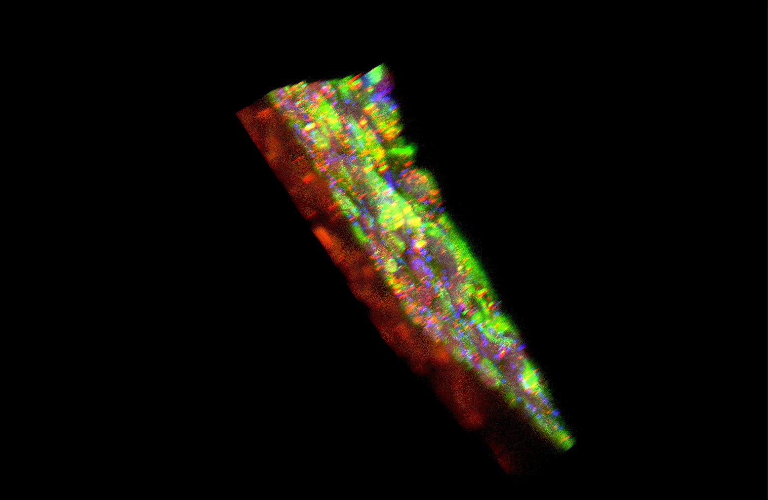
Movie
This clip rotates the image of the co-culture system on the transwell. Cells are immunostained to illustrate the three layers of the co-culture: macrophages, epithelium and endothelium .
See the methods and descriptions in the manuscript for further details.

