Slide 1
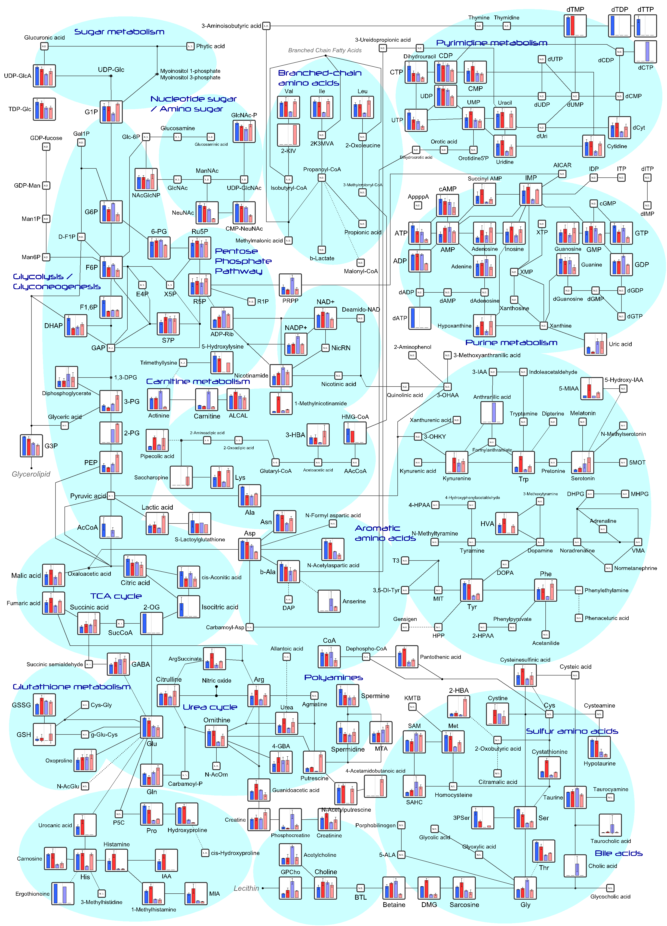
Figure S1
Air
O₂
Air
O₂
Neonate
Adult

