Slide 1
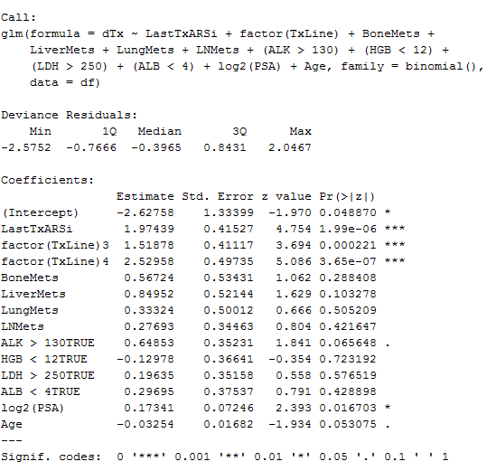
Supplementary Figure 1:
Physician Decision Analysis and Generalized Linear Model
Figure Legend
Generalized linear model incorporating significant features, with model weights shown.
The standardized mean difference between patients assigned either drug group in the analysis cohort before and after weighting was applied. Positive values indicate bias toward taxane-assigned patients (i.e. higher values for indicated variables), negative values indicate bias toward ARSi-assigned patients.
(A)
(B)
 | Standardized Mean Difference
Variable | Before | After
2nd Line | -0.77 | -0.01
3rd Line | 0.2 | 0.26
4th Line | 0.58 | 0.09
Last Tx ARSi | 0.23 | 0.39
Bone Mets | 0.3 | 0.5
Liver Mets | 0.35 | 0.2
Lung Mets | 0.15 | 0.15
LN Mets | 0.15 | 0.34
Alk Phos | 0.59 | 0.25
HGB | 0.36 | 0.33
LDH | 0.33 | 0.24
ALB | 0.17 | 0.16
PSA (log2) | 0.74 | 0.31
Age | -0.19 | 0.23

Slide 2
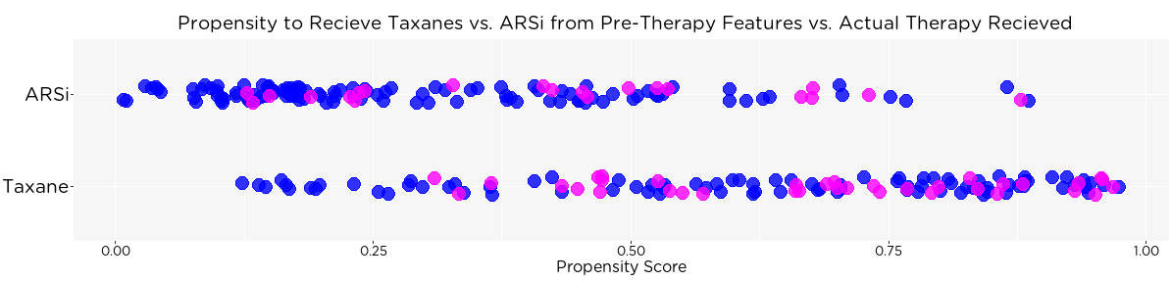
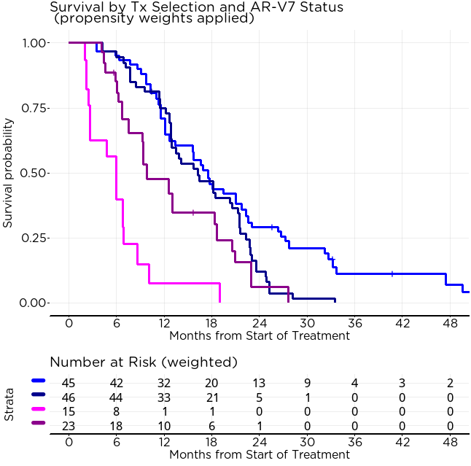
Supplementary Figure 2:
Cohort subset of most overlapping propensity
(A)
Excluded from subset analysis
Included in subset analysis
Excluded from subset analysis
AR-V7(+)
AR-V7(-)
Greater Propensity for ARS inhibitor Use
Greater Propensity for Taxane Use
(B)
AR-V7(+) on ARS inhibitor
Median (CI) | HR | p-value
6.0 (2.7 – 10.1) | 3.6 | 0.00424
9.8 (7.5 – 20.5)
17.6 (12.7 – 22.6) | 0.73 | 0.056
16.2 (13.0 – 21.5)
AR-V7(+) on Taxane
AR-V7(-) on ARS inhibitor
AR-V7(-) on Taxane
Figure Legend
Propensity distribution of n = 255 comparison cohort, with subset highlighted (n = 118) for propensity scores of 0.25 to 0.75, representing the greatest area of uncertainty of physician decisions in the cohort
Overall survival of the subset highlighted in (A), with propensity weights applied.

Slide 3
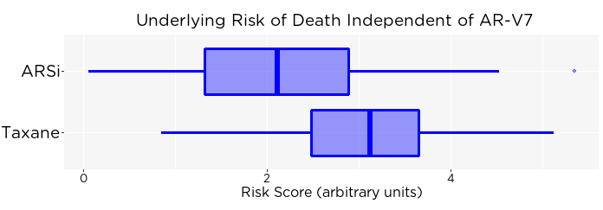
Supplementary Figure 3: Patient Risk by Therapy Class Assigned
Relative hazards of death
(A)
(B)
1
2
4
Feature | Coefficient | HR (95% CI) | p-value
Tx Line 3 vs. 2 | 0.26 | 1.3 (0.93 – 1.8) | 0.12
Tx Line 4 vs. 2 | 0.38 | 1.5 (0.97 – 2.2) | 0.066
Bone Mets (+ vs. -) | 0.56 | 1.7 (0.98 – 3.1) | 0.058
Liver Mets (+ vs. -) | 0.36 | 1.4 (0.88 – 2.3) | 0.15
Lung Mets (+ vs. -) | 0.43 | 1.5 (1.1 – 2.3) | 0.024
LN Mets (+ vs. -) | 0.42 | 1.5 (1.1 – 2.1) | 0.011
Alk Phos > 130 U/L | 0.36 | 1.4 (1.0 – 2.0) | 0.027
HGB < 12 g/dL | 0.33 | 1.4 (1.0 – 2.0) | 0.064
LDH > 250 U/L | 0.47 | 1.6 (1.2 – 2.2) | 0.0041
Albumin < 4 g/dL | -0.17 | 0.84 (0.61 – 1.2) | 0.30
PSA (per 2X increase) | 0.051 | 1.1 (1.0 – 1.2) | 0.19
Age | 0.025 | 1.0 (1.0 – 1.0) | 0.99
Line of Tx in Metastatic Setting
Positive for Bone Metastases
Positive for Liver Metastases
Positive for Lung Metastases
Positive for LN Metastases
Alkaline Phosphatase above ULN
Hemoglobin below LLN
Lactate Dehydrogenate above ULN
Albumin below LLN
PSA Level
Age
2 3 4
No
Yes
No
Yes
No
Yes
No
Yes
No
Yes
No
Yes
No
Yes
Yes
No
Figure Legend
The Cox proportional hazards model for underlying risk of death independent of prior drug chose, next drug chosen, and AR-V7. The multivariable coefficient, hazard ratio, and p-value are shown for each factor in the model. For each given sample, the coefficients were summed to obtain the risk score.
Visualization of the risk score Cox proportional hazards model. Factors correlating to higher underlying risk of death prior to therapy assignment, not considering therapy choice and AR-V7 status. Length of arrow indicates relative hazards predicted by the model.
The sum of the coefficients of the model was condensed into a risk score for each patient. These risk scores are shown by therapy class as box plot. Patients who were assigned a taxane had generally more advanced or aggressive disease.
0
32
1024
85
55
(C)
p < 0.0001

Slide 4
Supplementary Figure 4:
Unadjusted vs. Adjusted Cox PH Interaction Models (n = 255 comparison cohort)
(A)
Feature* | Hazard Ratio (95% CI) | p-value
AR-V7 (+ vs. -) | 3.8 (2.0 – 7.4) | < 0.0001
Next therapy: Taxane vs. ARSi | 1.7 (1.3 - 2.2) | < 0.0001
Interaction: AR-V7(+) on Taxanes | 0.48 (0.23 - 0.98) | 0.045
Feature | Hazard Ratio (95% CI) | p-value
AR-V7 (+ vs. -) | 5.2 (2.6 - 10.4) | < 0.0001
Next therapy: Taxane vs. ARSi | 1.4 (0.96 – 2.0) | 0.076
Interaction: AR-V7(+) on Taxanes | 0.37 (0.17 - 0.81) | 0.014
Feature | Hazard Ratio (95% CI) | p-value
Risk (per point increase) | 2.0 (1.6 - 2.3) | < 0.0001
AR-V7 (+ vs. -) | 3.4 (2.0 – 5.8) | < 0.0001
Last Therapy was ARSi | 0.83 (0.62 - 1.2) | 0.24
Next therapy: Taxane vs. ARSi | 1.0 (0.74 - 1.4) | 0.91
Interaction: AR-V7(+) on Taxanes | 0.46 (0.24 - 0.87) | 0.017
Feature | Hazard Ratio (95% CI) | p-value
Tx Line: 3 vs. 2 | 1.2 (0.80 – 1.8) | 0.38
Tx Line: 4+ vs. 2 | 1.4 (0.89 – 2.2) | 0.14
Liver Mets (+ vs. -) | 2.4 (1.1 – 5.4) | 0.038
Bone Mets (+ vs. -) | 1.5 (0.87 – 2.5) | 0.14
PSA (per 2X increase) | 1.0 (0.92 – 1.1) | 0.75
Alk Phos > ULN | 1.2 (0.88 - 1.7) | 0.22
Lactate Dehydrogenase > ULN | 1.6 (1.2 - 2.2) | 0.0038
Hemoglobin < LLN | 1.5 (1.1 - 2.0) | 0.021
Albumin < LLN | 1.2 (0.89 - 1.7) | 0.21
AR-V7 (+ vs. -) | 4.1 (2.5 – 6.8) | < 0.0001
Last therapy was ARSi | 0.70 (0.44 - 1.1) | 0.13
Next therapy: Taxane vs. ARSi | 0.84 (0.31 – 2.3) | 0.73
Interaction: Last Tx was ARSi, next is Taxane | 1.3 (0.72 – 2.4) | 0.35
Interaction: Liver metastases on Taxanes | 0.78 (0.30 – 2.0) | 0.61
Interaction: Higher PSA on Taxanes | 1.0 (0.90 - 1.2) | 0.77
Interaction: AR-V7(+) on Taxanes | 0.40 (0.21 - 0.78) | 0.0076
Feature | Hazard Ratio (95% CI) | p-value
Risk (per point increase) | 2.4 (1.6 - 4.1) | < 0.0001
Last therapy was ARSi | 0.77 (0.27 - 2.2) | 0.88
Next therapy: Taxane vs. ARSi | 3.5 (1.1 - 11.1) | 0.81
AR-V7 (+ vs. -) | 0.57 (0.12 - 2.7) | 0.028
Interaction: Higher Risk and Last Tx was ARSi | 1.0 (0.61 - 1.7) | 0.49
Interation: Higher Risk on Taxanes | 0.59 (0.37 - 0.93) | 0.020
Interaction: Risk and AR-V7(+) | 1.4 (0.83 - 2.4) | 0.098
Interaction: Last Tx was ARSi, next is Taxane | 0.61 (0.29 - 1.3) | 0.55
Interaction: Last Tx was ARSi, patient is AR-V7(+) | 3.5 (1.5 - 8.4) | 0.0064
Interaction: AR-V7(+) on Taxanes | 0.38 (0.18 - 0.84) | 0.0098
Figure Legend
*Multivariable Cox PH model of the outcome association cohort (n = 255) assessing only AR-V7, drug class assigned, and the interaction between AR-V7 and drug class assigned, without risk adjustment or propensity weighting to account for known imbalances.
The same as (A) except with propensity weights from Figure 3 applied. Note that this is the identical model from Figure 4D.
The model as (A) except with with Risk term additionally included (from Supplemental Figure S3).
The same model as (C) but with individual components of the Risk score included as separate features instead of the consolidated risk score.
The same model as (C) except with the additional term of prior therapy, as well as additional interaction terms.
Denotes model with Global Schoenfeld residuals p < 0.05 indicating significant imbalances. The estimates should be interpreted less strongly than the other models, and are shown here only for comparison to other models.
(B)
(C)
(D)
(E)

