Slide 1
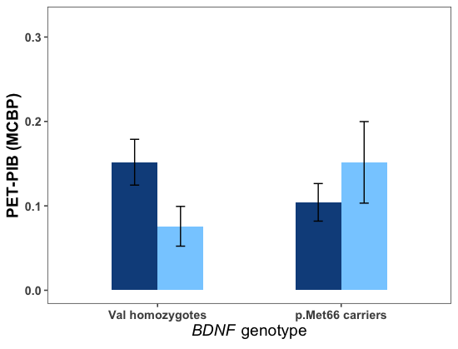
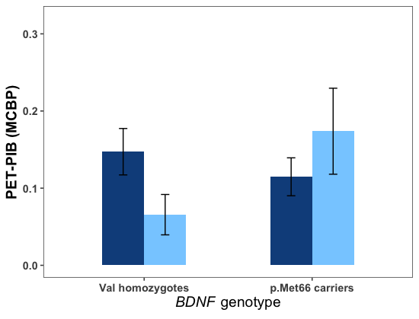
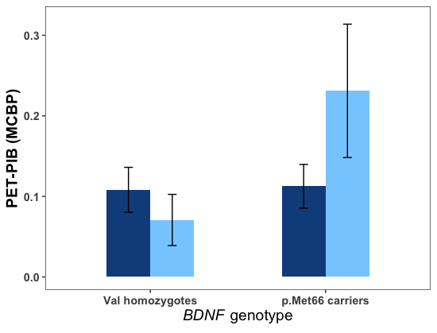
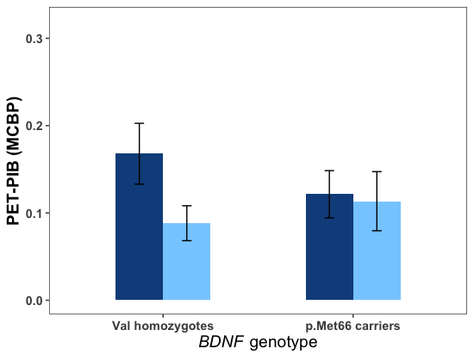
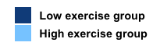
A. Full Sample: AHA Groups
B. 4-Year Delay Subsample: AHA Groups
C. 2-Year Delay Subsample: AHA Groups
D. Full Sample: Median Split Groups
Notes:
Supplementary Figure 1. Cross-sectional interaction between BDNF genotype and exercise group for PET-PIB. Error bars represents standard error. A) There was a greater benefit of exercise on MCBP for Val homozygotes (p=.046) than for Met carriers (p=.081; BDNF × exercise interaction, p=.022). B) There was a greater benefit of exercise on MCBP for Met carriers (p=.053) than for Val homozygotes (p=.122; BDNF × exercise interaction, p=.019). C) There was a greater benefit of exercise on MCBP for Met carriers (p=.009) than for Val homozygotes (p=.255; BDNF × exercise interaction, p=.017). D) There was a greater benefit of exercise on MCBP for Val homozygotes (p=.005) than for Met carriers (p=.542; BDNF × exercise interaction, p=.028).

