Slide 1
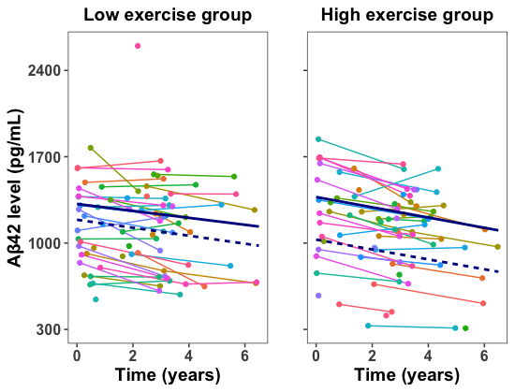
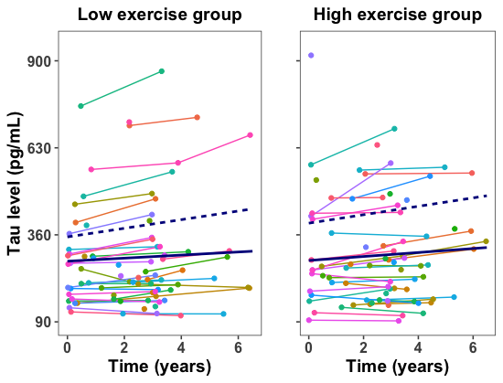
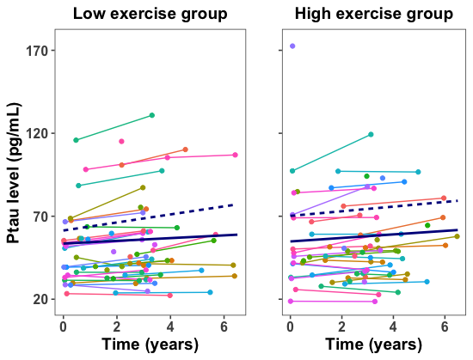
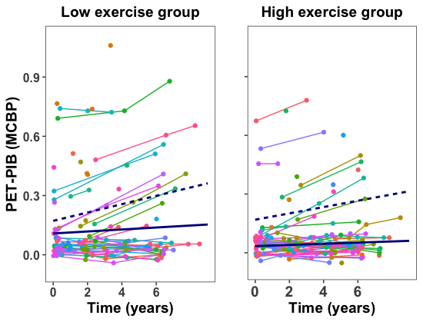
A. CSF Aβ₄₂
B. CSF Tau
C. CSF Ptau₁₈₁
D. PET-PIB
APOE ε4 allele carriers
APOE ε4 allele non-carriers
Notes:
Supplementary Figure 4. Exercise engagement and AD biomarkers: median split groups. Plots depict regression lines for low and high exercise groups defined by median split.

