Slide 1
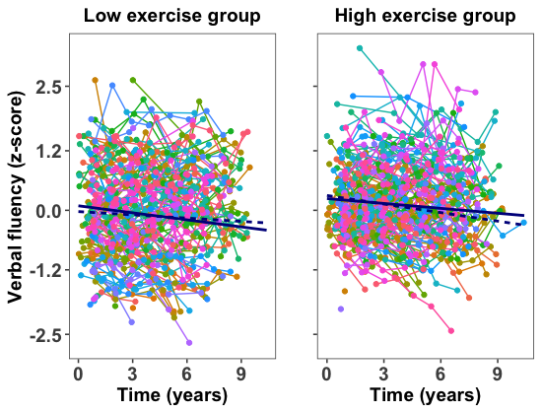
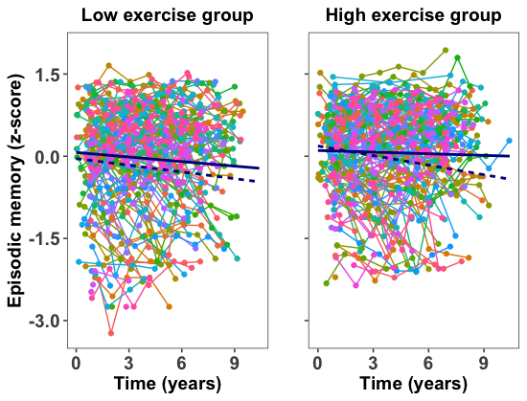
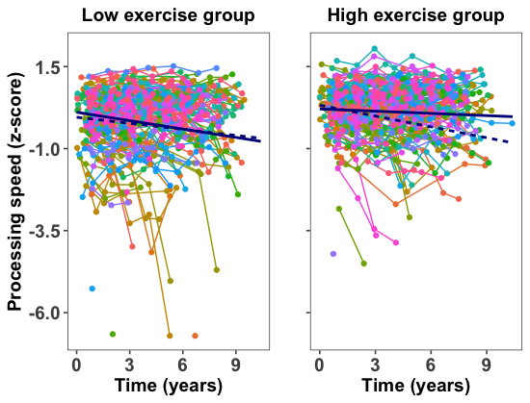
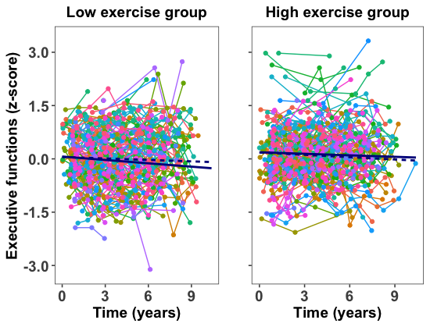
A. Verbal Fluency
B. Episodic Memory
C. Processing Speed
D. Executive Functions
APOE ε4 allele carriers
APOE ε4 allele non-carriers
Notes:
Supplementary Figure 5. Exercise engagement and cognitive decline: median split groups. Plots depict regression lines for low and high exercise groups defined by median split. The APOE x time x exercise interaction was significant for processing speed (p=.004), but not for verbal fluency (p=.081), episodic memory (p=.200) or executive functions (p=.333).

