Slide 1
Figure S1

Slide 2
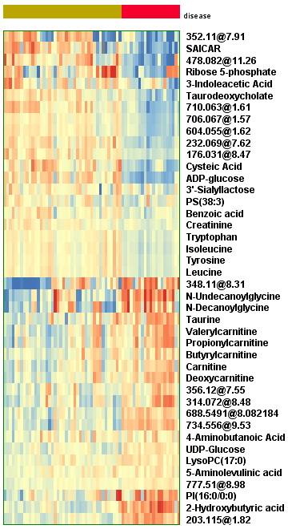
Figure S2
CTR
sALS-1

Slide 3
Figure S3
Glutamate
B
Lactate
A
Patient: S C S C S C
Time (h): 1 1 5 5 24 24
Patient: S C S C S C
Time (h): 1 1 5 5 24 24
C
Citrate
D
Oxo-glutarate
P=0.05
Patient: S C S C S C
Time (h): 1 1 5 5 24 24
Patient: S C S C S C
Time (h): 1 1 5 5 24 24
E
Succinate
F
Fumarate
P=0.007
P=0.002
Patient: S C S C S C
Time (h): 1 1 5 5 24 24
Patient: S C S C S C
Time (h): 1 1 5 5 24 24
G
Malate
P=0.002
Patient: S C S C S C
Time (h): 1 1 5 5 24 24

Slide 4
Figure S4
A
alanine
B
Aspartate
P=0.05
P=0.05
Patient: S C S C S C
Time (h): 1 1 5 5 24 24
Patient: S C S C S C
Time (h): 1 1 5 5 24 24
C
Acetylcarnitine
D
Butyrylcarnitine
Patient: S C S C S C
Time (h): 1 1 5 5 24 24
Patient: S C S C S C
Time (h): 1 1 5 5 24 24

Slide 5
Figure S5
A
Citrate-48h
B
Oxo-glutarate-48h
P=0.02
P=0.0003
sALS-1 CTR
sALS-1 CTR
C
Succinate-48h
D
Malate-48h
E
Fumarate-48h
P=0.02
P=0.001
P=0.003
sALS-1 CTR
sALS-1 CTR
sALS-1 CTR
F
Lactate-48h
G
Aspartate-48h
H
Alanine-48h
P=0.0006
P=0.03
sALS-1 CTR
sALS-1 CTR
sALS-1 CTR

Slide 6
Figure S6
A
ATP
B
CTP
P=0.03
P=0.03
Patient: S C S C S C
Time (h): 1 1 5 5 24 24
Patient: S C S C S C
Time (h): 1 1 5 5 24 24
C
UTP
D
GTP
P=0.03
P=0.03
P=0.01
Patient: S C S C S C
Time (h): 1 1 5 5 24 24
Patient: S C S C S C
Time (h): 1 1 5 5 24 24
E
6-Phosphoglucuronate
P=0.03
Patient: S C S C S C
Time (h): 1 1 5 5 24 24

Slide 7
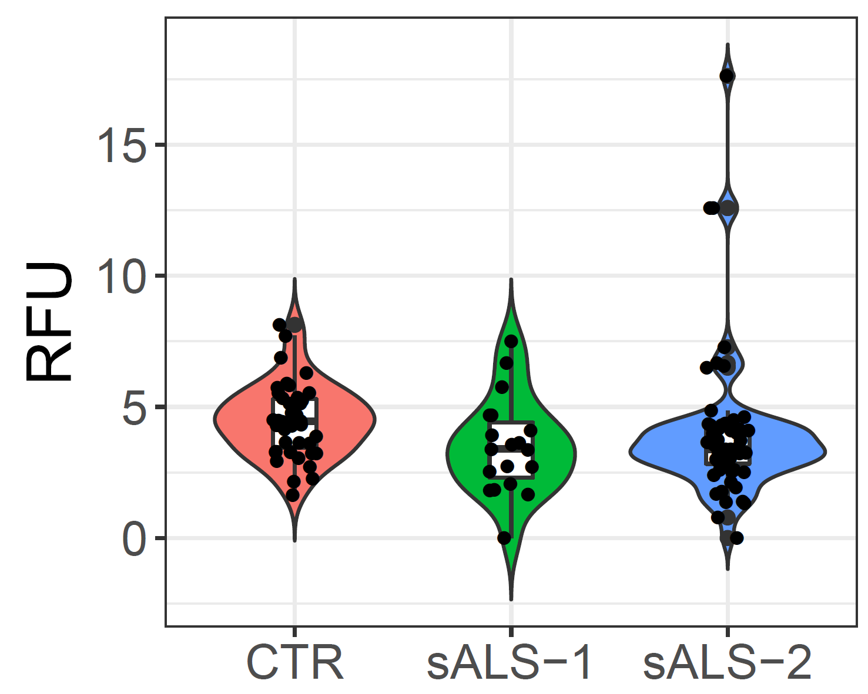
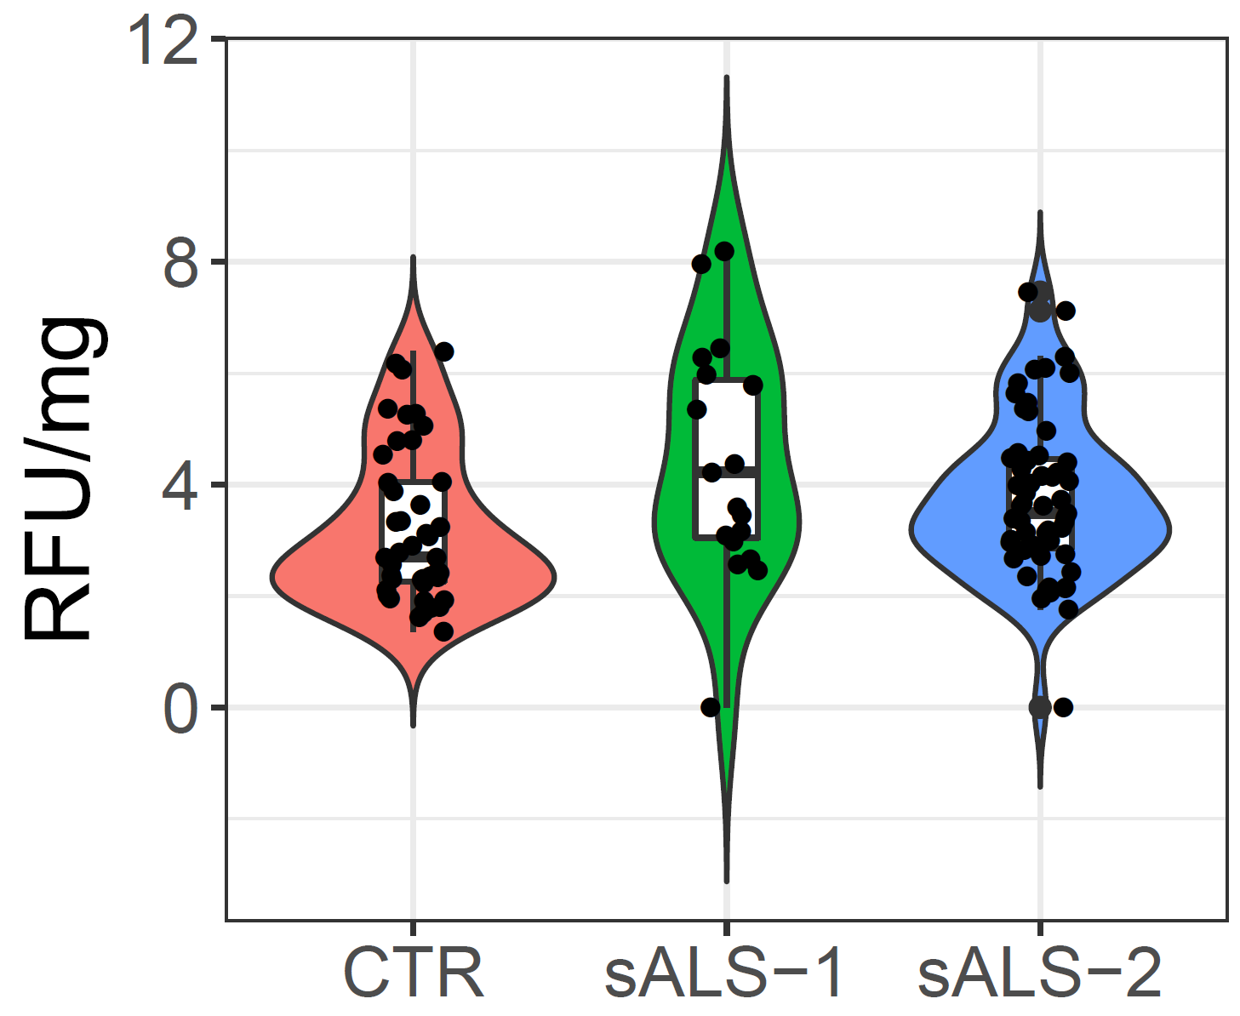
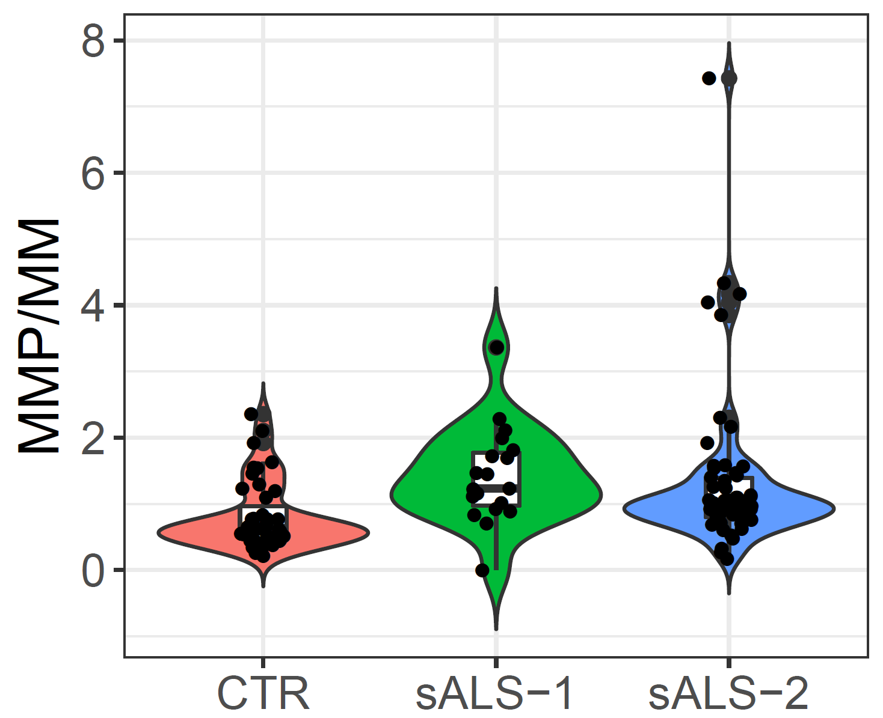
Figure S7
A
MM
B
MMP
C
MMP/MM
P=0.01
P=0.04
P=0.04
P<0.0001

Slide 8
Figure S8

