Slide 1
Supplementary data
The Association Between Monocytic Myeloid-derived Suppressor Cells levels and the Anti-tumor Efficacy of Anti-PD-1 Therapy in NSCLC patients
Jiuxing Feng^{1, †}, Shujing Chen^{2, †}, Shuangqi Li^{1, †}, Baitong Wu³, Jiacheng Lu⁴, Li Tan¹, Jiamin Li², Yuanlin Song², Guoming Shi⁴, Yujiang Geno Shi^{1,5*}, Jinjun Jiang^{2*}
¹Key Laboratory of Medical Epigenetics and Metabolism, Institutes of Biomedical Sciences, Fudan University, Shanghai 200032, China
²Pulmonary and Critical Care Medicine, Zhongshan Hospital, Fudan University, Shanghai 200032, China
³School of Medicine, Tongji University, Shanghai 200120 China
⁴Liver Cancer Institute, Zhongshan Hospital, Fudan University, Shanghai 200032, China
⁵Division of Endocrinology, Diabetes and Hypertension, Brigham and Women’s Hospital, Harvard Medical School, Boston, MA 02115, USA
Figure S1-S6; table S1

Slide 2
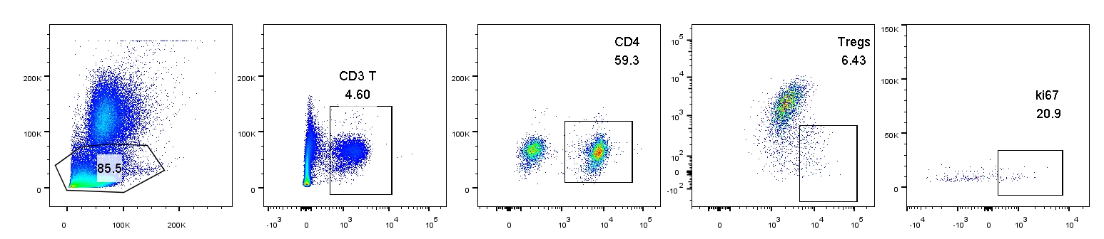
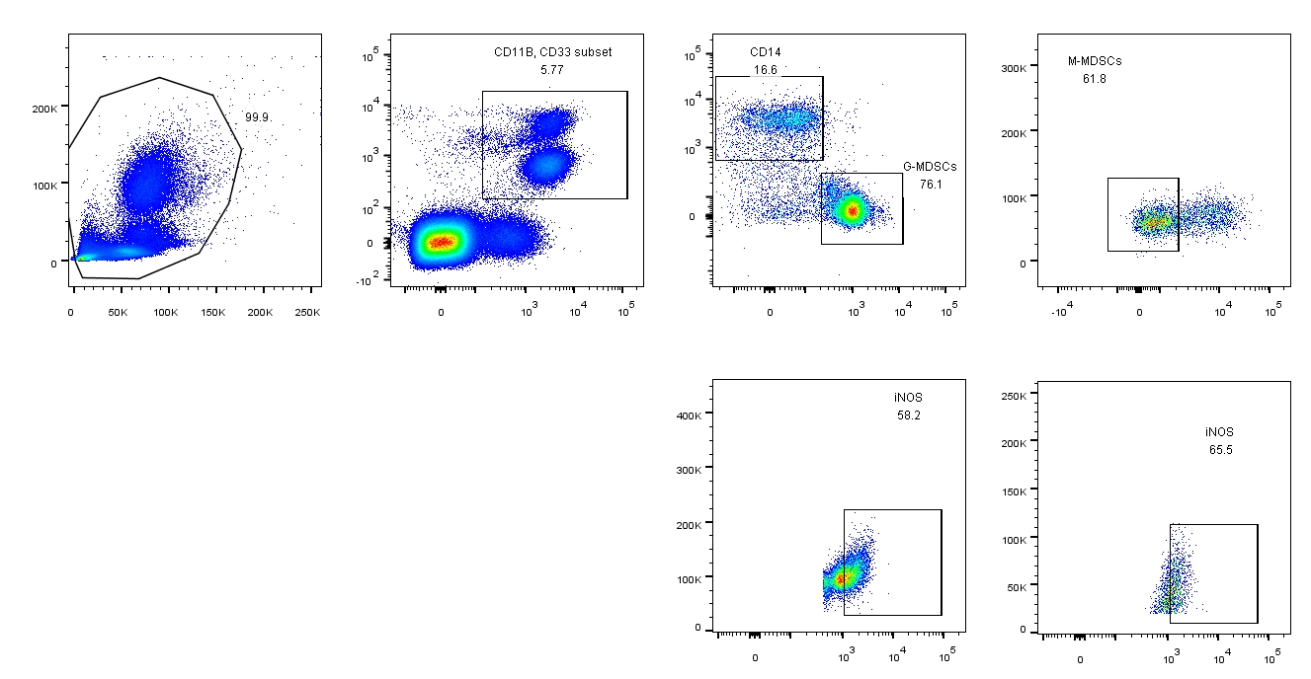
A
SSC
SSC
SSC
CD127
SSC
FSC
CD3
CD4
CD25
Ki67
B
SSC
CD33
CD14
SSC
FSC
CD11b
CD15
HLA-DR
SSC
SSC
iNOS
iNOS
Figure S1. The flow cytometry The flow cytometry strategy to analyze Tregs, G-MDSCs, and M-MDSCs levels.

Slide 3
Figure S1. The flow cytometry strategy to analyze Tregs, G-MDSCs, and M-MDSCs levels.
(A) The strategy to analyze Tregs in the peripheral blood of NSCLC patients. Tregs was defined as CD3⁺CD4⁺CD25⁺CD127⁻. Proliferative Tregs was defined as CD3⁺CD4⁺CD25⁺CD127⁻ Ki67⁺.
(B) The C-flow strategy to analyze the frequency of G-MDSCs and M-MDSCs. G-MDSCs was defined by:CD33⁺CD11B⁺CD14⁻CD15⁺; M-MDSC was defined by CD33⁺CD11B⁺HLA-DR^{lo}CD15⁻CD14⁺. Functional G-MDSC was defined as CD33⁺CD11B⁺CD14⁻CD15⁺iNOS⁺; Functional M-MDSCs was defined as CD33⁺CD11B⁺HLA-DR^{lo}CD15⁻CD14⁺iNOS⁺. We presents the percentage of G-MDSCs and M-MDSCs relative to CD33⁺CD11B⁺ cells throughout the manuscript.

Slide 4
A
B
C
D
E
F
Figure S2. Pembrolizumab and nivolumab treatment have the similar effect on Tregs, M-MDSCs, and G-MDSCs among different groups in NSCLC patients

Slide 5
Figure S2. Pembrolizumab and nivolumab treatment have the similar effect on Tregs, M-MDSCs, and G-MDSCs among different groups in NSCLC patients
(A-C) The effect of Pembrolizumab and nivolumab treatment on (A)Tregs (B) G-MDSCs, and (C) M-MDSCs level compared with baseline. Pembro, N=21; Nivo, N=6. Two-tailed paired T-test was performed for intro-group, and two-tailed unpaired T-test was performed for inter-group.
(D-F) The effect of Pembrolizumab and nivolumab treatment on (D)Tregs € G-MDSCs and (F) M-MDSCs level in PR, SD, and PD group. PR, N=7; SD, N=13; PD, N=7. Two-tailed paired T-test was performed.
Ns: no significant difference, * p < 0.05, compared to corresponding baseline group. A P value less than 0.05 was considered to be statistically significant. All significant change were labelled with asterisks.

Slide 6
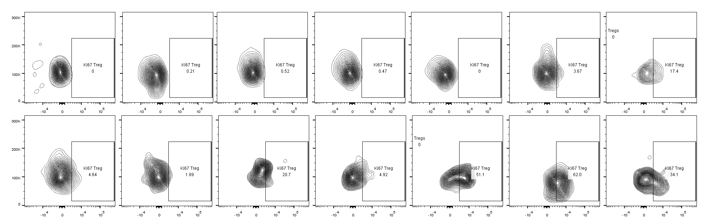
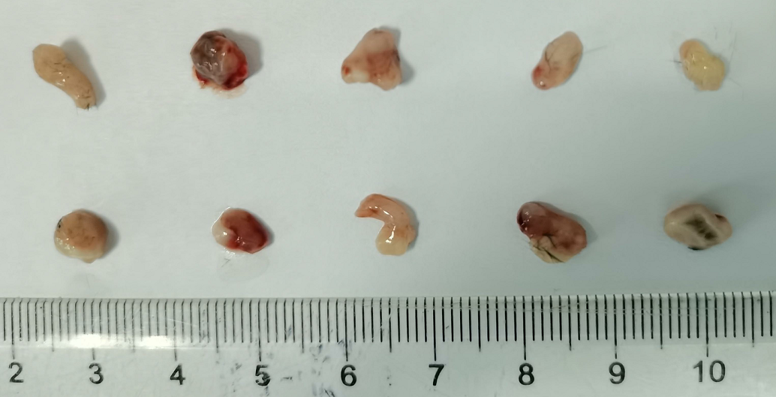
A
B
Patient 1
Patient 2
Patient 3
Patient 4
Patient 5
Patient 6
Patient 7
baseline
After anti-PD-1
C
D
PBS
Anti-PD-1
Figure S3. The effect of anti-PD-1 therapy on the percentage of Tregs and Ki67⁺ Tregs in human peripheral blood and mouse

Slide 7
Figure S3. The effect of anti-PD-1 therapy on the percentage of Tregs and Ki67⁺ Tregs in human peripheral blood and mouse.
(A) The Tregs levels in PR, SD, and PD groups after the first cycle of anti-PD-1 therapy. PR, N=7; SD, N=13; PD, N=7. Two tailed unpaired T-test was performed.
(B) The effect of anti-PD-1 therapy on Ki67 Tregs level in selected seven patients. N=7. Tregs was defined as CD3⁺CD4⁺CD25⁺CD127⁻; proliferative Tregs was defined as CD3⁺CD4⁺CD25⁺CD127⁻ Ki67⁺.
(C-D) The tumor picture (C) and tumor weight statistic (D) at the time of detecting Tregs level. Anti-PD-1 antibody or PBS was administrated seven days post tumor challenge. Tregs was detected two days post anti-PD-1 or PBS treatment. N=5. Five tumors were included in the picture since PBS group only has five mice. Two-tailed unpaired T-test was performed.

Slide 8
A
B
C
D
E
F
G
H
I
J
K
L
M
Figure S4. the effect of anti-PD-1 treatment on the level and suppressive capacity of MDSCs in NSCLC patients and in mice.

Slide 9
Figure S4. the effect of anti-PD-1 treatment on the level and suppressive capacity of MDSCs in NSCLC patients and in mice.
(A) The baseline level of G-MDSCs in PR, SD, and PD groups. PR, N=7; SD, N=13; PD, N=7. The percentage of M-MDSC were relative to CD33⁺CD11B⁺ cells.
(B-C) The effect of anti-PD-1 on M-MDSCs frequency in (B) SD, and (C) PD groups. SD, N=13; PD;N=7. Two-tailed paired T-test was performed. The percentage of M-MDSCs were relative to CD33⁺CD11B⁺ cells.
(D) The change of G-MDSCs after the first anti-PD-1 treatment. P(X)-Before: baseline level in P(X) group, P(X)-After: G-MDSC frequency after first anti-PD-1 treatment in P(X) group, P(X) represents PR, SD or PD. PR, N=7, SD; N=13, PD=N=7. Two-tailed unpaired (inter-group) and paired (intro-group) T-test was performed.
(E-F) The effect of anti-PD-1 on M-MDSCs frequency in (E) the peripheral blood and spleen (F) in syngeneic tumor model. PD group, N=5. One-tailed unpaired T-test was performed in figure E.
(G-H) The effect of anti-PD-1 on (G) iNOS⁺ G-MDSC and on (H) iNOS⁺ M-MDSCs frequency in the peripheral blood of NSCLC patients. N=10. Two-tailed paired T-test was performed.
(I-L) The effect of anti-PD-1 on (I and K) iNOS⁺ M-MDSCs and on (J and L) iNOS⁺ G-MDSCs frequency in (I and J) the peripheral blood and (K and L) the spleen . N=6. Two-tailed unpaired T-test was performed.
(M) The mRNA level of Arginase 1 and iNOS⁺ in isolated MDSCs for PBS or anti-PD-1 treated syngeneic tumor mouse model. Two primers were used for every targeted gene. Two-tailed unpaired T-test was performed.

Slide 10
Figure S5. The tumor volumes when the mice were treated with anti-PD-1 treatment.

Slide 11
Figure S5. The tumor volumes when the mice were treated with anti-PD-1 treatment..
The tumor volumes at the time of the first anti-PD-1 treatment. The tumor volumes were measured by caliper seventh days post tumor injection. PBS: N=6; anti-PD-1: N=6; Anti-Ly6c：N=6; Anti-PD-1+Anti-Ly6c: N=5.

Slide 12
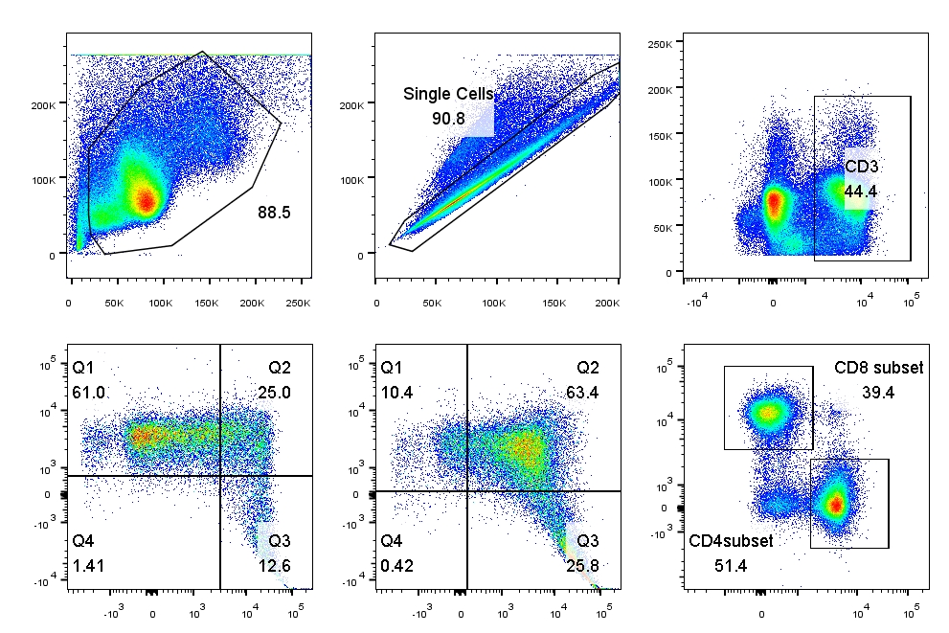
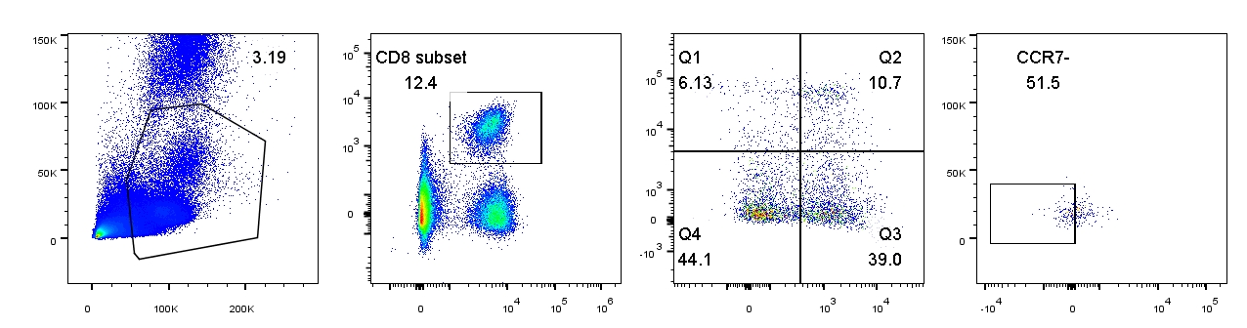
A
A
C
SSC
SSH
SSC
FSC
SSA
CD3
CD62L
CD62L
CD8
CD4
D
B
CD44
CD44
SSC
CD8
CD45RA
SSC
FSC
CD3
CD62L
CCR7
Figure S6. The flow cytometry strategy and detection of effector CD8⁺ T cells

Slide 13
Figure S6. The flow cytometry strategy and detection of effector CD8⁺ T cells.
(A) The strategy to analyze various of cell types in mice. Those cell types were defined with the surface molecule of CD8, CD62L and CD44. The effector T cells was CD8⁺CD62L⁻CD44⁺ and the naïve T cells was CD8⁺CD62L⁺CD44⁺ T cells.
(B) The strategy to analyze various of cell types in human. Those cell types were defined with the surface molecule of CD8, CD62L, CCR7, and CD45RA. The effector T cells was CD8⁺CD62L⁻CD45RA⁺CCR7⁻.
(C) The effect of anti-PD-1 treatment on the level of effector CD8+ T cells in PD group. Two-tailed paired T-test was performed.
(D) The difference of Ki67⁺ effector CD8⁺ T cells in PR group. Two-tailed paired T-test was performed
ns: no significant difference, compared to corresponding baseline group. A P value less than 0.05 was considered to be statistically significant.

Slide 14
Table S1. The baseline and therapeutic information of NSCLC patients.
Patients | PD-1 antibody | PD-L1 expression in tumor | PD-1 expression in tumor | Chemotherapy | Patient response
JXL | premb | Unknown | Unknown | pemetrexed | PR
JJJ | premb | tumor-;stromal- | tumor-;stromal- | Unknown
ZLX | nivo | tumor 70%; stromal- | tumor-;stromal 2% | gemcitabine+carboplatin
WJG | nivo | tumor 5%;stromal- | tumor-;stromal- | Gemcitabine + cis-platinum
XWZ | premb | tumor-;stromal 5% | tumor-;stromal- | pemetrexed +carboplatin
SGB | premb | tumor 30%; stromal unknown | tumor-;stromal- | pemetrexed +cis-platinum
PYF | premb | tumor 80%; stromal 5% | Unknown | pemetrexed +carboplatin
KYY | premb | tumor 40%; stromal 2% | tumor-;stromal 1% | gemcitabine | PD
YDQ | nivo | Unknown | Unknown | Albumin Taxol
ZQ | premb | Unknown | Unknown | gemcitabine
XSY | premb | Unknown | Unknown | Unknown
SRP | premb | Unknown | Unknown | Unknown
GH | premb | tumor 5%;stromal- | tumor-;stromal- | Gemcitabine + carboplatin
CNH | premb | tumor-;stromal- | tumor-;stromal- | irinotecan
CBY | premb | tumor-;stromal- | tumor-;stromal- | Unknown | SD
WY | premb | tumor-;stromal+ | tumor-;stromal- | pemetrexed
CZM | nivo | tumor 30%;stromal- | tumor-;stromal 3% | gemcitabine
ZHY | premb | tumor-;stromal 1% | tumor-;stromal 1% | gemcitabine
ZXG | Premb | Unknown | Unknown | gemcitabine
ZSG | premb | Unknown | Unknown | pemetrexed
PYM | premb | tumor-;stromal- | Unknown | gemcitabine
PYS | premb | tumor 1%;stromal- | tumor-;stromal 1% | pemetrexed
DKP | premb | Unknown | Unknown | Unknown
GYR | premb | tumor 60%;stromal unknown | tumor-;stromal- | pemetrexed +carboplatin
LJX | premb | Unknown | Unknown | Nextinib + Oshitinib
JRY | Nivo | Unknown | Unknown | Albumin Taxol
YH | Nivo | Unknown | Unknown | Unknown
premb: pembrolizumab; nivo: nivolumab; PR: partial response; PD, progressive disease; SD: stable disease.

