Slide 1
Supplemental material to
Deficiency in Aim2 affects viability and calcification of vascular smooth muscle cells from murine aortas and Angiotensin-II induced aortic aneurysms
by Markus Wortmann¹, Muhammad Arshad¹, Maani Hakimi^{1, 2}, Dittmar Böckler¹ and Susanne Dihlmann¹
1: University Hospital Heidelberg, Department of vascular and endovascular surgery, Im Neuenheimer Feld 110, 69120 Heidelberg, Germany
2: Luzerner Kantonsspital, Department of vascular surgery, Spitalstrasse, 6000 Luzern 16, Switzerland

Slide 2
Supplementary table 1: primer sequences for real-time PCR
Gene/transcript | Sequence forward primer (5`-3`) | Sequence reverse primer (5`-3`)
Mouse Acta2 | TCAAGATCATTGCCCCTCCA | CCCAGCTTCGTCGTATTCCT
Mouse Actb | CACCATGTACCCTGGCATTG | AGTACTTGCGCTCAGGAGG
Mouse Aim2 | AGTTGAAATCTGGACCTTGTAGC | TCACTCCACACTTTTCATGTCAG
Mouse Asc/Pycard | GCAGAGCTGAGGTATCTTTTCC | ACATCCCAGAGAGTAAACACAA
Mouse B2m | ACTGGGATCGAGACATGTGA | TGCTATTTCTTTCTGCGTGCA
Mouse Bmp4 | TGCAGCTTTCTAGAGGTCCC | CGAATGGCACTACGGAATGG
Mouse Casp1 | GGTGACCCTGACAAAACGTT | GGCACGATTCTCAGCATAGG
Mouse Cdkn2a | CCGACGGGCATAGCTTCA | CTGAGGCCGGATTTAGCTCT
Mouse Gapdh | TGTCAAGCTCATTTCCTGGT | TGGTCCAGGGTTTCTTACTCC
Mouse Il1b | AAAATACCTGTGGCCTTGGG | TGGGTATTGCTTGGGATCCA
Mouse Nlrp3 | TCCTGCAGAGCCTACAGTTG | CTTTTCTTCCTGGAGCGCTT
Mouse Runx2 | AGCCAGGTTCAACGATCTGA | TAGCTCTGTGGTAAGTGGCC
Mouse Sox9 | AGCACTCTGGGCAATCTCAG | CCCCTCTCGCTTCAGATCAA
Mouse Tnfsf11 (Rankl) | CCATTTGCACACCTCACCAT | GTTAGAGATCTTGGCCCAGC

Slide 3
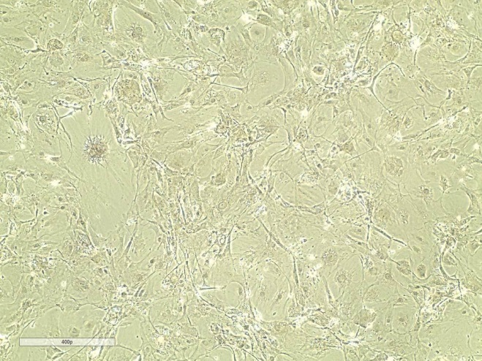
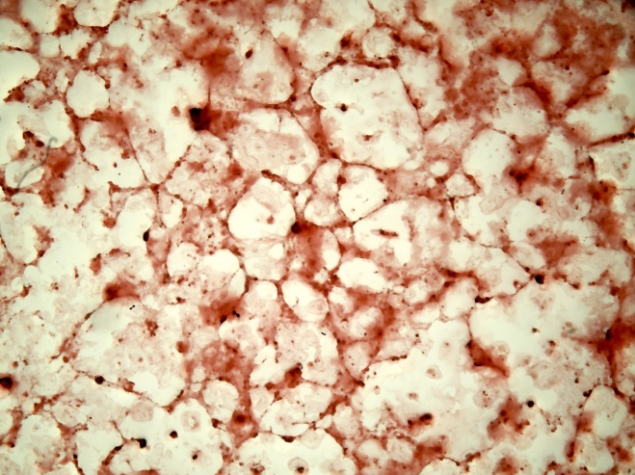
Supplementary figure S1:
a. SMC growth medium 2
b. Osteoblast mineralization medium
Mouse VSMC (C57Bl/6N) were grown for 27 days in Smooth muscle cell growth medium or in osteoblast mineralization medium. Subsequently calcification was visualized in both cultures by staining with Alizarin Red S as described in Materials and methods. Images were taken using a light microscope with phase contrast (a) or bright field (b).

Slide 4
Supplementary figure S2:
a
b
c
****
*
ns
ns
****
ns
*
ns
ns
ns
ns
ns
d
e
**
*
ns
ns
ns
ns
ns
ns
Supplementary figure S2: Analysis of mRNA expression by RT-qPCR. Total RNA was extracted from VSMC grown in vitro with normal growth medium (-OM) or osteoblast mineralization medium (+ OM). A.u. arbitrary unit; relative expression of target gene was normalized against expression of housekeeping genes (Actb, Gapdh and B2m). Bars show the mean +/- SD of n = 3 measurements of 3 VSMC pools, each. Data were statistically analyzed by one-way-ANOVA. *: P < 0.05; **: P < 0.01; ****: P < 0.0001; ns: not significant.

Slide 5
Supplementary figure S3:
a
b
****
*
****
*
ns
ns
ns
**
Supplementary figure S3: Expression of genes encoding inflammsome components. Analysis of mRNA expression of Asc (a), and Casp1 (b) by real-time reverse-transcriptase-polymerse chain reaction (n = 3 measurements of 3 experiments for each). Total RNA was extracted from VSMC grown in vitro with normal growth medium (-OM) or osteoblast mineralization medium (+ OM). A.u. arbitrary unit; relative expression of target gene was normalized against expression of housekeeping genes (Actb, Gapdh and B2m).
Asc expression was similarly low in VSMC of both genotypes grown in normal growth medium. After shifting the cells to mineralization medium, Asc mRNA levels were significantly increased in both genotypes (-OM versus + OM: P < 0.001), although the increase was less intense in Aim2-/- VSMC (a). In contrast, expression of Casp1 was increased in Aim2-/- compared with WT VSMC in either growth medium (b). Data were statistically analyzed by one-way-ANOVA. *: P < 0.05; **: P < 0.01; ****: P < 0.0001; ns: not significant.

Slide 6
Supplementary figure S4:
a
b
n.s.
n.s.
c
Il1b
Il6
Il18
Mcp1
Supplementary figure S4. Plasma levels of inflammatory cytokines IL-1β (a) and IL-6 (b) were determined by specific ELISAs from AngII-treated WT Bl6J and Aim2 deficient mice at the end of the 28d infusion. Data show the mean and standard deviations of n = 11 mice for each group. c. Real-time RT-PCR of aortas showing Il1b, Il6, Il18 and Mcp1 gene expression of AngII-infused WT Bl6J (n = 3) and AngII-infused Aim2-/- (n = 3) mice. Data show the mean +/- SEM of three mice analyzed in triplicates. n.s.: not significant

Slide 7
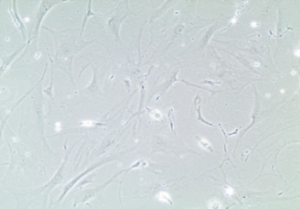
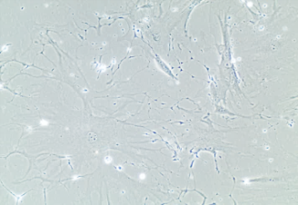


Supplementary figure S5:
a
b
c
Aorta + AngII
***
WT Bl6J + 28d AngII
Aim2-/- + 28d AngII
WT Bl6J
Aim2-/-
4751
4743
4746
4745
191
182
188
202
AA
- + + - - - - -
p16ink4A
Vinculin
40 µm
40 µm
d
n.s.
n.s.
n.s.
n.s.
n.s.
Supplementary figure S5. a. Protein Expression of the senescence marker p16ink4A is increased in AAA. Mouse aortas with and without aneurysms (AAA) were lysed and analyzed by Western blotting. b. Quantitative analysis of p16ink4A expression normalized to Vinculin. Blots were scanned and signals were densitometrically analyzed by Image J software. c. Mouse VSMC (C57Bl/6J) were isolated from AngII treated mice and grown in vitro. Each pool contained VSMC of 3 animals. VSMC derived from Aim2-/- mice are larger, rounded and contain big vacuoles. The picture shows representative cultures of passage 3 from n = 3 (Aim2-/-) and n = 3 (WT) VSMC pools. d. mRNA levels of VSMC derived from AngII infused WT Bl6J ( n = 3 pools) and Aim2-/- (n = 3 pools) animals. ). A.u. arbitrary unit; relative expression of target gene was normalized against expression of housekeeping genes (Actb, Gapdh and B2m).

