Slide 1
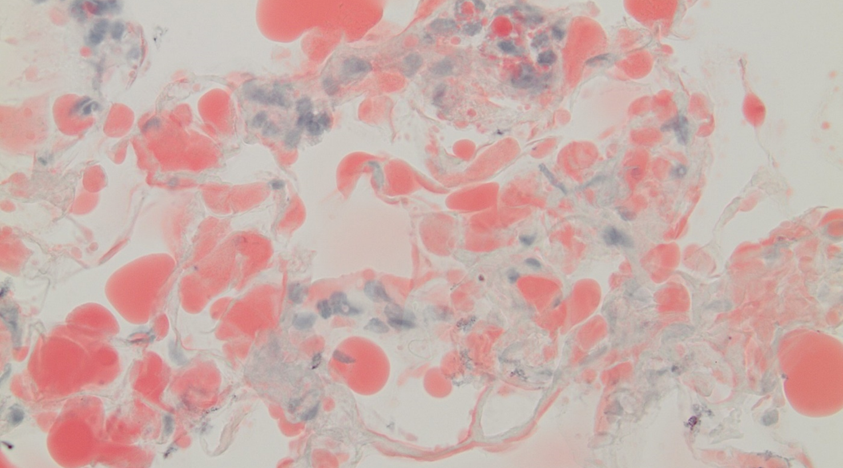
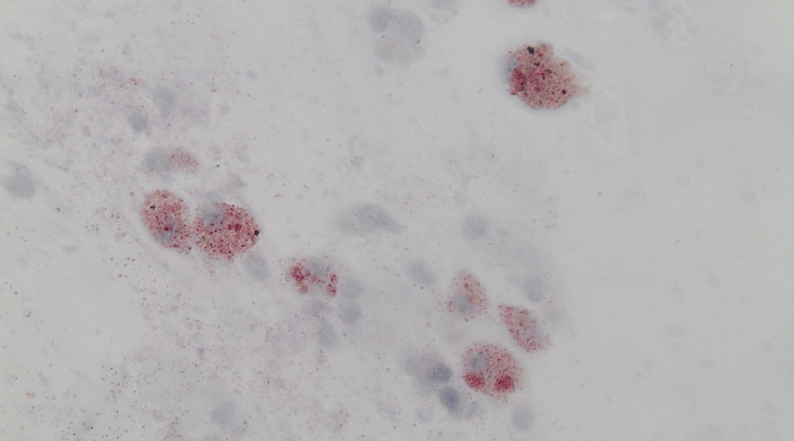
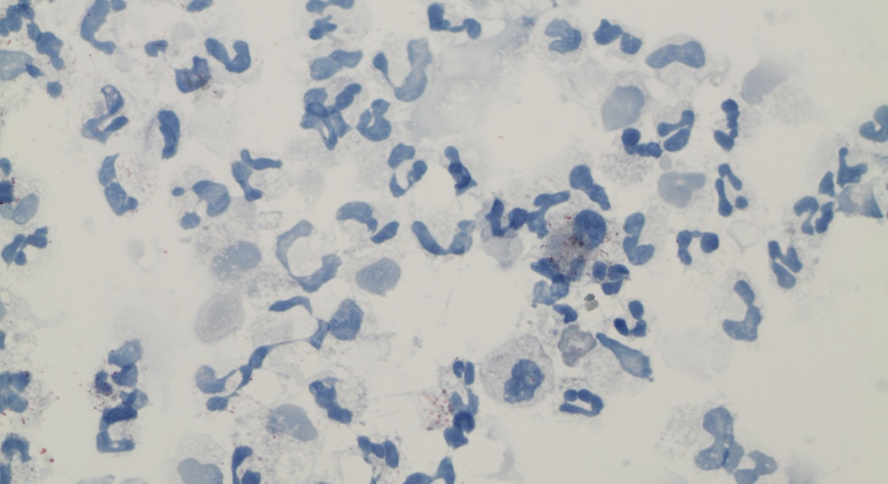
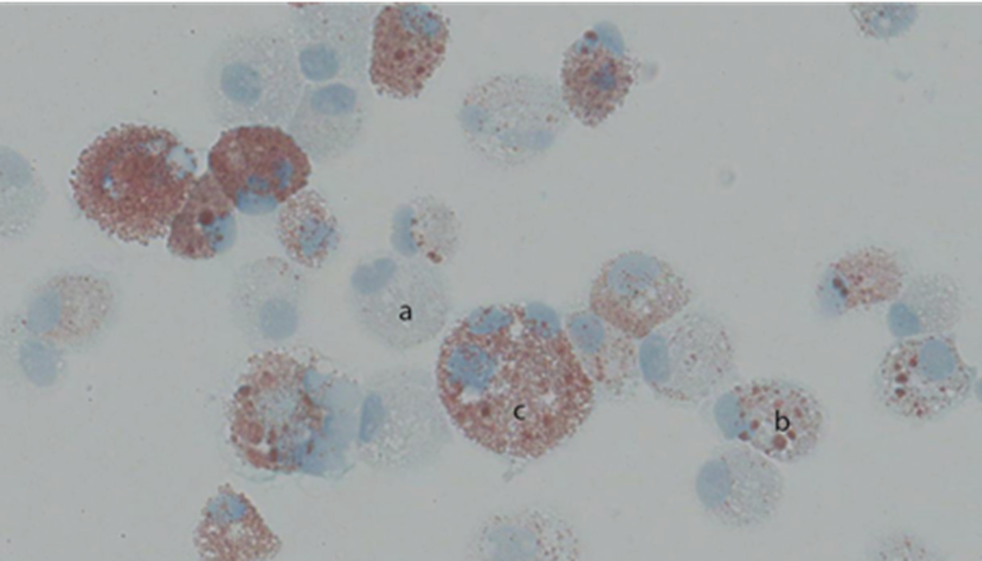
Supplementary Figure 1
(a) adipose tissue with red staining
(b) Smoker
(c) Never-smoker with acute
bronchopneumonia
(d) Lipid-laden Macrophage Index

