Slide 1
Associations of eczema phenotypes with emotional and behavioural problems from birth until school age. The Generation R Study
Chen Hu, Tamar Nijsten, Suzanne G.M.A. Pasmans, Johan C. de Jongste, Pauline W. Jansen, Liesbeth Duijts
Erasmus MC, University Medical Center Rotterdam, Rotterdam, The Netherlands
British Journal of Dermatology. DOI: 10.1111/bjd.18705

Slide 2

Lead researcher: Chen Hu

Slide 3
Introduction
What’s already known?
Previous cohort studies using non-data driven methods to define eczema phenotypes observed that children with early onset and persistent eczema had a higher risk of emotional and behavioural problems in preadolescence.
Alternatively, previous cohort studies showed that children with emotional and behavioural problems had more severe eczema and eczema exacerbations in childhood. The direction of effects between eczema and emotional and behavioural problems is not fully clear.

Slide 4
Objective
To examine the associations of eczema phenotypes with school-age emotional and behavioural problems, and the bidirectional associations of eczema and emotional and behavioural problems from birth until 10 years.

Slide 5
Methods – Eczema & Child Behavior Checklist (CBCL)
Internalizing (emotional) problems | Externalizing (behavioural) problems
Anxious/depressed Somatic complaints Withdrawn/depressed (in 6-18yrs) | Attention Problems* Agressive behaviors
Collected at ages 1.5, 3, 5 (via CBCL 1,5-5years) and 10 years (via CBCL 6-18 years) * Not part of externalizing problems in CBCL 6-18 years
All information was obtained via questionnaires

Slide 6
Methods - Statistical analysis
Multiple imputation covariates (125 datasets)
Linear regression model
  Standardized CBCL-scale scores after transformation (Z-scores)
  Multiple sampling (on 125 datasets)
Cross-lagged models
Confounders:
  Maternal: age, parity, education, history of eczema allergy or asthma, psychiatric symptoms
  Child: sex, gestational age, birthweight, ethnicity, breastfeeding, sleep problems at age 2 months

Slide 7
Methods - Cross-lagged model
Cross-lagged effects
Cross-sectional effects
Stability effects

Slide 8
Eczema phenotypes with internalizing and externalizing problems at age 10yrs
 | Internalizing problems Z-score (95%CI) | Anxious-depressed symptoms Z-score (95%CI) | Withdrawn-depressed symptoms Z-score (95%CI) | Somatic symptoms Z-score (95%CI) | Externalizing problems Z-score (95%CI) | Aggressive behaviour symptoms Z-score (95%CI) | Attention problems Z-score (95%CI)
Never | Reference | Reference | Reference | Reference | Reference | Reference | Reference
Ever | 0.21 (0.14,0.29)* | 0.10 (0.02,0.17)* | 0.05 (-0.02,0.12) | 0.29 (0.22,0.37)* | 0.13 (0.06,0.21)* | 0.12 (0.05,0.19)* | 0.15 (0.08,0.23)*
Never | Reference | Reference | Reference | Reference | Reference | Reference | Reference
Early transient | 0.20 (0.09,0.31)* | 0.10 (-0.02,0.21) | 0.09 (-0.02,0.20) | 0.23 (0.12,0.34)* | 0.16 ( 0.04,0.27)* | 0.16 (0.05,0.27)* | 0.20 (0.09,0.31)*
Mid-transient | 0.14 (0.01,0.27)* | 0.12 (-0.01,0.25) | 0.12 (-0.01,0.25) | 0.15 (0.02,0.27)* | 0.12 (-0.01,0.25) | 0.12 (-0.01,0.25) | 0.21 (0.08,0.34)*
Late transient | 0.14 (0.03,0.25)* | 0.07 (-0.04,0.19) | 0.09 (-0.03,0.20) | 0.13 (0.01,0.24)* | 0.08 (-0.03,0.20) | 0.10 (-0.01,0.22) | 0.15 (0.04,0.26)*
Persistent | 0.30 (0.10,0.51)* | 0.18 (-0.03,0.38) | 0.00 (-0.20,0.21) | 0.39 (0.18,0.60)* | 0.05 (-0.16,0.26) | 0.04 (-0.17,0.24) | 0.24 (0.04,0.45)*
Values are average standardized regression coefficients (95% confidence intervals) from linear regression models. Reference group is the never eczema (phenotype) group. Models were adjusted for maternal education and psychiatric symptoms, and child’s sex, gestational age, ethnicity, breastfeeding and sleep disturbances. *p-value <0.05.

Slide 9
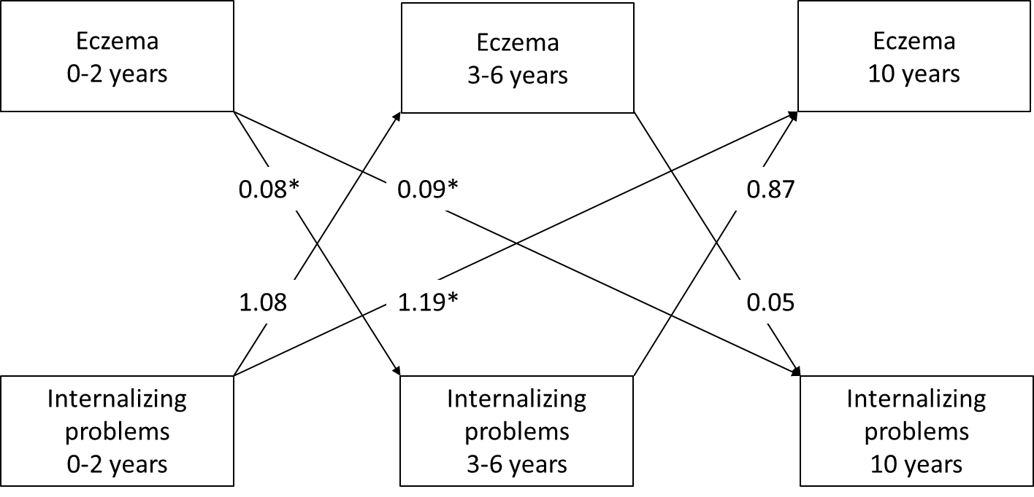
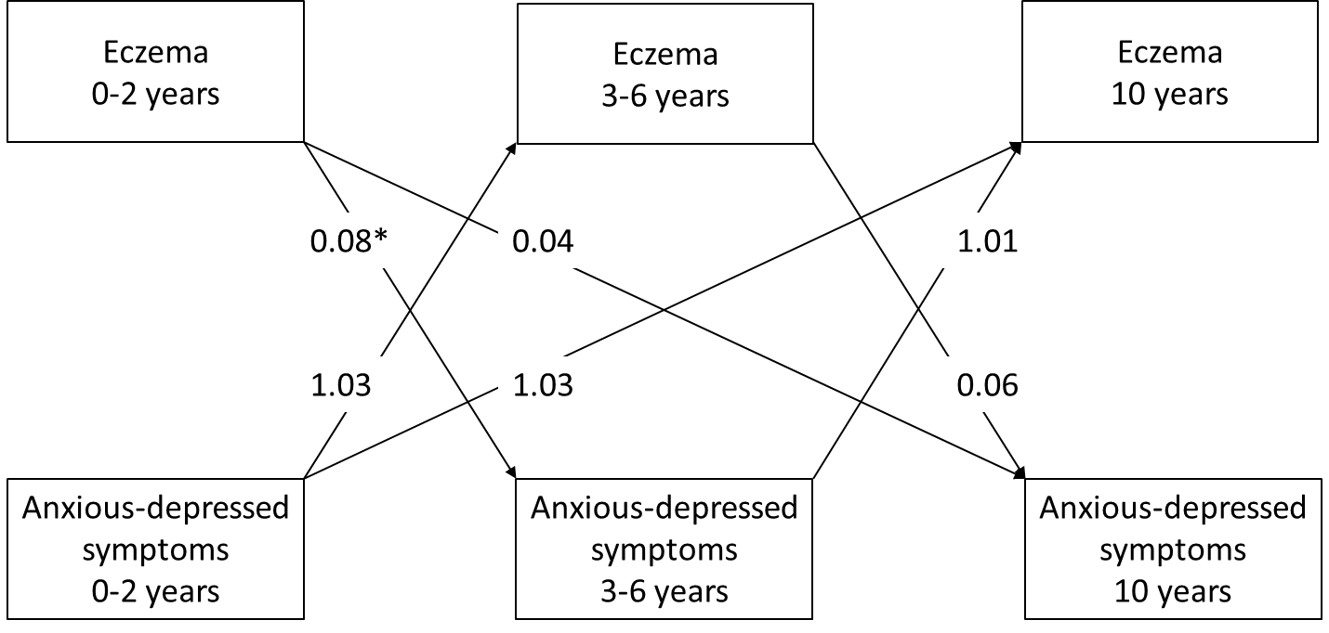

Direction of associations between eczema and internalizing problems 0-10yrs
Eczema
↕
Internalizing symptoms
Eczema
↕
Anxious-depressed symptoms
Eczema
↕
Somatic symptoms

Slide 10



Direction of associations between eczema and externalizing problems 0-10yrs
Eczema
↕
Externalizing symptoms
Eczema
↕
Aggressive behaviour
Eczema
↕
Attention problems

Slide 11
Discussion - Conclusions
All eczema phenotypes were most consistently but very modestly associated with more somatic symptoms and attention problems at school age.
Children with early transient eczema had more aggressive behaviour symptoms at school age.
The direction of effects were predominantly present for eczema until 2 years leading to increased internalizing and externalizing problems at school age rather than reversely.

Slide 12
Discussion - Strengths and limitations
Strengths:
Prospective design
Detailed information on repeated measures
Data-driven eczema phenotypes
Cross-lagged modelling for bidirectional analyses
Limitations:
Healthier population selection
Residual confounding: no severity of eczema, sleep problems in later life, other comorbidities
Minimal clinical impact (small effect sizes)
Natural course of studied effects

Slide 13
Conclusions
What does this study add?
Taking the variability of eczema onset and persistence within and between children over time into account, all identified eczema phenotypes were very modestly associated with more somatic symptoms and attention problems at school age.
Directional effects seem from eczema leading to emotional and behavioural problems rather than reversely. Future research should focus on the effect of early optimal eczema management on mental health disorders in children later in life.

Slide 14





The research team
Tamar Nijsten
Liesbeth Duijts
Pauline Jansen
Suzanne Pasmans
Johan de Jongste

Slide 15
Call for correspondence
Why not join the debate on this article through our correspondence section?
Rapid responses should not exceed 350 words, four references and one figure
Further details can be found here

