Slide 1
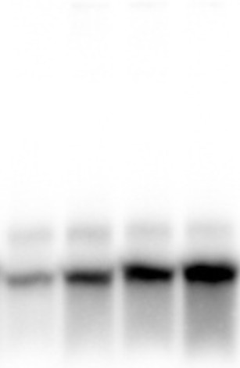
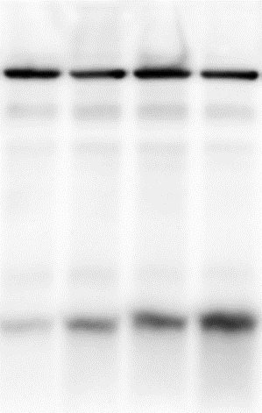
S1 Fig. Raw blot images related to Fig 2. C
A
B
Bafilomycin A1
Bafilomycin A1
Control
Melasolv
Control
Melasolv
Control
Melasolv
Control
Melasolv
Actin
LC3 I
LC3 II

