Slide 1
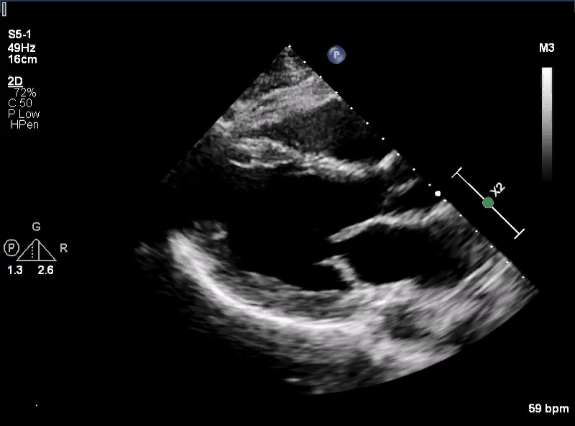
Supplement Video 1: Echocardiogram displaying MAD at the posterior wall. The arrow points to the area of atrial and ventricular displacement during systole.

