Slide 1
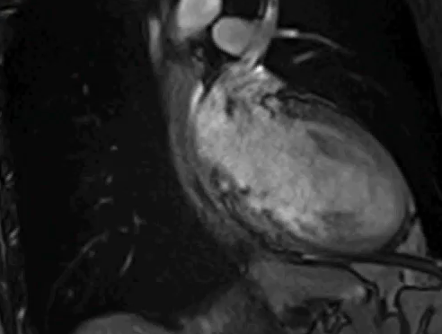
Supplement Video 2: MRI Cine of MAD located at the posterior wall. The arrow points to the area of atrial and ventricular displacement during systole.

