Slide 1
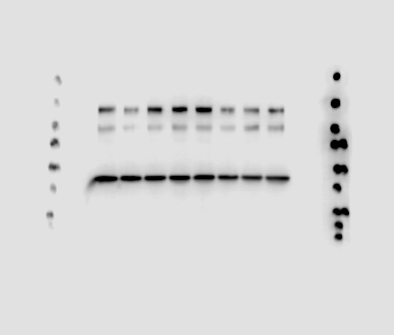
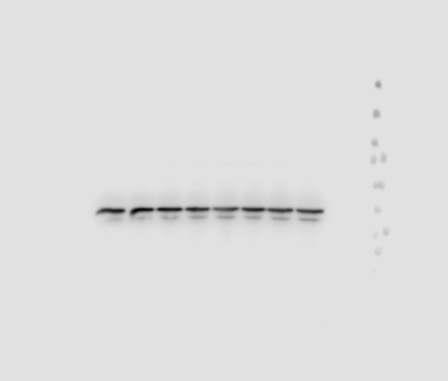
(a)
Synaptopodin
GAPDH
(kD)
250
150
100
75
50
37
25
20
15
con ADR
ADR+
saxa
con ADR
ADR+
saxa
(b)
RhoA
GAPDH
(kD)
250
150
100
75
50
37
25
20
con ADR
ADR+
saxa
con ADR
ADR+
saxa
Additional File 2

