Slide 1
Recurrent spontaneous coronary artery dissection in a middle-aged male athlete patient: a case report
September 2018
EHJ-CR-D-19-00293

Slide 2
Introduction
Spontaneous coronary artery dissection (SCAD)
Rare condition mainly affecting young women(1,2)
Associated with fibromuscular dysplasia, connective tissue diseases and hormonal states(3,4,5)
Rare in men
Recurrent SCAD is rare in women with limited number of cases in the literature

Slide 3
Case Presentation
History and Examination Findings
59-year-old male athlete presents in 2014
      History of presenting complaint:
        Chest pain after 5km run
        B/G: hypertension
      Clinical examination:
        Normotensive on Enalapril
        HR 55

Slide 4
Case Presentation
Investigations 2014
Blood profiling:
      Raised troponin I ( 47,865 ng/L) suggestive of STEMI
      Cholesterol 4.3 mmol/l - normal LDL, HDL and triglycerides

Slide 5
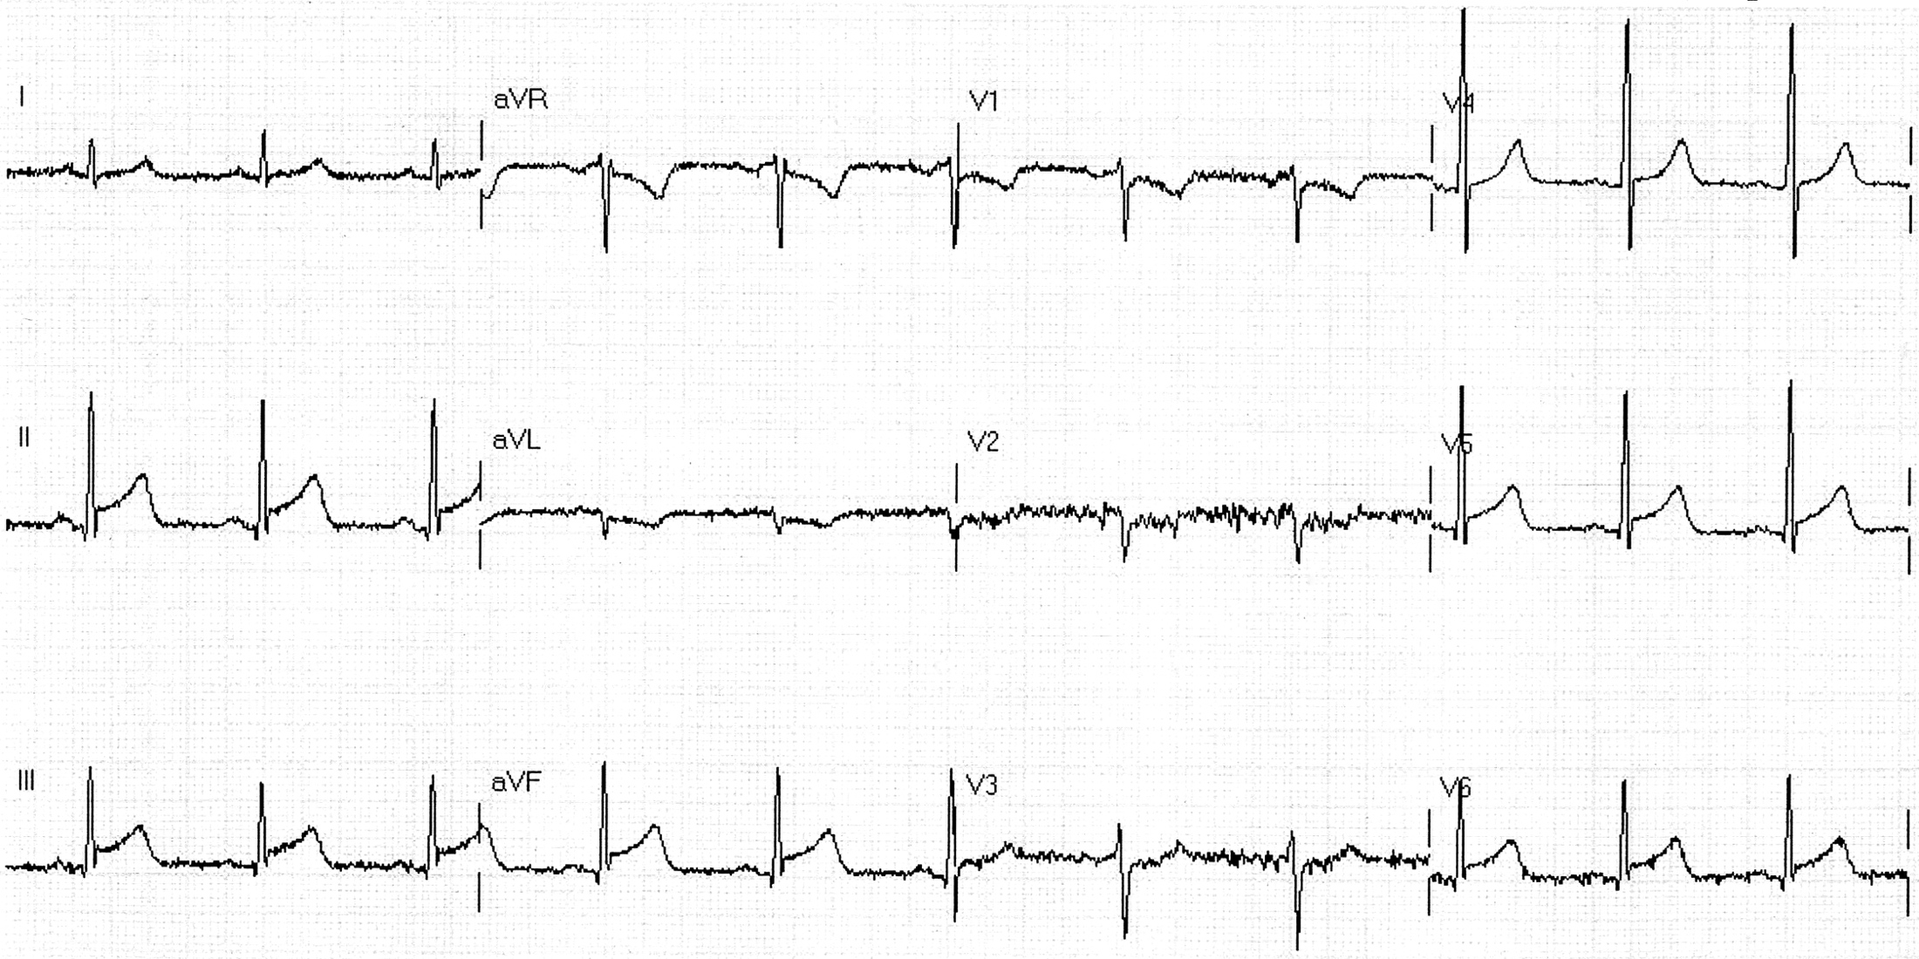
Case Presentation
Investigations: ECG 2014
ECG:
ST elevation in leads II, III and aVF in keeping inferolateral ST elevation myocardial infarction

Slide 6
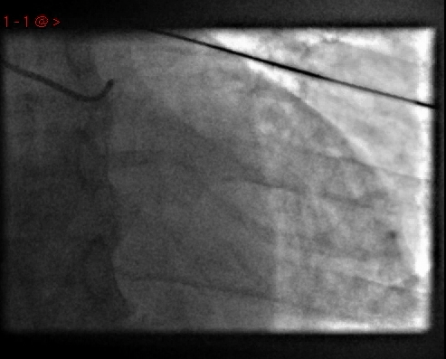
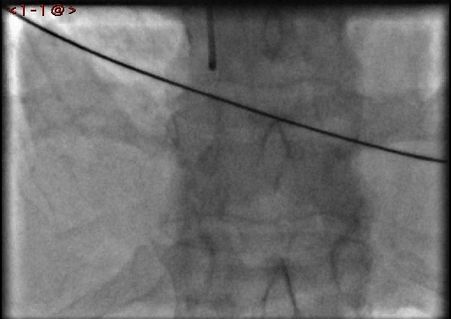
Case Presentation
Investigations: Coronary Angiogram 2014
No abnormal findings on LCA angiogram (left side) or on the RCA angiogram (right side)

Slide 7
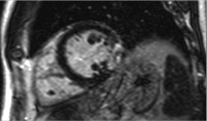
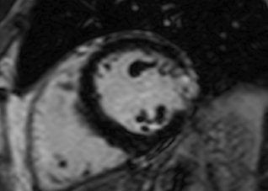
Case Presentation
Investigations: MRI 2014
Performed 7 months after event
Transmural infarct in the lateral wall at mid-cavity level

Slide 8
Case Presentation
Management 2014
Diagnosis of MINOCA or possible myocarditis:
      Commenced on dual antiplatelet therapy of Aspirin 75mg (long-term) and Ticagrelor 90mg (for one year).
      Commenced on Simvastatin 40mg
      Changed from Enalapril 10mg to Ramipril 5mg.
      Referred for Cardiac rehab

Slide 9
Case Presentation
History and Examination Findings
Four years later
Patient represents in 2018
      History of presenting complaint :
        Chest pain 12 hours after a run
        Similar to previous
      Clinical examination:
        Normotensive
        HR 54

Slide 10
Case Presentation
Investigations
Blood profiling:
      Raised troponin I (4,500 ng/L)
      Cholesterol 3.2 mmol/l - normal LDL, HDL and triglycerides

Slide 11
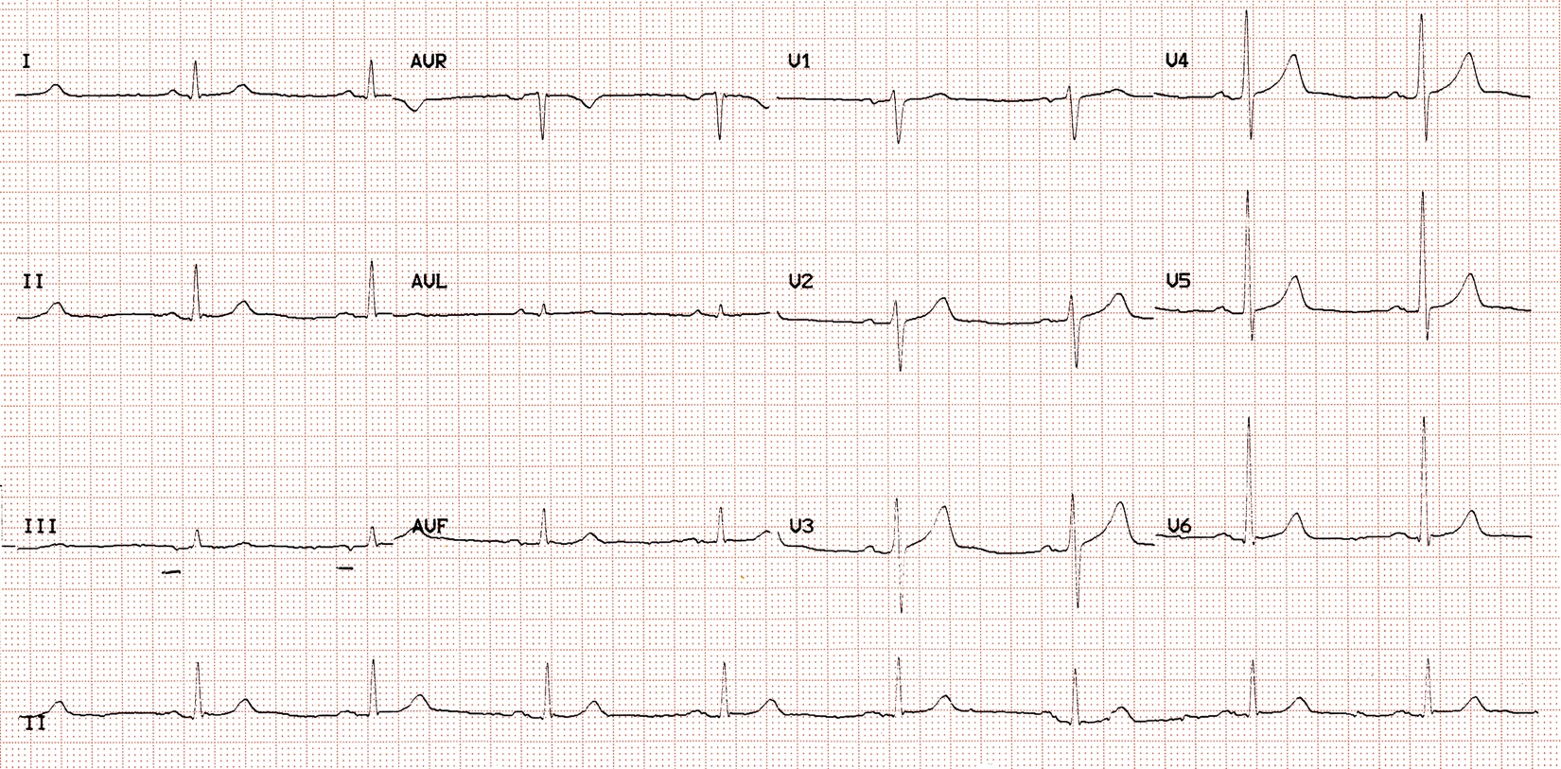
Case Presentation
Investigations: ECG 2018
No ST elevation

Slide 12
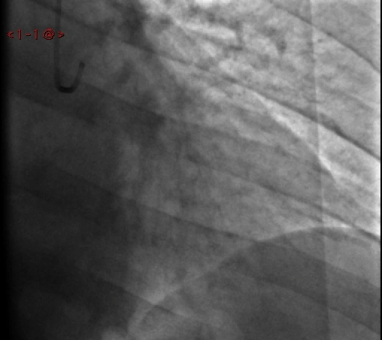
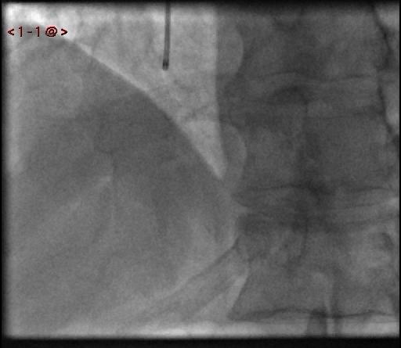
Case Presentation
Investigations: Coronary Angiogram 2018
Initially felt to be normal – Type 2a dissection seen in PL branch of RCA on review
Minor changes in the terminal branches of the left circumflex, suggestive of distal intra-mural coronary haematoma formation.

Slide 13
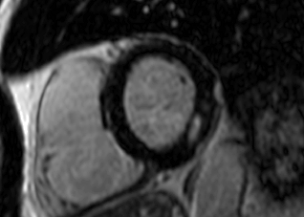
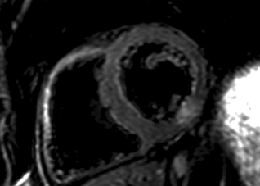
Case Presentation
Investigations: MRI 2018
Performed 7 days after event.
Subendocardial infarct with presence of oedema on T2 SPAIR sequence

Slide 14
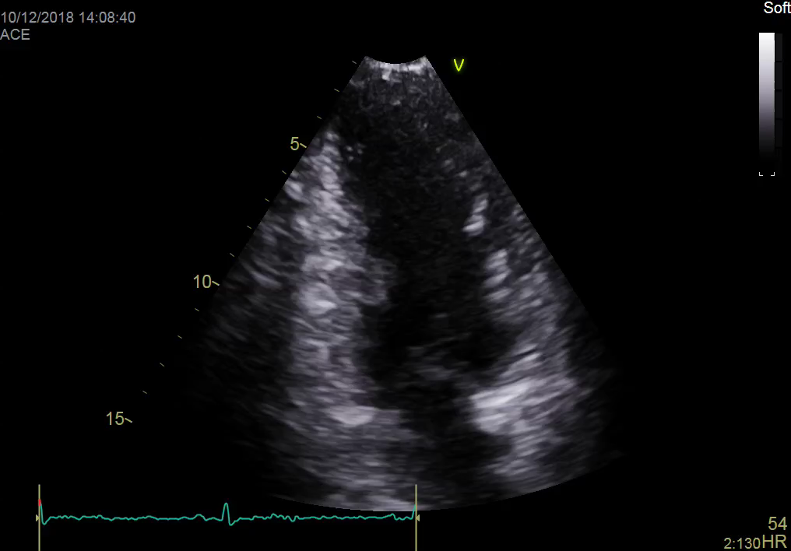
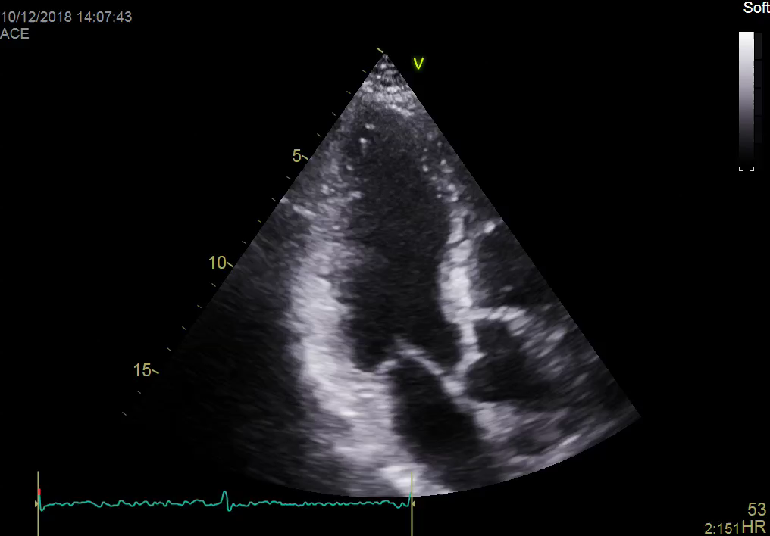
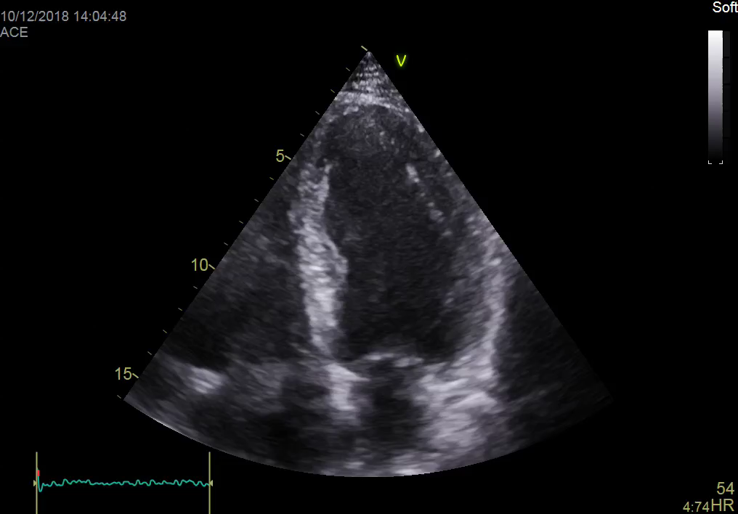
Case Presentation
Investigations: ECHO 2018
Ejection fraction of 63% with LVEDD of 4.7cm (ECHO show above).
Infero-lateral wall hypokinesia was noted( see right video).

Slide 15
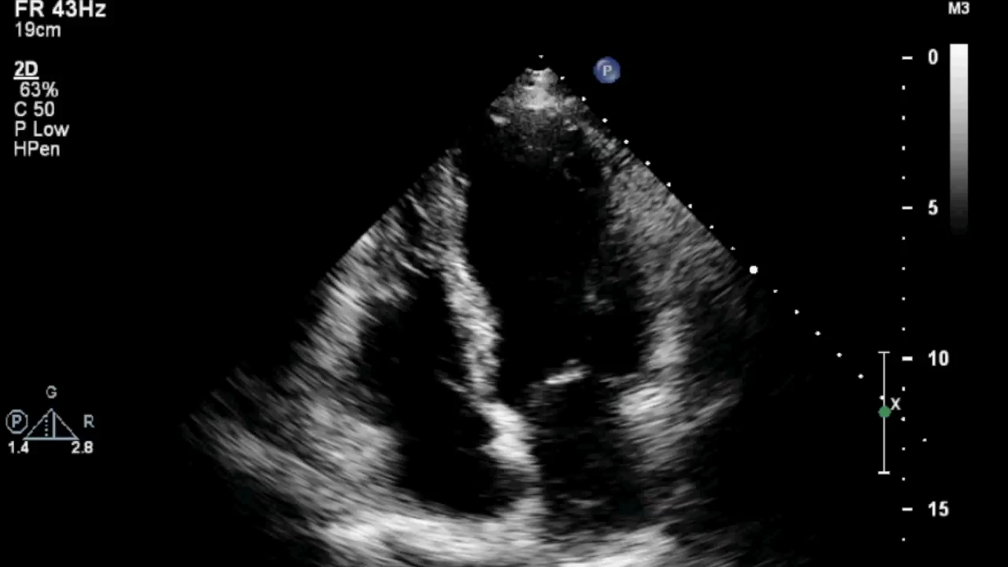
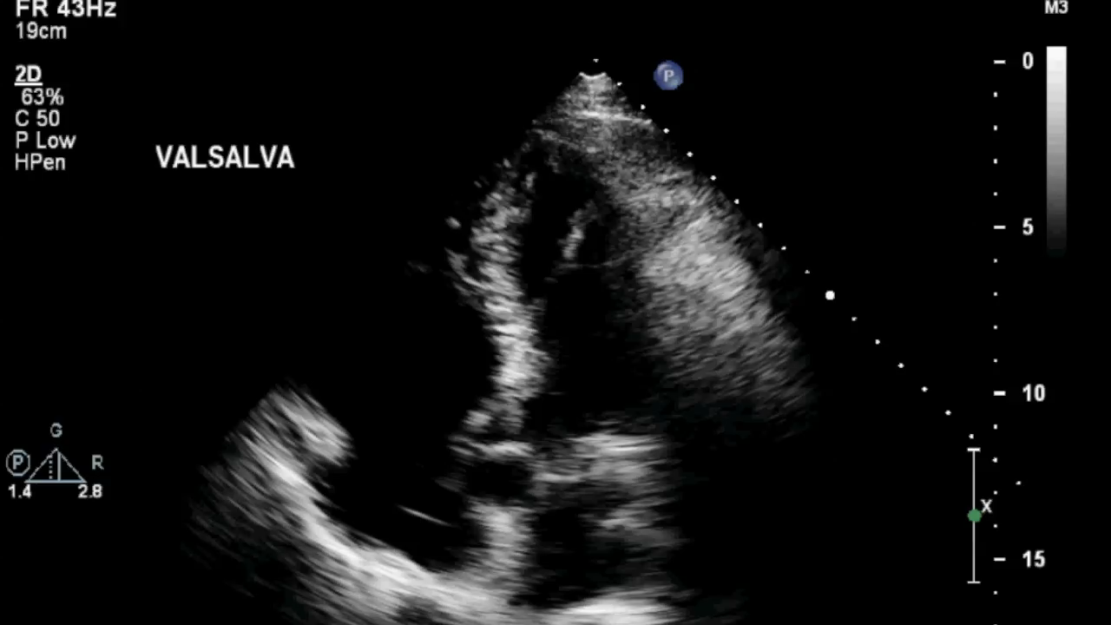
Case Presentation
Investigations: Agitated saline ECHO
No evidence of patent foramen ovale during rest (left side) or Valsalva manoeuvre (right side)

Slide 16
Case Presentation
Management 2018
Diagnosis of Type 2b after review of Angiogram
      Initially continued on Ramipril 5mg and Aspirin75mg and Ticagrelor 90mg was re-commenced for 3 months.
      Aspirin was subsequently stopped after diagnosis of Type 2b SCAD to reduce the risk of intramural bleeding.
      Beta blocker not used due to low resting heart rate (54 bpm)

Slide 17
Discussion
SCAD
      Recurrence rate of 13-16% reported in the literature – data mostly from female cohorts (1).
      No abnormality identified on the initial angiogram, but detection of Type 2 SCAD is often not appreciated or misdiagnosed (6).
      The presence of SCAD in the second event is highly suggestive of SCAD as the pathophysiology of the primary event.
      The overall mortality in women is relatively low, ranging from 0-5% over 3-6 years (7).

Slide 18
Discussion
Imaging
      Coronary angiography is the most common modality to diagnose .
      Intracoronary imaging has been shown to be a useful adjunct in cases of subtle dissection(8).
      IVUS was not used in this case due to the risk of further vessel wall damage give the distal nature of the dissection.
      CT coronary angiogram (CTCA) useful in diagnosis of larger coronary vessels and in follow-up (8), but has lower temporal resolution than coronary angiography.
      Cardiac MRI is a useful initial diagnostic investigation for evaluating the case of MINOCA. It allows assessment of infarct size & myocardial dysfunction (9).
      Cardiac MRI also can differentiate infarcts from other causes of troponin rise.

Slide 19
Discussion
Management
      Limited data
      Current preferred strategy is conservative management
      Beta-blockers, angiotensin converting enzyme inhibitors, anti-platelet therapy and statin therapy(1)
      Other approaches include emergent revascularization and coronary artery bypass grafting (1).
      Pt did not wish to discontinue exercise in spite of advice to do so. A medium-distance strategy running strategy was agree as a compromise.
      Avoidance of power sport was advised (3)

Slide 20
Learning Points
Spontaneous coronary artery dissection (SCAD) is rare in male patients
It must be considered in cases where no atherosclerotic disease is identified on angiogram.
Cardiac MRI can aid confidence in identifying the affected vessel by confirming and locating the infarct.

Slide 21
References
1. Saw J, Mancini GBJ, Humphries KH. Contemporary Review on Spontaneous Coronary Artery Dissection. Journal of the American College of Cardiology JID - 8301365
2. Adlam D, Maas A, Vrints C, Alfonso F. Spontaneous coronary artery dissection. Eur Heart J 2016;37:3073-3074.
3. Tweet M, Hayes S, Lerman A, Rihal C, Gulati R. Percutaneous coronary intervention for acute spontaneous coronary artery dissection is associated with reduced rates of technical success. Circulation 2012;126
4. Papireddy MR, Nandish S, Mishkel GJ. Recurrent spontaneous coronary artery dissection: First case report in men with three episodes of spontaneous coronary dissection in separate vascular territories. Catheter Cardiovasc Interventions 2016;87:E192-E196.
5. Rosengarten JA, Dana A. Recurrent spontaneous coronary artery dissection: acute management and literature review. Eur Heart J Acute Cardiovasc Care 2012;1:53-56.
6. Yip A, Saw J. Spontaneous coronary artery dissection-A review. Cardiovascular diagnosis and therapy JID - 101601613 PMC - PMC4329168 OTO - NOTNLM
7. Pasupathy S, Tavella R, McRae S, Beltrame JF. Myocardial Infarction With Non-obstructive Coronary Arteries - Diagnosis and Management. European cardiology JID - 101574780 PMC - PMC6159468 OTO - NOTNLM
8. FAU HS, Kim EF, Saw JF, Adlam DF, Arslanian-Engoren C FAU - Economy, Katherine et al. Spontaneous Coronary Artery Dissection: Current State of the Science: A Scientific Statement From the American Heart Association. Circulation JID - 0147763
9. Pasupathy S, Tavella R, McRae S, Beltrame JF. Myocardial Infarction With Non-obstructive Coronary Arteries - Diagnosis and Management. European cardiology JID - 101574780 PMC - PMC6159468 OTO – NOTNLM

