Slide 1
Supplementary video files
Hematopoietic Stem Cell Transplantation and vasculopathy associated with STAT3-dominant-negative Hyper-IgE syndrome
MJ Ponsford et al.
Front. Pediatr. 8:575. doi: 10.3389/fped.2020.00575

Slide 2
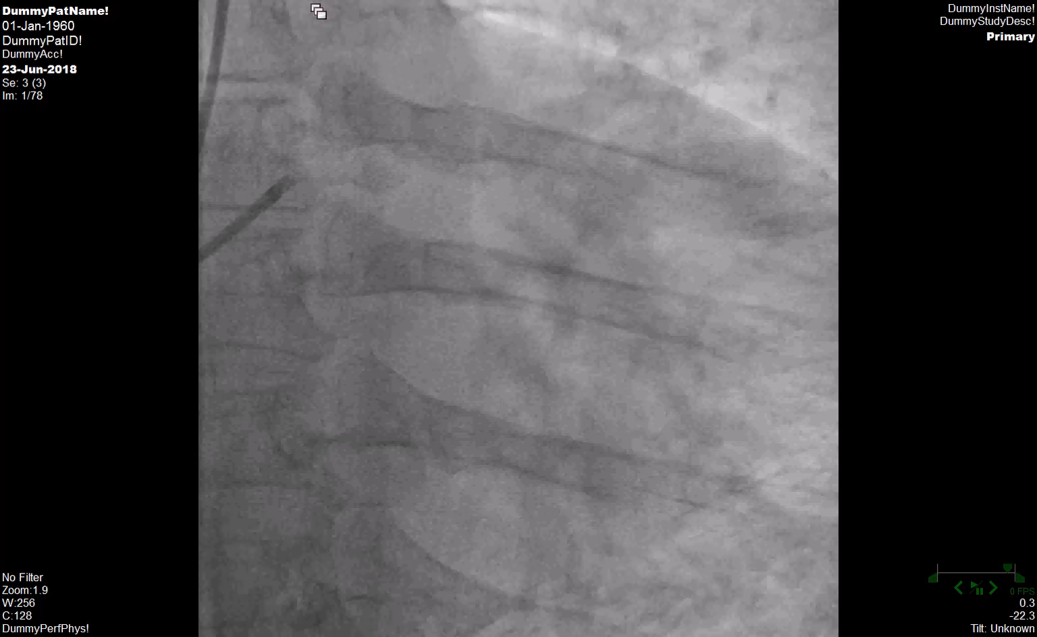
Supplementary online video 1: Proximal Coronary Ectasia on coronary angiography
Notes:
He underwent coronary angiography – which even to the untrained eye clearly shows dilatation of the coronary arteries.

Slide 3
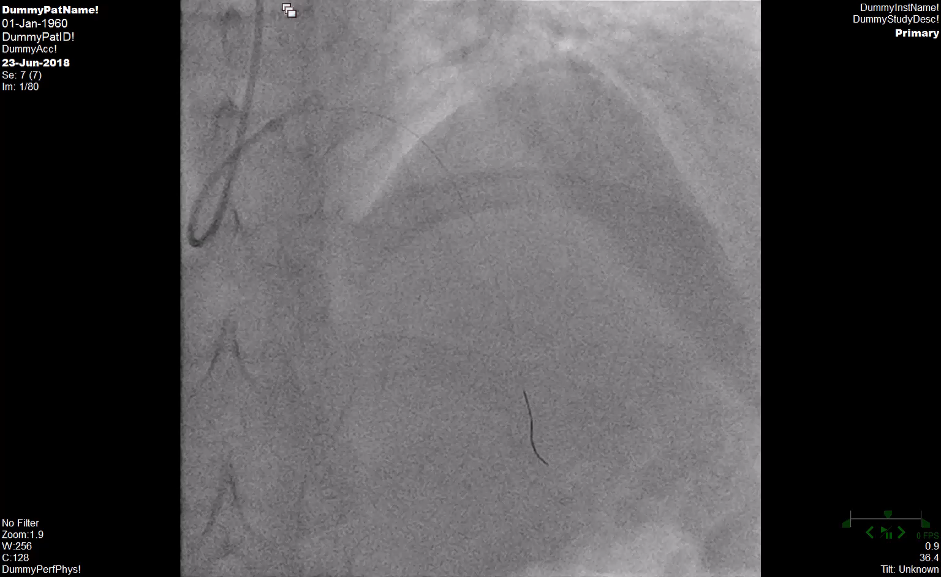
Supplementary online video 2: Occlusion of Left Anterior Descending (LAD)
Notes:
Here catherization of the left coronary circulation Is made
Should see blood/contrast flow
Absence indicates blockage.

Slide 4
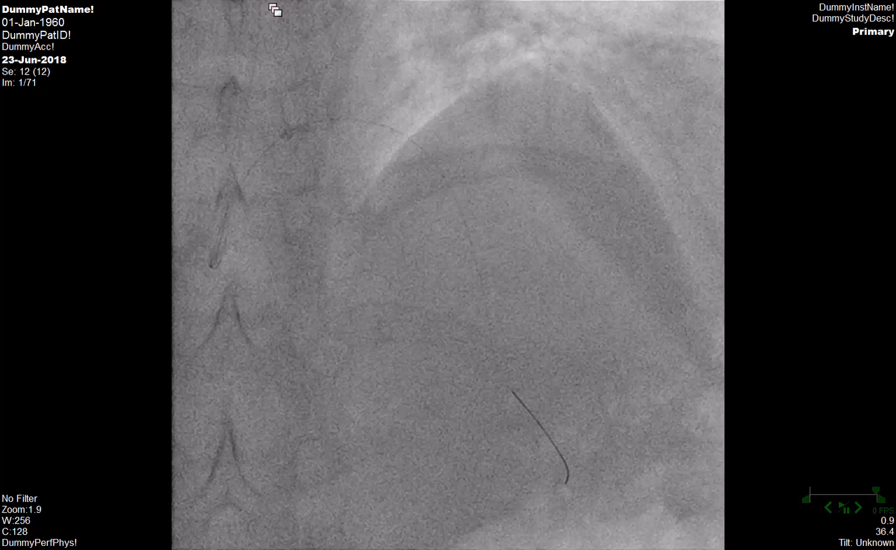
Supplementary online video 3: Post clot aspiration and thrombolysis
Notes:
Interventional cardiology team: performed clot aspiration with intra-coronary thrombolysis
Able to relive the obstruction & restore circulation.
No stent /metal work left in place.

Slide 5
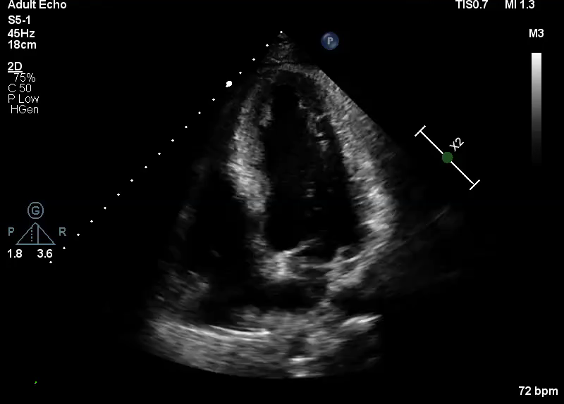
Supplementary video 4: Echocardiogram 1-week post-infarction

