Slide 1
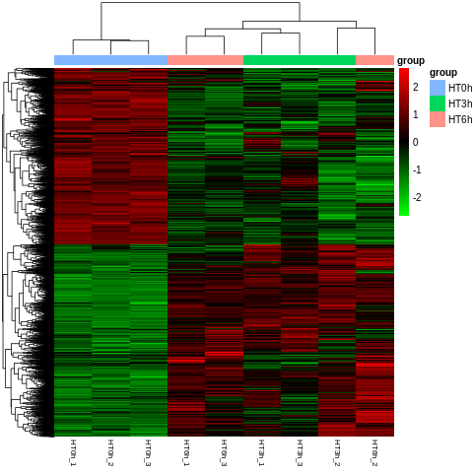
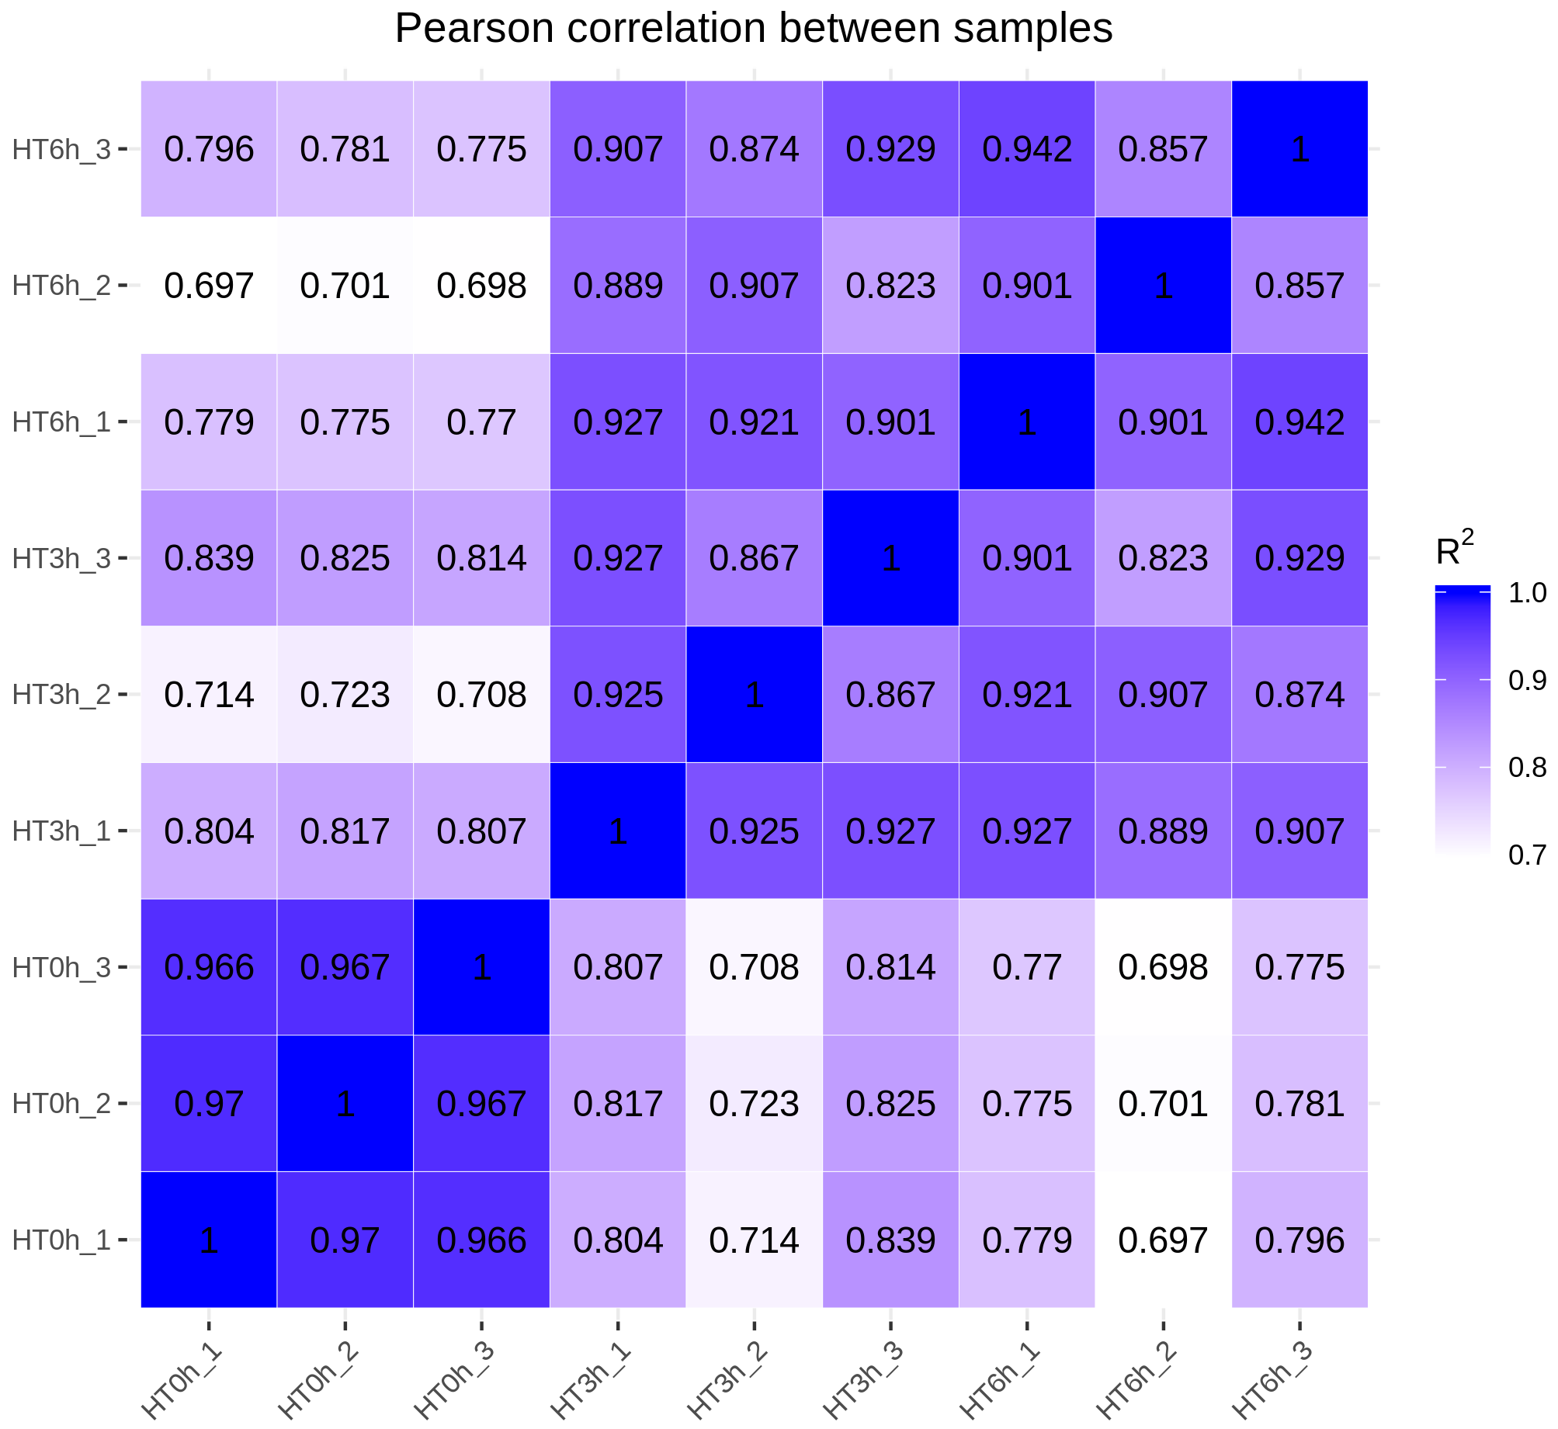
A
B
Additional file 11: Fig. S3 Hierarchical clustering of cucumber gene expression profiles under heat treatment. A, Hierarchical cluster of expressed cucumber genes in 9 samples. In the color panels, each transverse line represents a single gene and the color of the line indicates the expression level of the gene relative to the mean center in a specific sample: red, high expression; green, low expression level. B, The hierarchical clustering on the gene expression matrix, using the Pearson correlation coefficient as a proxy of similarity between transcriptomes. HT0h = heat treatment for 0 h (hours), HT3h = heat treatment for 3 h, HT6h = heat treatment for 6 h.

