Slide 1
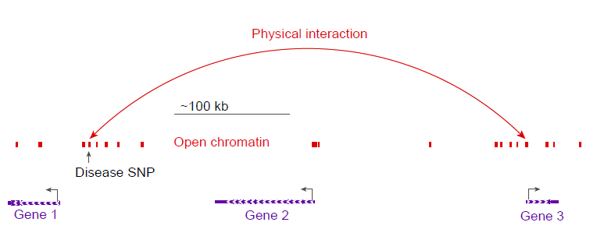
Possible promoter interactions in open chromatin regions
Grant et al (2020) Diabetologia DOI 10.1007/s00125-020-05248-8
©The Authors 2020. Distributed under the terms of the CC BY 4.0 Attribution License (http://creativecommons.org/licenses/by/4.0/)

