Slide 1
Hypertensive Disorders of Pregnancy: A Major
Risk Factor for Cardiovascular Disease in Women
Alina Brener, PGY-2 IM
Irene Lewnard, PGY-2 Ob/Gyn
Jennifer Mackinnon, Associate Professor Internal Medicine
Cresta Jones, Assistant Professor Ob/Gyn
Jacquelyn Kulinski, Assistant Professor Cardiology

Slide 2
Heart disease is the leading cause of death for women in the United States, killing 292,188 women in 2009—that’s 1 in every 4 female deaths
All Females, All Ages (CDC 2013) | Percent*
1) Heart disease | 22.4
2) Cancer | 21.5
3) Chronic lower respiratory diseases | 6.1
4) Stroke | 5.8
5) Alzheimer's disease | 4.6
6) Unintentional injuries | 3.8
7) Diabetes | 2.8
8) Influenza and pneumonia | 2.3
9) Kidney disease | 1.8
10) Septicemia | 1.6

Slide 3
Pregnancy as a “Stress Test” for Heart Disease
Since 2011, the AHA has listed preeclampsia as an established risk factor for CVD in women with a significance equaling obesity, smoking, or diabetes, especially when pre-term or recurrent
Notes:
Make sure to state that it is independent risk factor

Slide 4
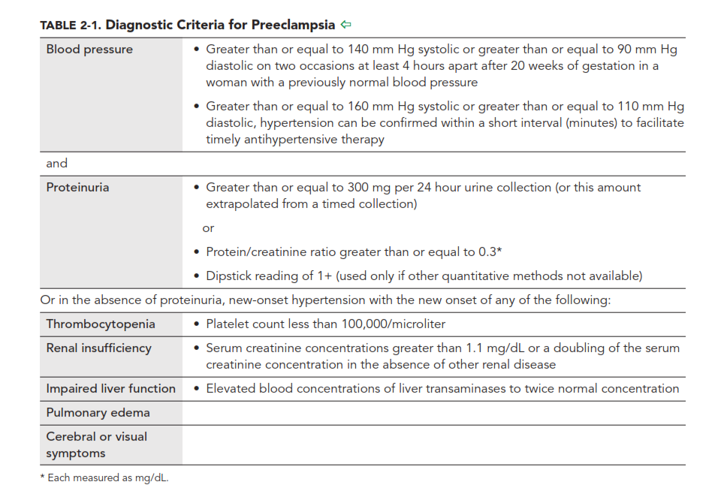
What is Preeclampsia?
Preeclampsia
HELLP Syndrome
Notes:
Change this slide! To either do flow chart or arrows
Protenuria—dipstick 1+, protein/creatinie ration .3, greater than or equal ot 300mg 24hour urine colleciton

Slide 5
California Health and Developmental Study
2.1 fold increased risk of death from CVD in all women with PreE
9.5 fold increased risk of death from CVD in women with PreE before 34 weeks
Notes:
The study looked at a cohort of 14403 women in kaiser permanente health care in califorial. Median age of enrollment into the study was 26 years old and median follow up was 37 years.

Slide 6

ACOG-Recommended Screening Questions for Primary Care Providers
American College of Obstetricians and Gynecologists, Task Force on Hypertension in Pregnancy. Hypertension in pregnancy: Report of the American College of Obstetricians and Gynecologists’ Task Force on hypertension in pregnancy. Obstet Gynecol. 2013;122(5):1122–1131

Slide 7
Screening guidelines per ACOG as of 2013
For women with a history of recurrent or preterm preeclampsia, ACOG recommends yearly measurement of blood pressure, lipids, fasting blood sugar and BMI
Quality of Evidence: Low
Strength of evidence: Qualified
American College of Obstetricians and Gynecologists, Task Force on Hypertension in Pregnancy. Hypertension in pregnancy: Report of the American College of Obstetricians and Gynecologists’ Task Force on hypertension in pregnancy. Obstet Gynecol. 2013;122(5):1122–1131

Slide 8
Provider Knowledge Gap
Canadian study:
-54% of maternity care providers (family medicine, obstetricians, and midwives) are aware of PreE as a risk factor for CVD
United States Survey:
-56% of internists, 23% of obstetricians unsure or unaware PreE is risk factor for CVD
-only 9% of internists and 38% of obstetricians counsel women with history of PreE about CVD risk reduction
Notes:
A web-based survey in 2009 was sent to 295 residents and attendings in IM and 108 residents and attendings in OB in beth israel deaconess medical center.

Slide 9
Together we can improve women’s health!
Ask about your female patient’s obstetrical history and if she had any pregnancy complications
Notify patients with history of preeclampsia that they are at increased risk of heart disease and need close follow-up
Talk to your patients about whether they might benefit from early screening for heart disease
Please update the problem list

Slide 10
References
American College of Obstetricians and Gynecologists, Task Force on Hypertension in Pregnancy. Hypertension in pregnancy: Report of the American College of Obstetricians and Gynecologists’ Task Force on hypertension in pregnancy. Obstet Gynecol. 2013;122(5):1122–1131
MacDonald SE, Walker M, Ramshaw H, Godwin M, Chen XK, Smith G. Hypertensive disorders of pregnancy and long-term risk of hypertension: what do Ontario prenatal care providers know, and what do they communicate? J Obstet Gynaecol Can. 2007;29(9):705–710
Morgana L Mongraw-Chaffin, Piera M Cirillo, and Barbara A Cohn. Preeclampsia and Cardiovascular Disease Death: Prospective Evidence from the Child Health and Development Studies Cohort. Hypertension. 2010 Jul; 56(1): 166-171
Young B, Hacker MR, Rana S. Physicians’ knowledge of future vascular disease in women with preeclampsia. Hypertens Pregnancy. 2012;31(1):50–58.

