Slide 1
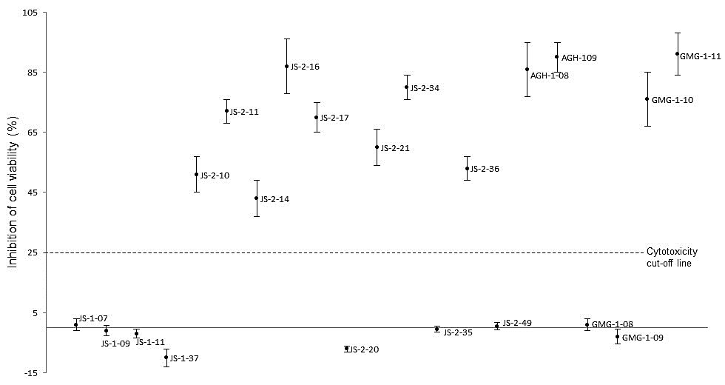
S2 Fig. Cytotoxic effects of test compounds on human ileocecal adenocarcinoma (HCT-8) cells cultured in vitro. Confluent monolayers of HCT-8 cells were treated with 40 µM of compound, while control cells were treated with a volume of DMSO equivalent to that used in compound-treated cells (1% v/v). Following 48 h of culture, the cells were analyzed for viability by a colorimetric assay using the cell proliferation reagent WST-1 (Roche). The difference in absorbance between the compound-treated cells and the DMSO-treated cells was divided by the absorbance from the DMSO-treated cells and multiplied by 100 to derive the inhibition of cell viability (%) values. The data shown represent the means from three independent experiments with standard error bars.

