Slide 1
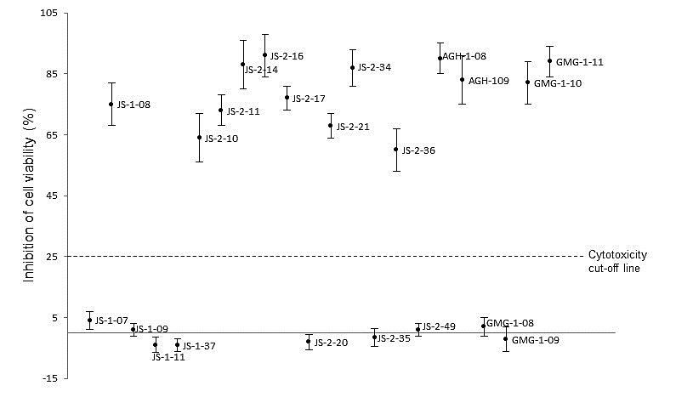
S3 Fig. Cytotoxic effects of test compounds on human foreskin fibroblasts (HFF) cells cultured in vitro. Confluent monolayers of HFF cells were treated with 40 µM of compound, while control cells were treated with a volume of DMSO equivalent to that used in compound-treated ells. Following 48 h of culture, the cells were analyzed for viability by a colorimetric assay using the cell proliferation reagent WST-1 (Roche). The difference in absorbance between the compound-treated cells and the DMSO-treated cells was divided by the absorbance from the DMSO-treated cells and multiplied by 100 to derive the inhibition of cell viability (%) values. The data shown represent the means from three independent experiments with standard error bars.

