Slide 1
A computational guided, functional validation of a novel therapeutic antibody proposes Notch signaling as a clinical relevant and druggable target in glioma
D Herrera-Rios^{1,2, #}, G Li^{3, #}, D Khan¹, J Tsiampali¹, AC Nickel¹, P Aretz¹, M Hewera¹, AK Suwala^{4,5}, T Jiang³, HJ Steiger¹, MA Kamp¹, S Muhammad¹ , D Hänggi¹, J Maciaczyk⁶ , W Zhang^{3, #} and UD Kahlert^{1,7, *, #}

Slide 2
Suppl. Figure S1
Primers
Name | Gene name | Gene ID (NCBI) |  | Forward primer |  |  | Reverse primer
β-actin | ACTB | 60 |  | CCCAGCACAATGAAGATCAA |  |  | CGATCCACACGGAGTACTTG
TWIST1 | TWIST1 | 7291 |  | TCCGCGTCCCACTAGCA |  |  | TTCCTCGGAAACAATGACATCTAGGT
SNAIL1 | SNAI1 | 6615 |  | GCTGCAGGACTCTAATCCAGA |  |  | ATCTCCGGAGGTGGGATG
HEY1 | HEY1 | 23462 |  | TCTGAGCTGAGAAGGCTGGT |  |  | CGAAATCCCAAACTCCGATA
HES1 | HES1 | 3280 |  | AGTGAAGCACCTCCGGAAC |  |  | TCACCTCGTTCATGCACTC
ZEB1 | ZEB1 | 6935 |  | AAGAATTCACAGTGGAGAGAAGCCA |  |  | CGTTTCTTGCAGTTTGGGCATT
Notch1 | NOTCH1 | 4851 |  | CCGCAGTTGTGCTCCTGAA |  |  | ACCTTGGCGGTCTCGTAGCT
CBF1 | RBPJ | 3516 |  | ACCGAACTTGCATTGATTCCAG |  |  | AAGGAGCCCCACGAGAAAAAT
β-catenin CTNNB1 1499 CTGGCCATATCCACCAGAGT GAAACGGCTTTCAGTTGAGC
AXIN2 AXIN2 8313 AGCCAAAGCGATCTACAAAAGG GGTAGGCATTTTCCTCCATCAC
Antibodies |  | Name |  |  | clone (company) | dilution
Primary |  | Notch1 |  |  | D6F11(Sigma-Aldrich) | 1 to 1000
Primary |  | α-tubulin |  |  | T9026(Sigma-Aldrich) | 1 to 10000
Secondary antibody |  | Donkey-anti-rabbit (IRDye800CW) |  |  | 92632213(LiCOR) | 1 to 10000
Primary cleaved Notch1 D3B8 (Cell Signaling) 1 to 700
Primary GAPDH 60004-1 (proteintech) 1 to 10000
Secondary antibody Donkey-anti-mouse (IRDye680RD) 926-68072 (LICOR) 1 to 10000

Slide 3
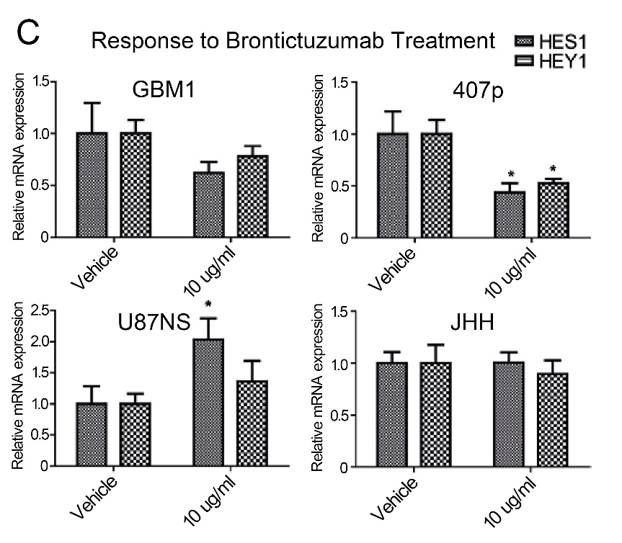
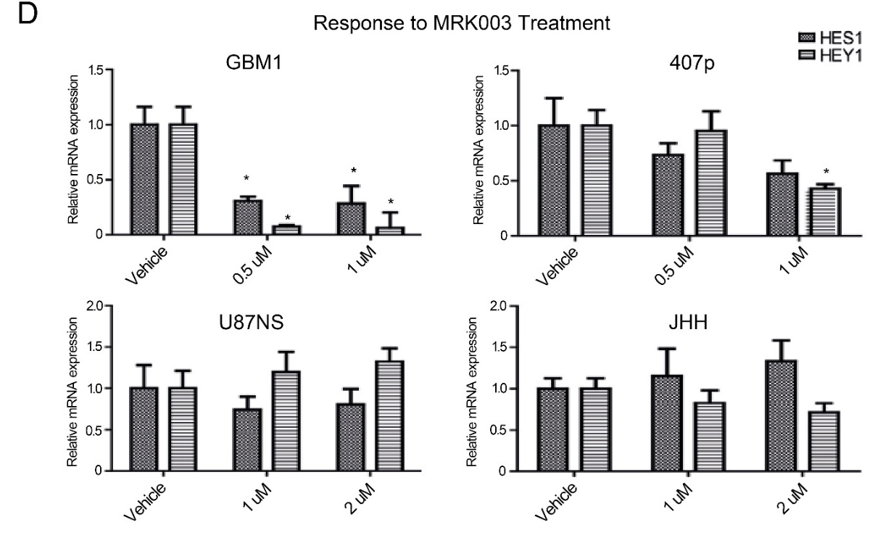
Suppl. Figure S2

Slide 4
Suppl. Figure S3

Slide 5
Suppl. Figure S4
GBM1
407p

Slide 6
Suppl. Figure S5

Slide 7
Suppl. Figure S6

Slide 8
Suppl. Figure S7

Slide 9
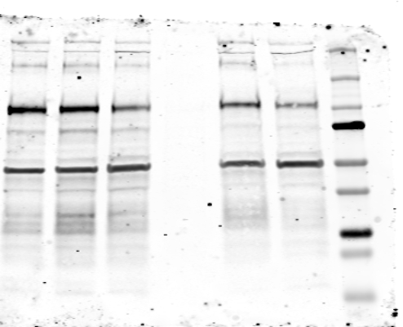
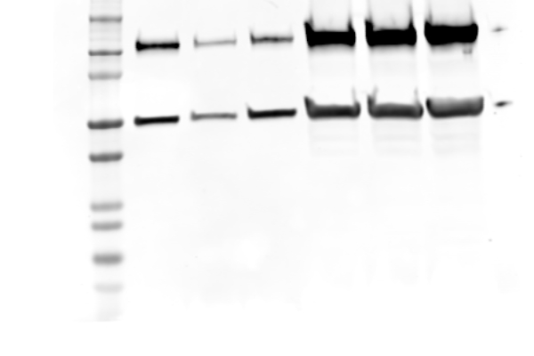
Suppl. Figure S8
GBM1
pLKO.1
N 1.1
N 1.3
407p
pLKO.1
N 1.1
N 1.3
Notch1
Notch1
B-Actin
B-Actin

Slide 10
Suppl. Figure S9
Cleaved Notch1
GAPDH
DMSO
DMSO
BRON
BRON
DMSO
DMSO
DMSO
BRON
DMSO
BRON
BRON
BRON
DMSO
407p
DMSO
BRON
GBM1
BRON
407p
GBM1
100kDa
35kDa
GAPDH

