Slide 1
Supplementary Figure 1
A: Human cytomegalovirus infection pathway identified with ivermectin-related proteins by KEGG pathway enrichment analysis.
B: Human papillomavirus infection pathway identified with ivermectin-related proteins by KEGG pathway enrichment analysis.
C: Epstein-Barr virus infection pathway identified with ivermectin-related proteins by KEGG pathway enrichment analysis.
D: Human immunodeficiency virus 1 infection pathway identified with ivermectin-related proteins by KEGG pathway enrichment analysis.

Slide 2
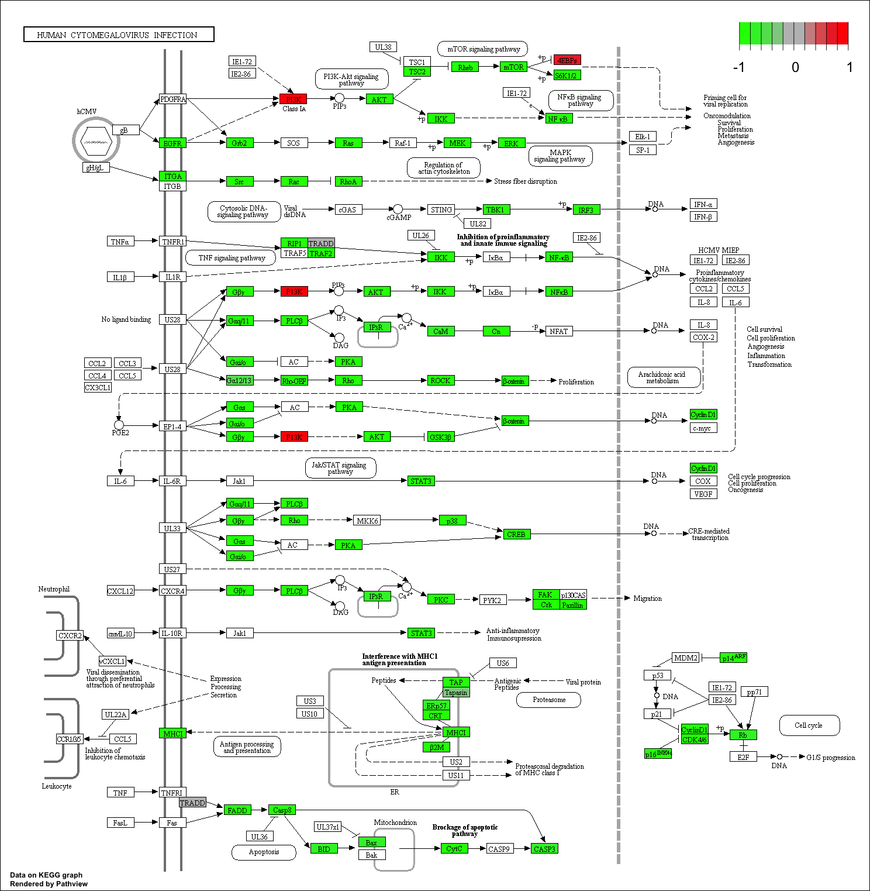
A

Slide 3
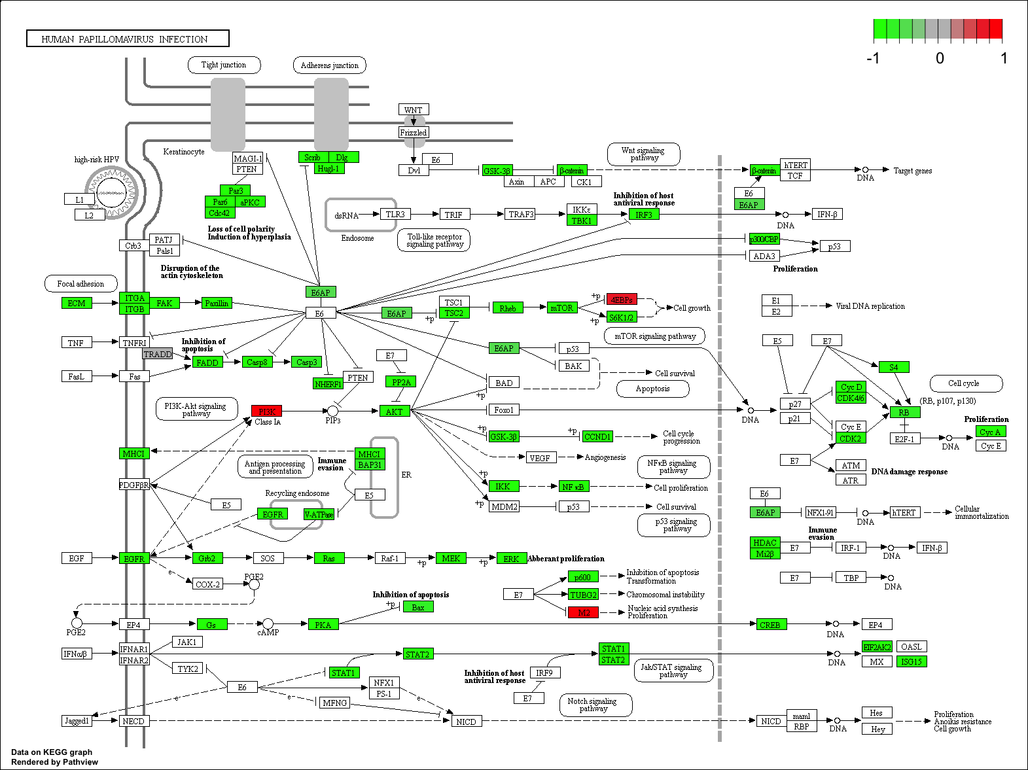
B

Slide 4
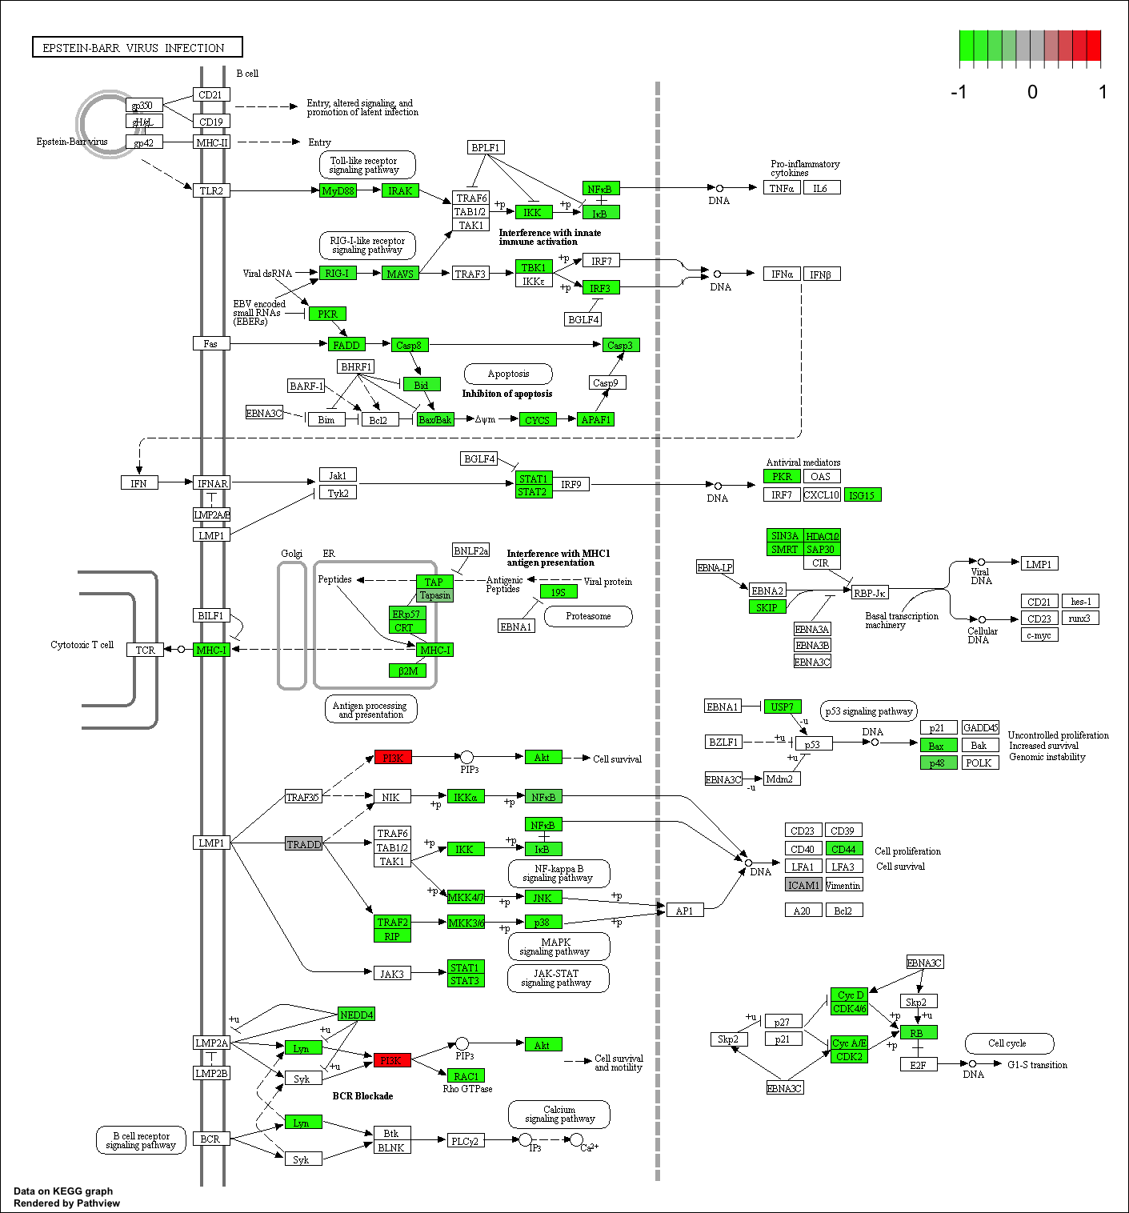
C

Slide 5
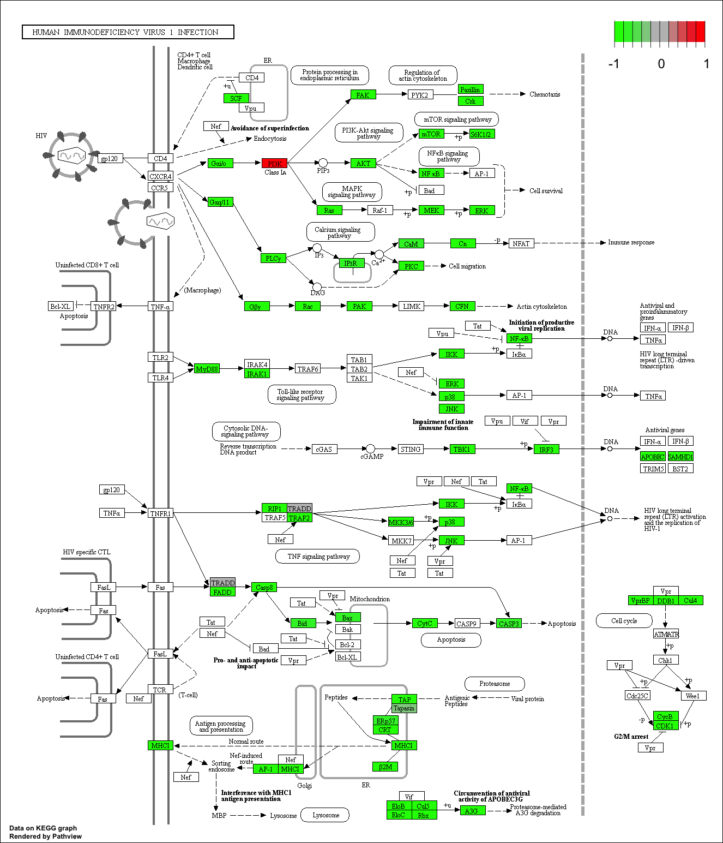
D

