Slide 1
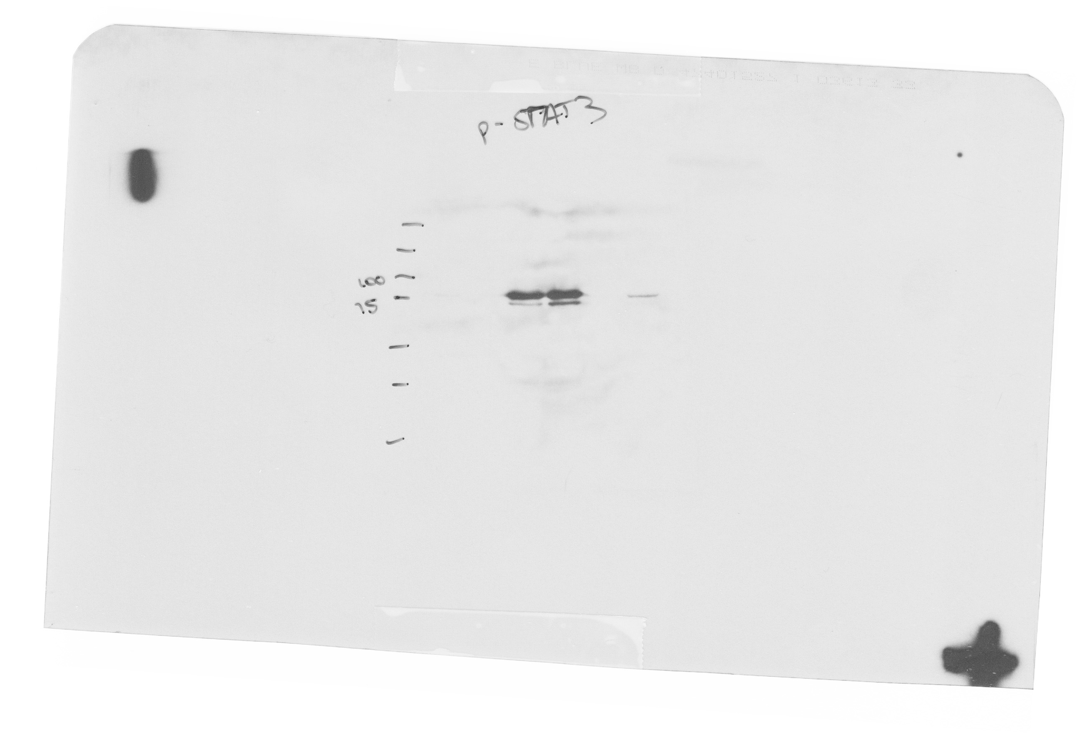
Phospho-STAT3
200
150
100
75
50
37
25

Slide 2
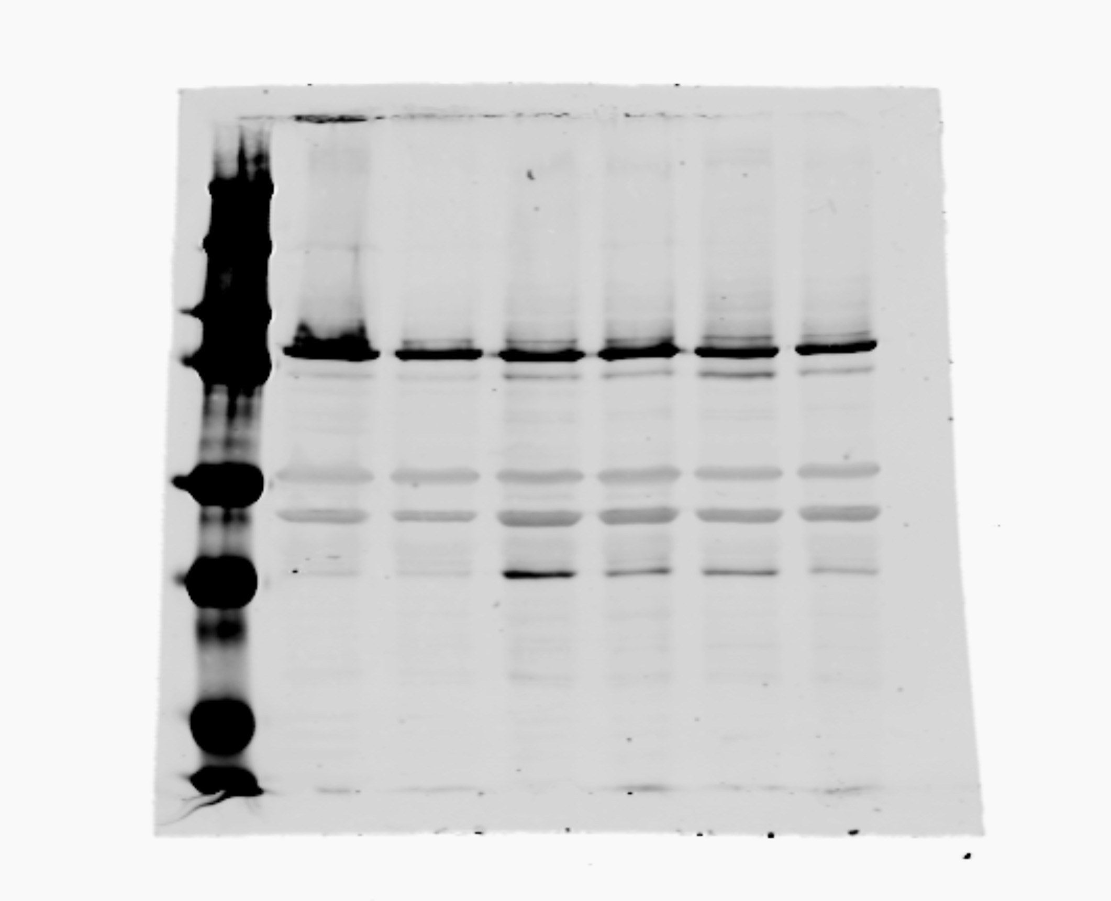
Total STAT3
200
150
100
75
50
37
25

Slide 3
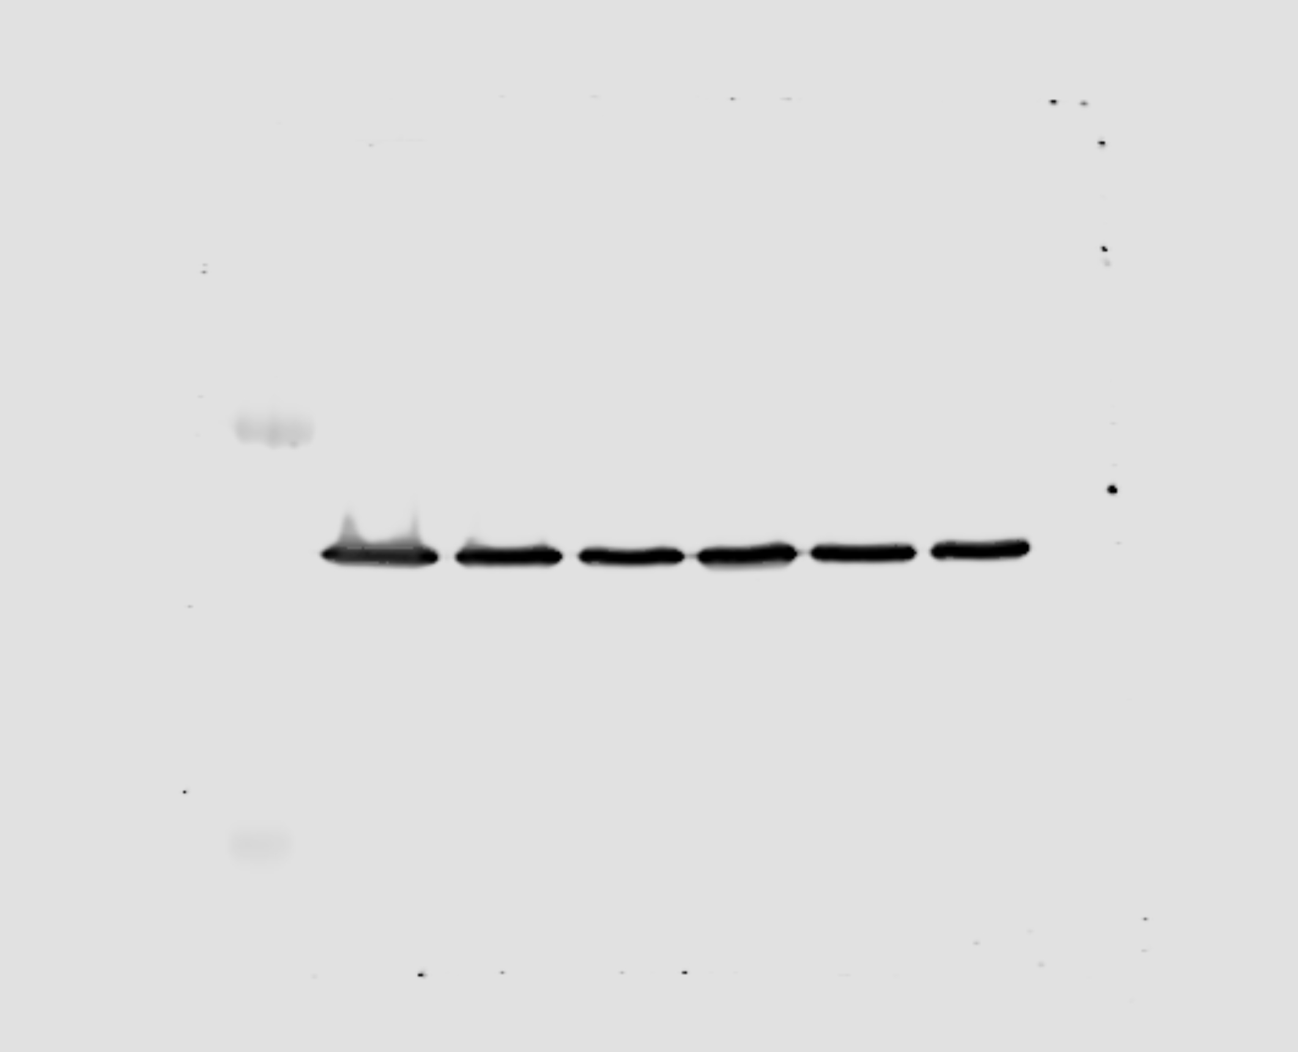
Tubulin
200
150
100
75
50
37
25

