Slide 1
AML- Leukemic Stem Cell
gating at diagnosis and in MRD
Department of Hematology
VU University Medical Center, Cancer Center Amsterdam
Amsterdam, The Netherlands

Slide 2
Contents
Content of LSC tube ……………………………………………………… 3
How to identify LSCs in a diagnosis/f-up AML ………………. 4
Analyzing samples (WBC, lymphocytes and blast cells) … 5
Gating CD34+ blasts …………………………………………………….. 6
Gating CD38^{low} progenitors ………………………………………….. 7
Gating CD38^{verylow} stem cells ………………………………………… 8
Determining LSC/HSC …………………………………………………… 9-21
CD33 How to gate CD33 positivity …… 10-11
CD44 How to gate CD44 positivity …… 12-14
CD45RA How to gate CD45RA positivity … 15-16
CD123 How to gate CD123 positivity …… 17-18
PE-Combi How to gate Combi positivity …… 19-21
Back gating ……..………………………………………… 22-24
Gating summary …………………………………………………………… 25
How to report results …………………………………………………… 26
Examples ……………………………………………………………………… 27-28

Slide 3
Contents of LSC tube
Version 1 | FITC | PE | PerCP-Cy5.5 | Pe-Cy7 | APC | APC-H7 | BV421 | HV500c
 | CD45RA (L48) | CLEC12A (50C1) | CD123 (7G3) | CD33 (WM53) | CD38 (HB7) | CD44 (G44-26) | CD34 (8G12) | CD45 (2D1)
 |  | TIM-3 (7D3)
 |  | CD7 (MT701)
 |  | CD11b (D12)
 |  | CD22 (S-HCL-1)
 |  | CD56 (My31)
Version 2 | FITC | PE | PerCP-Cy5.5 | Pe-Cy7 | APC | APC-H7 | BV421 | HV500c
 | CD45RA (L48) | CLEC12A (50C1) | CD123 (7G3) | CD34 (8G12) | CD38 (HB7) | CD44 (G44-26) | CD33 (WM53) | CD45 (2D1)
 |  | TIM-3 (7D3)
 |  | CD7 (MT701)
 |  | CD11b (D12)
 |  | CD22 (S-HCL-1)
 |  | CD56 (My31)

Slide 4
How to identify LSCs in a diagnosis/f-up AML
Combination of markers:
Blasts (CD45^{dim}/SSC^{low})
Primitive population (CD34⁺)
Stem cell compartment (CD38⁻)
Aberrant marker:
- CD45RA
- CLEC12A / TIM-3 / CD7 / CD11b / CD22 and/or CD56 (= ´Combi´)
- CD33
- CD123
- CD44

Slide 5
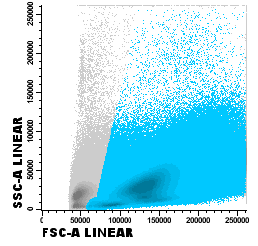
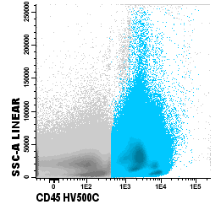
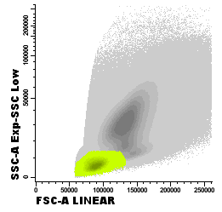
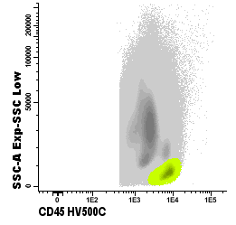
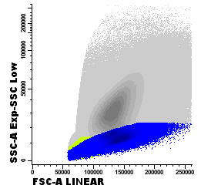
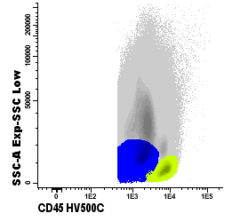
Analyzing samples
1. Gate white blood cells (WBC)
- step 1: exclude FSC^{low} cells
- step 2: exclude CD45^{low} cells
2. Gate lymphocytes
- step 3: gate CD45^{high}/SCC^{low} population
- step 4: gate FSC^{low}/SSC^{low} population
3. Gate blast cells
- step 5: gate CD45^{dim}/SSC^{low} population
- step 6: extra gate around SSC^{low} cells
SSC
SSC
FSC
CD45 HV500C
SSC
SSC
FSC
CD45 HV500C
SSC
SSC
FSC
CD45 HV500C
WBC lymphocytes blast cells

Slide 6
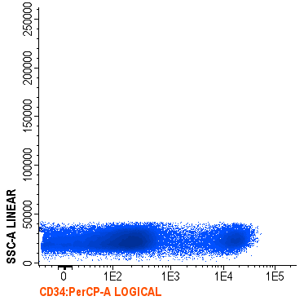
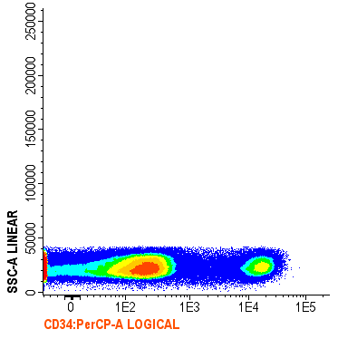
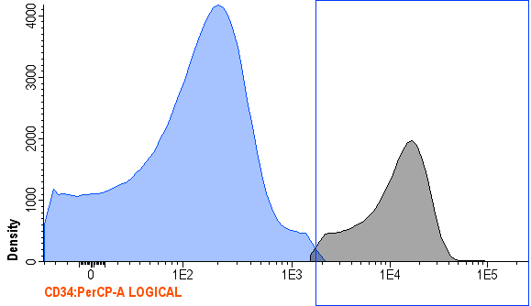
Gating CD34+ blasts
Specific expression level for appropriate cut-off differs per sample. A histogram may help. Never gate through a population with a homogeneous distribution of marker of interest. Important: CD34 expression may be higher or lower than normal CD34+ cells
CD34 BV421
CD34 BV421
CD34 BV421
As a guideline, not per se for gating purposes
#2813
blast cells

Slide 7
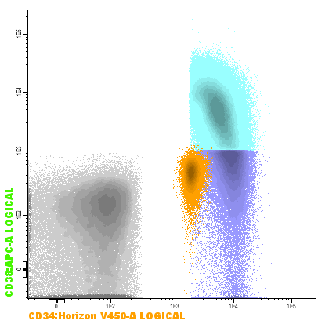
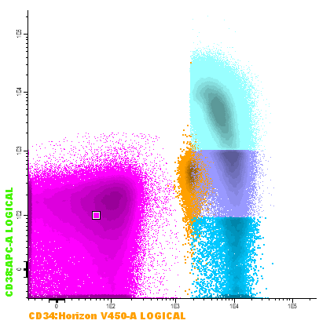
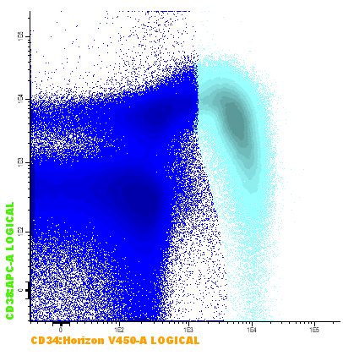
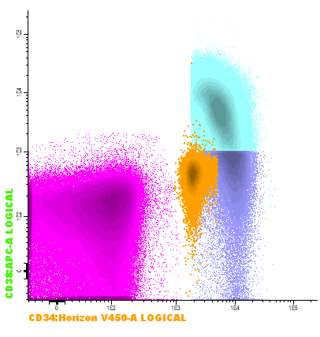
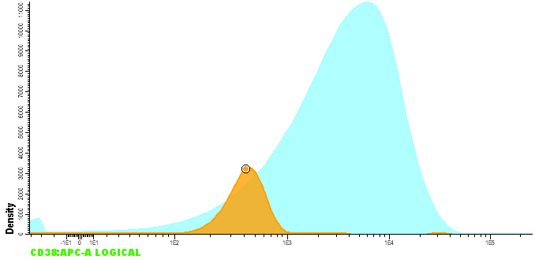
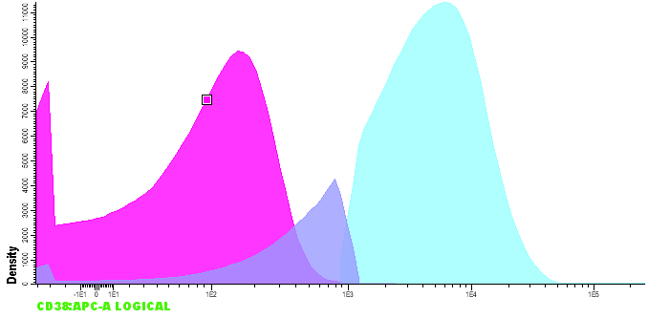
Gating CD38^{low} progenitors
Both cut-off of CD38^{low} (progenitors: this slide) and CD38^{verylow} (stem cells: next slide) may differ between samples. If possible use upper limit of spherotech beads, if not possible use ‘red/dead fraction’ (i.e. CD45-/SSC^{low}/FSC^{low} events/debris) or choose 10³ as cut-off point
(2)
Cut-off for CD38^{low}
above red fraction,
above 99% of beads,
often close to 10³
Cut-off for CD38^{low}
above red fraction,
above 99% of beads,
often close to 10³
CD38 APC
CD38 APC
CD38 APC
Cut-off for CD38^{verylow}
mean of the red fraction,
below the beads,
often close to 10²
CD34 BV421
CD34 BV421
CD34 Horizon V450
CD38 APC
CD38 APC
#2622
Blast cells CD34+ blast cells red fraction Spherotech beads CD34+CD38low

Slide 8
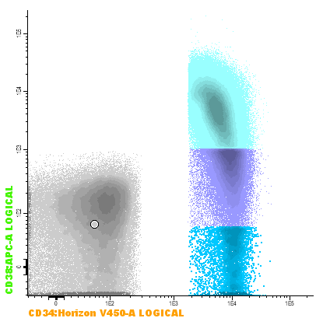
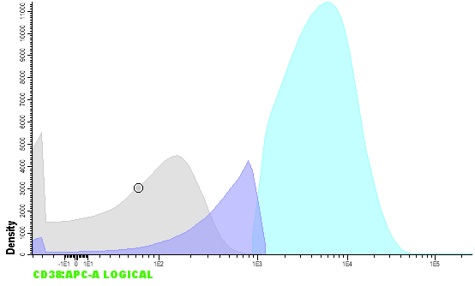
Gating CD38^{verylow} stem cells
Preferably use median of ‘red/dead fraction’ (i.e. CD45-/SSClow/FSClow events/debris) (make sure this fraction has no CD38^{high} sup-population). If not possible, gate below the bulk of spherotech beads or choose 10² as cut-off point
(2)
Cut-off for CD38^{low}
above red fraction,
above 99% of beads,
often close to 10³
CD38 APC
CD38 APC
Cut-off for CD38^{verylow}
mean of the red fraction,
below the beads,
often close to 10²
CD38 APC
CD38 APC
Cut-off for CD38^{verylow}
median of the red fraction,
below the beads,
often close to 10²
CD34 BV421
CD34 BV421
CD34 BV421
CD34 Horizon V450
CD38 APC
CD38 APC
CD38 APC
#2622
Blast cells CD34+ blast cells red fraction Spherotech beads CD34+CD38low CD34+CD38verylow

Slide 9
Rationale behind red/dead fraction and beads
In AML flow cytometry, gating of high/low expression is often relative to expression found on reference populations rather than using set cut-offs. For the gating of CD34+CD38^{low} or CD34+CD38^{verylow} no true reference populations could be identified. We therefore tested the use of beads and the red/dead fraction.
Spherotech beads: Beads with negative signal in the APC channel, has its upper limit around 10³ which correlated with the gating of the progenitor population in previous studies. Interestingly, while the tail of the beads is likely noise, the lower limit in many cases was found to be around 10², which was more in common with the gating of stem cells in previous studies (Terwijn, et al. PLoS One. 2014).
Red/dead fraction: To identify background fluorescence of antigen-negative cells and other particles (e.g. debris) were gated. In this case, the ‘red/dead’ fraction was gated, showing its upper limit to be around 10³ and its median around 10². Red/dead is identified as: CD45-/SSClow/FSClow events/debris; make sure this fraction has no CD38^{high} sup-population
Overall; we suggest to use the 10² and 10³ cutoff, until a true objective cutoff is identified.

Slide 10
Determining LSC/HSC
After defining CD38^{low} and CD38^{verylow} population, the other makers in the LSC tube (CD33, CD44, CD123, CD45RA and Combi) are used to define normal hematopoietic stem cells/progenitor cells versus leukemic stem cells/progenitors cells.
Specific features on expression of these markers are described in the next slides. Positivity/negativity of marker expression is preferably defined by fluorescence of spherotech beads or of a negative lymphocyte (sub)population.
Marker negative
or
Marker positive
CD38 APC
CD34 BV421
CD34+ blast cells red fraction CD34+CD38low CD34+CD38verylow

Slide 11
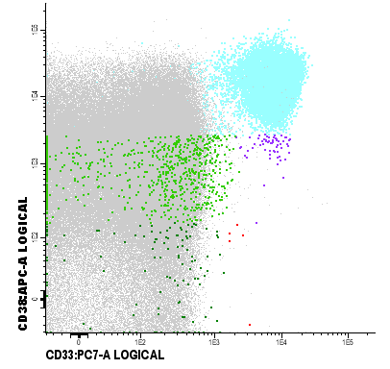
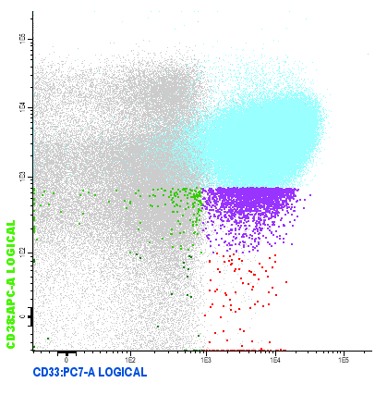
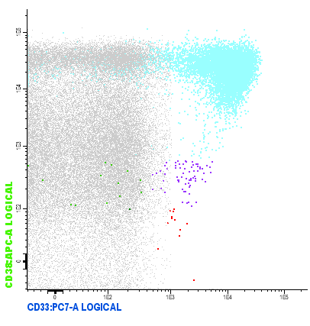
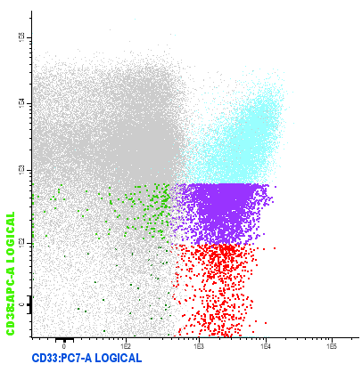
CD33
CD33 is especially useful at time of diagnosis. CD33 is usually weakly expressed on HSCs at time of diagnosis but can be up-regulated on HSC after treatment.
Diagnosis examples:
CD38 APC
CD38 APC
CD38 APC
CD38 APC
CD33 PC7
CD33 PC7
CD33 PC7
CD33 PC7
#2518, 2534, 2534, 2506
lymphocytes CD34+CD38+ blasts CD34⁺/CD38^{low}/marker^{neg}, CD34⁺/CD38^{low}/marker^{pos}, CD34⁺/CD38^{verylow}/marker^{neg}, CD34⁺/CD38^{verylow}/marker^{pos}

Slide 12
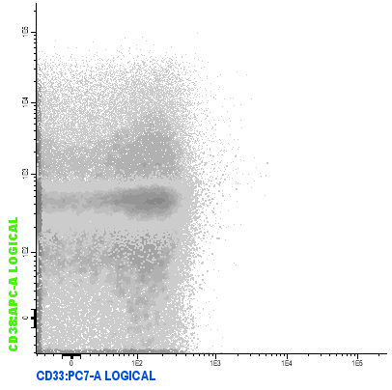
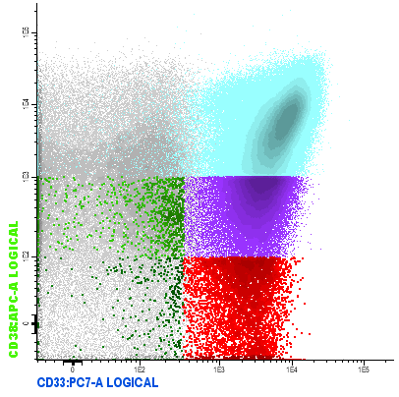
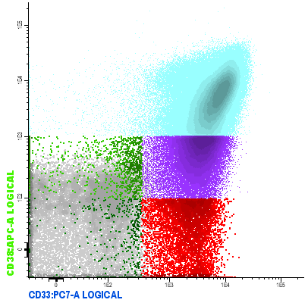
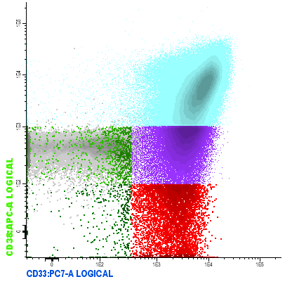
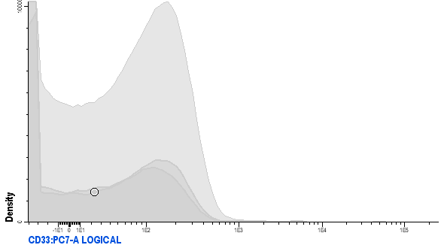
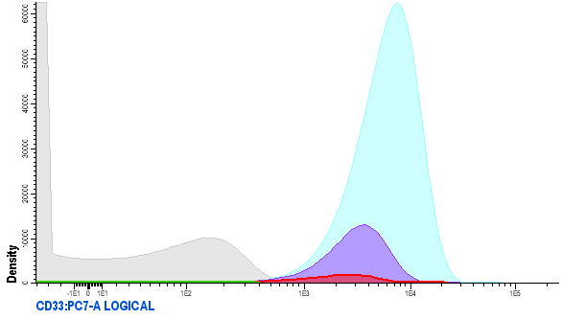
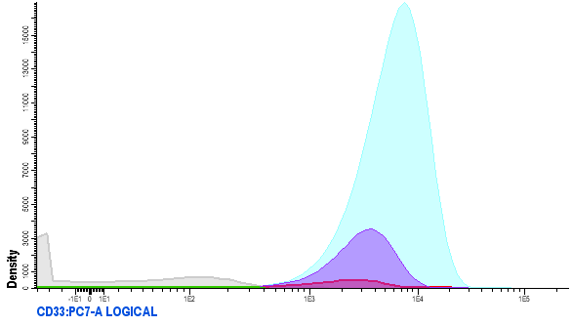

How to gate CD33 positivity
When gating for marker positivity/negativity, both lymphocytes, red fraction and/or beads can be used as these are all CD33⁻ as shown here.
overlay lymphocytes red fraction spherotech beads
CD38 APC
CD38 APC
CD38 APC
CD38 APC
CD33 PC7
CD33 PC7
CD33 PC7
CD33 PC7
lymphocytes
beads
red fraction
CD33 PC7
CD33 PC7
CD33 PC7
CD33 PC7
#2622
negative population CD34+CD38+ blasts CD34⁺/CD38^{low}/marker^{neg}, CD34⁺/CD38^{low}/marker^{pos}, CD34⁺/CD38^{verylow}/marker^{neg}, CD34⁺/CD38^{verylow}/marker^{pos}

Slide 13
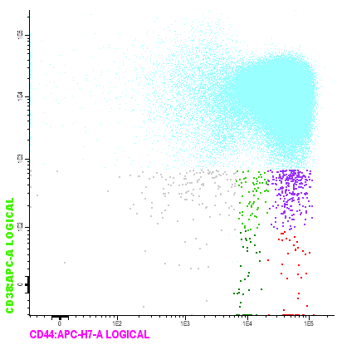
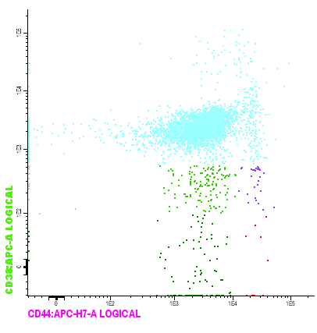
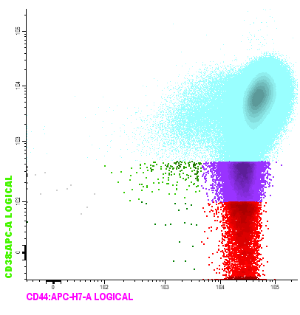
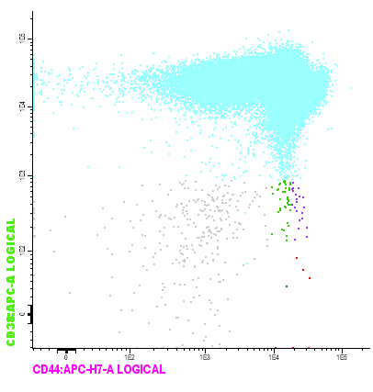
CD44
CD44 is highly expressed on HSCs (CD44⁺⁺) at time of diagnosis and F-up AML. LSCs are CD44⁺⁺⁺. CD44^{-/dim} are indicative for a-specific events. CD44 expression is only used as discriminative marker when there is unambiguous overexpression
Diagnosis examples:
Not clear: HSCs or LSCs Not clear: HSCs or LSCs
not used as LSC marker in this patient not used as LSC marker in this patient
a-specific HSCs LSCs HSCs LSCs
CD38 APC
CD38 APC
CD38 APC
CD38 APC
CD38 APC
CD38 APC
CD38 APC
CD38 APC
CD33 PC7
CD33 PC7
CD33 PC7
CD44 APC-H7
CD44 APC-H7
CD44 APC-H7
CD44 APC-H7
CD33 PC7
#2509, 2537, 2542, 2542
lymphocytes CD34+CD38+ blasts CD34⁺/CD38^{low}/marker^{neg}, CD34⁺/CD38^{low}/marker^{pos}, CD34⁺/CD38^{verylow}/marker^{neg}, CD34⁺/CD38^{verylow}/marker^{pos}

Slide 14
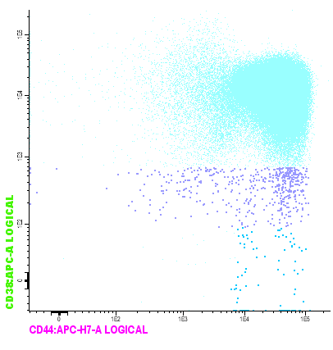
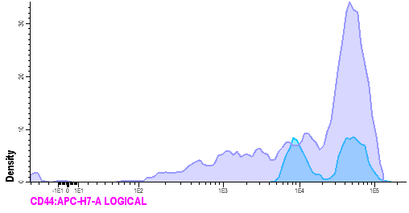
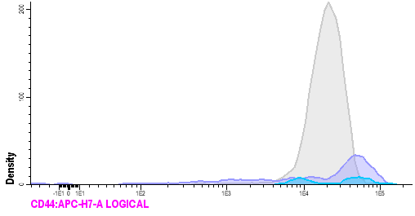
How to gate CD44 positivity
Gating CD44 overexpression is relatively difficult. However, looking at the pattern of the total CD38^{low} and CD38^{verylow} together with lymphocytes ( CD44⁺⁺) might help.
Relatively easy example:
CD38 APC
CD38 APC
CD38 APC
CD44 APC-H7
CD44 APC-H7
Expression of CD44 on LSCs is often higher than that of the lymphocytes, while HSCs have less expression.
CD44 APC-H7
CD44 APC-H7
#2509
CD34⁺ blast CD34⁺CD38^{low} CD34⁺CD38^{verylow} CD34⁺/CD38^{low}/marker^{neg}, CD34⁺/CD38^{low}/marker^{pos}, CD34⁺/CD38^{verylow}/marker^{neg}, CD34⁺/CD38^{verylow}/marker^{pos}

Slide 15
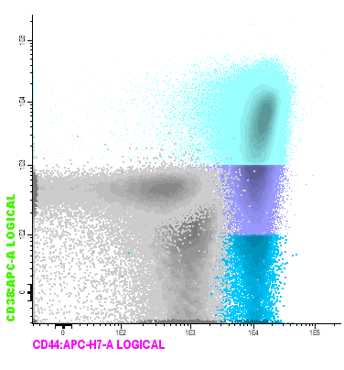
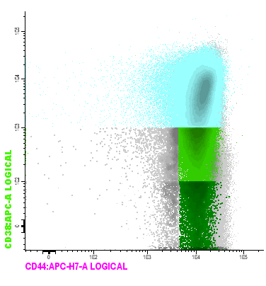
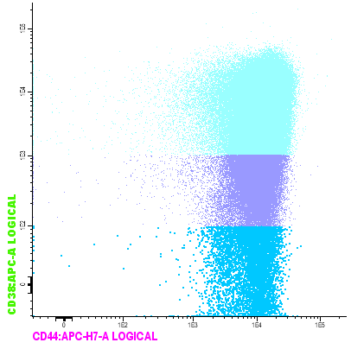
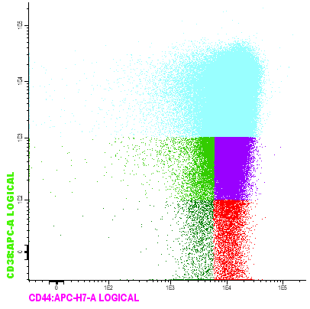
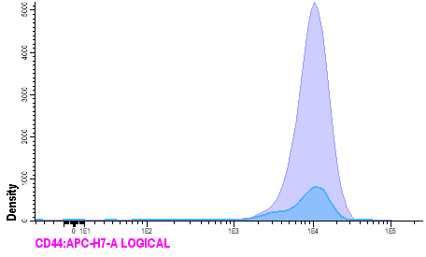

How to gate CD44 positivity
Difficult example: histogram distinguishes two populations in CD34⁺CD38^{verylow}. Red fraction and spherotech beads support this cut-off point.
beads
CD38 APC
CD38 APC
Red fraction
CD38 APC
CD44 APC-H7
CD44 APC-H7
CD44 APC-H7
Overexpression or normal CD44 expression which could be found on HSCs?
Not clearly distinctive
CD44 APC-H7
#2622
negative population CD34+CD38+ blasts CD34⁺/CD38^{low}/marker^{neg}, CD34⁺/CD38^{low}/marker^{pos}, CD34⁺/CD38^{verylow}/marker^{neg}, CD34⁺/CD38^{verylow}/marker^{pos}

Slide 16
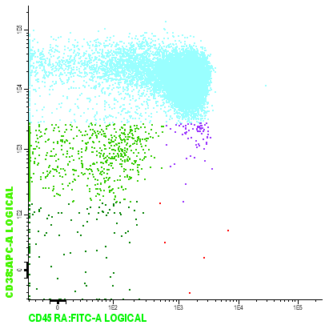
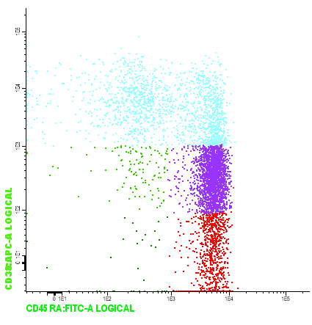
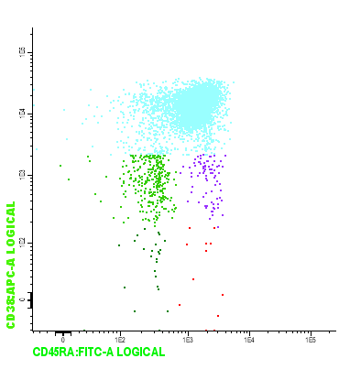
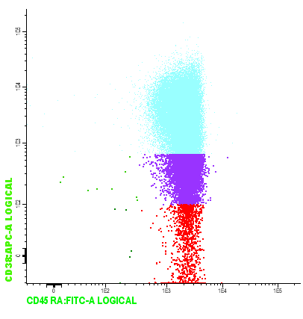
CD45RA
CD45RA is not expressed on HSCs and is a stable marker in both diagnosis and f-up. Mostly seen with clear separation between HSCs and LSCs.
Examples:
CD38 APC
CD38 APC
CD38 APC
CD38 APC
CD45RA FITC
CD45RA FITC
CD45RA FITC
CD45RA FITC
#2518, 2535, 2452, 2453
CD34+CD38+ blasts CD34⁺/CD38^{low}/marker^{neg}, CD34⁺/CD38^{low}/marker^{pos}, CD34⁺/CD38^{verylow}/marker^{neg}, CD34⁺/CD38^{verylow}/marker^{pos}

Slide 17
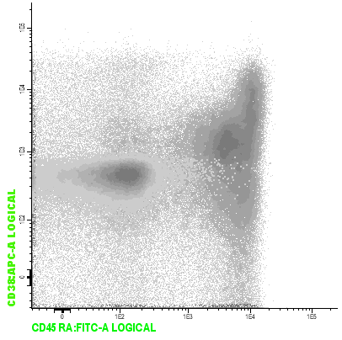
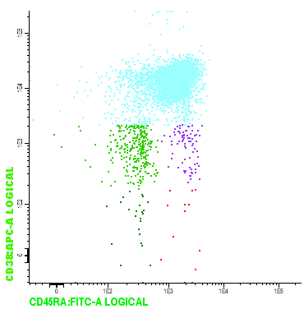
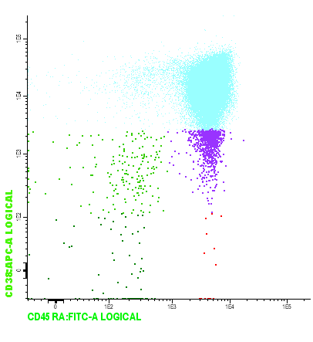
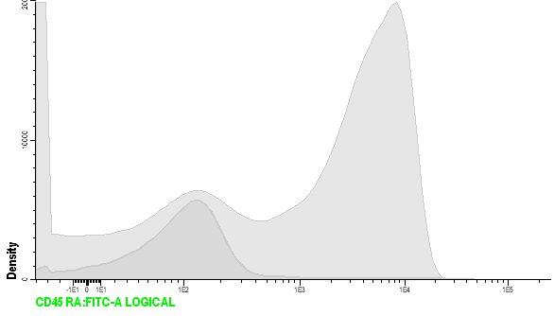
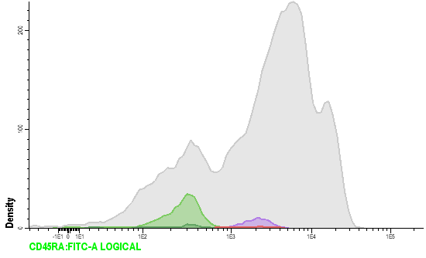
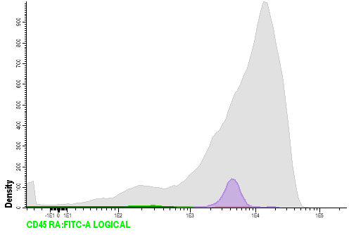
How to gate CD45RA positivity
When gating the CD45RA^{negative} fraction, the lymphocytes or spherotech beads can be used as negative control. Lymphocytes are clearly divided in two populations in a histogram
beads
Negative lymphocytes
positive lymphocytes
beads
CD38 APC
CD38 APC
CD38 APC
CD45RA FITC
CD45RA FITC
CD45RA FITC
CD45RA FITC
CD45RA FITC
CD45RA FITC
#2531
negative population CD34+CD38+ blasts CD34⁺/CD38^{low}/marker^{neg}, CD34⁺/CD38^{low}/marker^{pos}, CD34⁺/CD38^{verylow}/marker^{neg}, CD34⁺/CD38^{verylow}/marker^{pos}

Slide 18




CD123
CD123 is similar to CD33: weakly expressed on HSCs in AML at diagnosis. CD123 can be up-regulated on HSCs after treatment.
Examples:
CD38 APC
CD38 APC
CD38 APC
CD38 APC
CD123 PerCP
CD123 PerCP
CD123 PerCP
CD123 PerCP
CD34+CD38+ blasts CD34⁺/CD38^{low}/marker^{neg}, CD34⁺/CD38^{low}/marker^{pos}, CD34⁺/CD38^{verylow}/marker^{neg}, CD34⁺/CD38^{verylow}/marker^{pos}

Slide 19








How to gate CD123 positivity
When gating for marker positivity/negativity both lymphocytes, red fraction and beads can be used as these are all CD123⁻ as shown here.
overlay lymphocytes red fraction spherotech beads
CD38 APC
CD38 APC
CD38 APC
CD38 APC
CD123 PerCP
CD123 PerCP
CD123 PerCP
CD123 PerCP
lymphocytes
beads
red fraction
CD123 PerCP
CD123 PerCP
CD123 PerCP
CD123 PerCP
#2622
negative population CD34+CD38+ blasts CD34⁺/CD38^{low}/marker^{neg}, CD34⁺/CD38^{low}/marker^{pos}, CD34⁺/CD38^{verylow}/marker^{neg}, CD34⁺/CD38^{verylow}/marker^{pos}

Slide 20




PE-Combi
Positivity of at least one of the six markers in the combi-PE channel is needed to discriminate LSCs from HSCs
Examples:
CD38 APC
CD38 APC
CD38 APC
CD38 APC
CD38 APC
CD38 APC
CD38 APC
CD38 APC
Combi PE
Combi PE
CD123 PerCP
CD123 PerCP
Combi PE
CD123 PerCP
CD123 PerCP
Combi PE
#2534, 2452
CD34+CD38+ blasts CD34⁺/CD38^{low}/marker^{neg}, CD34⁺/CD38^{low}/marker^{pos}, CD34⁺/CD38^{verylow}/marker^{neg}, CD34⁺/CD38^{verylow}/marker^{pos}

Slide 21



How to gate PE-Combi positivity
Since the PE channel contains multiple markers, there is no negative sample-population which could be used as reference. In this case are beads the best discriminator (red fraction in case of retrospective analyses).
Example with lots of stem cells
beads
red fraction
CD38 APC
CD38 APC
Combi PE
Combi PE
Combi PE
#2622
negative population CD34+CD38+ blasts CD34⁺/CD38^{low}/marker^{neg}, CD34⁺/CD38^{low}/marker^{pos}, CD34⁺/CD38^{verylow}/marker^{neg}, CD34⁺/CD38^{verylow}/marker^{pos}

Slide 22



How to gate PE-Combi positivity
Since the PE channel contains multiple markers, there is no negative sample-population which could be used as reference. In this case are beads the best discriminator (red fraction in case of retrospective analyses).
Example with few stem cells
beads
red fraction
red fraction
CD38 APC
CD38 APC
CD38 APC
CD38 APC
Combi PE
Combi PE
Combi PE
Combi PE
Combi PE
Combi PE
#2622
negative population CD34+CD38+ blasts CD34⁺/CD38^{low}/marker^{neg}, CD34⁺/CD38^{low}/marker^{pos}, CD34⁺/CD38^{verylow}/marker^{neg}, CD34⁺/CD38^{verylow}/marker^{pos}

Slide 23







Back-gating (1)
For fine-tuning, we recommend back-gating after gating marker^{positive} LSC/marker^{negative} HSC. Back-gating serves two aims: 1) in cases of overlapping LSC and HSC population (e.g. slide 18), LSC and HSC may be purified by backward/forward gating in FSC/SSC, CD34/CD38 and CD34/CD45 bivarial plots.
BEFORE: The circled HSC population (green) is likely part of the neoplastic population
FSC-A CD34 BV421 CD34 BV421
SSC SSC
CD38 APC CD38 APC
CD45 V500c CD45 V500c
CD38 APC
CD123 PerCP
FSC-A CD34 BV421 CD34 BV421
CD34⁺/CD38^{verylow}/marker^{neg}, CD34⁺/CD38^{verylow}/marker^{pos}

Slide 24






Back-gating (2)
Differences in scatter properties between LSC and HSC are further elucidated in Terwijn M et al. Leukemic stem cell frequency: a strong biomarker for clinical outcome in acute myeloid leukemia. PLoS One 2014; 9: e107587.
AFTER: Gated on CD123 expression together with scatter properties
FSC-A CD34 BV421 CD34 BV421
FSC-A CD34 BV421 CD34 BV421
SSC SSC
CD38 APC CD38 APC
CD45 V500c CD45 V500c
CD38 APC
CD123 PerCP
CD123 PerCP
FSC-A CD34 BV421 CD34 BV421
CD34⁺/CD38^{verylow}/marker^{neg}, CD34⁺/CD38^{verylow}/marker^{pos}

Slide 25

Back-gating (3)
2) To exclude a-specific events after cells are gated for abberant marker expression (a ‘clean’ example see below, first gated on CD45RA expression
1. Are the CD38^{low}/CD38^{verylow} events clustered in the lower SSC/FSC? Scatter may be seen higher in the FSC and is likely a-specific | 2. Is there a-specificity in lower CD34? In most cases, stem cells and progenitors will be seen as one ‘tail’ | 3. Are there scattered events in a CD45/CD34 plot? | 4. Does CD44 expression gives any advice in this case? CD44^{low}/CD44^{neg} can be associated with a-specificity
#2509
CD34+CD38+ blasts CD34⁺/CD38^{low}/marker^{neg}, CD34⁺/CD38^{low}/marker^{pos}, CD34⁺/CD38^{verylow}/marker^{neg}, CD34⁺/CD38^{verylow}/marker^{pos}

Slide 26




Selection of best marker (1)
LSC marker/LSC marker plots are most illustrative in the identification of the marker best describing the total LSC population. Example 2:
Stem cells gated on presence of high CD33 expression:
CD33 (and also CD123) is not sufficient to capture the whole LSC population, and includes HSC
CD45RA/Combi plot is most illustrative. Both CD45RA and Combi are the best markers in this sample
LSC gated on CD33 expression .
LSC gated on Combi
CD123 gating
would select
part of LSC
LSC
LSC
CD33
CD33
CD123
CD45RA
HSC
CD45RA
HSC
CD45RA
Combi
Combi
Combi
Combi
#2879
Lymphocytes, CD34⁺/CD38^{verylow}/marker^{neg}, CD34⁺/CD38^{verylow}/marker^{pos}

Slide 27

Selection of best marker (2)
LSC marker/LSC marker plots are most illustrative in the identification of the marker best describing the total LSC population. Example 2:
Stem cells gated on presence of high CD123 expression:
- CD123 and CD33 both sufficient to identify LSCs, whereas in this case Combi and CD45RA do not
LSC gated on CD123 expression .
LSC
CD123
CD45RA
CD123
CD33
HSC
Combi
Combi
CD45RA
CD123
Lymphocytes, CD34⁺/CD38^{verylow}/marker^{neg}, CD34⁺/CD38^{verylow}/marker^{pos}

Slide 28
Gating Summary
  WBC, beads (when included), red/dead (CD45^{negative}) population
  lymphocytes blast cells
  CD34⁺ blast cells use lymphocytes as reference
  CD38^{low} CD38^{verylow} use beads as reference
- CD45RA + vs. - - CD45RA + vs. - For example + versus – : expression in LSC versus HSC - CD33 +/(+) vs. +/- - CD33 +/(+) vs. +/-
  - CD44 +++ vs. ++ - CD44 +++ vs. ++
  - CD123 +/(+) vs. +/- - CD123 +/(+) vs. +/-
  - PE-combi + vs. - - PE-combi + vs. –
  Back gating

Slide 29
How to report results
Upload the FCS files onto www.box.com in order to let us check
Analyze the data on your own and sent us the following information/pictures
  - (1) SSC/FSC, (2) SSC/CD45, (3) SSC/CD34 plots
  To show location of populations lymphocytes, blasts, CD34⁺ blasts, stem cells
  - (4) CD38/CD34 plot with complete CD34⁺ fraction and reference population
  To show gating of CD34⁺CD38^{low} and CD34⁺CD38^{verylow}
  - (5) CD38/stem cell marker plot with complete CD34+ fraction and reference population
  To show gating of marker positivity/negativity
  - Do this for all markers
  - (optional 6,7,8,9) stem cell marker of interest versus other stem cell marker
  To compare positivity/negativity with positivity/negativity of other markers and to fine-tune LSC versus HSC frequency.
  - define LSC frequency with the different markers and assess final LSC frequency
  - See following slides as template/example, both starting with CD45RA expression
Notes:
Login for www.box.com:
User: an.snel@vumc.nl
Pw: mrdopleiding

Slide 30










(1)
(2)
(3)
Stem cells gated on CD45RA negativity/positivity
  (1) SSC/FSC
  (2) SSC/CD45
  (3) SSC/CD34
  (4) CD38/CD34
  (5) CD38/stem cell marker
  (5b) gating strategy (negative lymphocytes)
  (optional 6,7,8,9) stem cell marker of interest versus other stem cell marker
Verification of leukemic phenotype with other markers (graph 6-9). Starting with CD45RA, the combi results (6) and CD44 (7) match with CD45RA, while CD123 (7) and CD33 (9) show overlap between LSC and HSC
Population |  | # of events
 | white blood cells | 476052
 | Lymphocytes | 29736
 | Blast cells | 209402
 | CD34⁺ blasts | 163758
 | CD34⁺CD38^{low} blasts | 489
 | CD34⁺/CD38^{low}/marker^{neg} | 169
 | CD34⁺/CD38^{low}/marker^{pos} | 320
 | CD34⁺CD38^{verylow} blasts | 113
 | CD34⁺/CD38^{verylow}/marker^{neg} | 49
 | CD34⁺/CD38^{verylow}/marker^{pos} | 64
 | Beads | Not in sample
(4)
(5)
Percentages of WBC
(5b)
0.036%
0.067%
0.010%
0.013%
(6)
(7)
(8)
(9)

Slide 31









(1)
(2)
(3)
Stem cells gated on CD45RA negativity/positivity
  (1) SSC/FSC
  (2) SSC/CD45
  (3) SSC/CD34
  (4) CD38/CD34
  (5) CD38/stem cell marker
  (5b) gating strategy (negative lymphocytes)
  (optional 6,7,8,9) stem cell marker of interest versus other stem cell marker
Verification of leukemic phenotype with other markers (graph 6-8). Starting with CD45RA, the combi results (6) match with CD45RA, while CD123 (7) and CD33 (8) show overlap between LSC and HSC
Population |  | # of events
 | white blood cells | 214005
 | Lymphocytes | 22789
 | Blast cells | 37474
 | CD34⁺ blasts | 6839
 | CD34⁺CD38^{low} blasts | 326
 | CD34⁺/CD38^{low}/marker^{neg} | 227
 | CD34⁺/CD38^{low}/marker^{pos} | 49
 | CD34⁺CD38^{verylow} blasts | 25
 | CD34⁺/CD38^{verylow}/marker^{neg} | 18
 | CD34⁺/CD38^{verylow}/marker^{pos} | 7
 | Beads | Not in sample
(4)
(5)
(5b)
0.106%
0.023%
0.0084%
0.0033%
(6)
(7)
(8)

