Slide 1
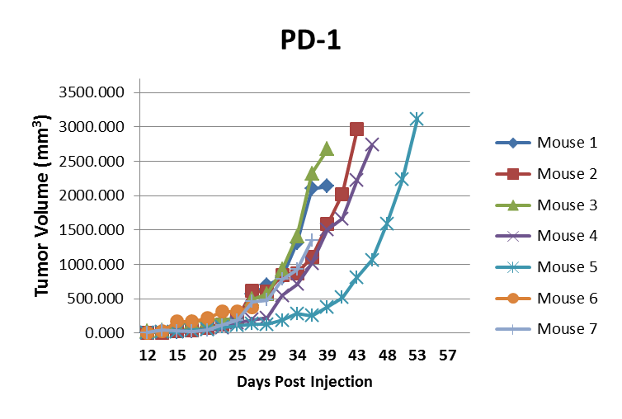
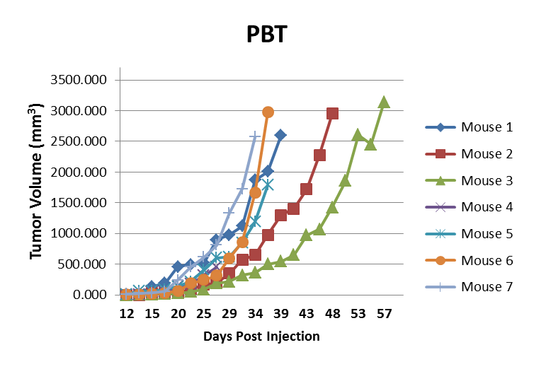
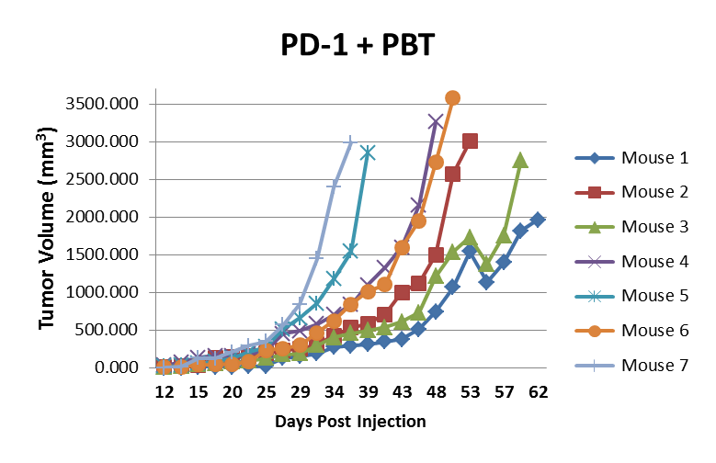
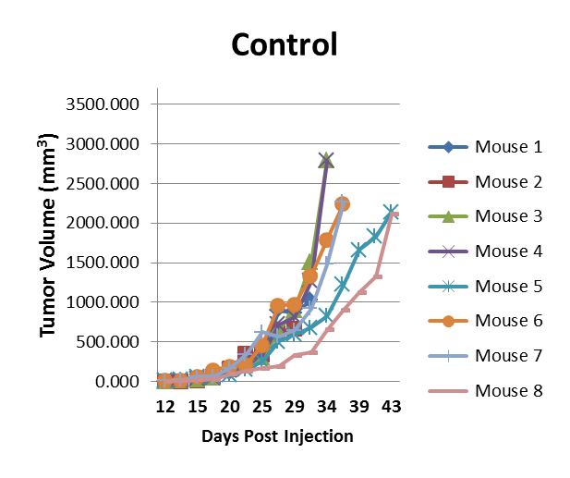
Supplementary Fig. 3
B16F10 Tumor Growth Curves

Slide 2
Supplementary Figure S3. Increased inhibition of B16F10 tumor growth in mice co-treated with PBT and anti-PD-1 mAb compared to mice treated with PBT or anti-PD-1 mAb alone. Mice were subcutaneously injected with 5 x 10⁵ B16F10-sTAC melanoma cells. Doses of 100 µg anti-PD-1 mAb or isotype control mAb were administered on days 10, 13 and 16. On day 14, treatment was initiated with either saline or PBT (0.25% DFMO (w/v) in the drinking water plus Trimer PTI [3 mg/kg, i.p., daily]). Graphs shows B16F10-sTAC tumor growth of individual mice in each treatment group until death.

