Slide 1
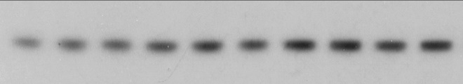
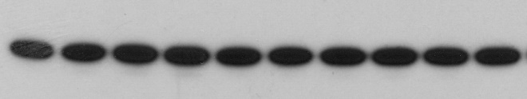
Supplementary Figure 1
AT13387 (nM)
0
1
10
30
67
100
300
670
10³
10⁴
Hsp70
GAPDH
2.5
2
Fold change in Hsp70 level
1.5
1
0.01
0.1
1
10
100
1000
10000
AT13387 (nM)
SF1. Effect of AT13387 on Hsp70 protein expression in UMSCC74B cells. UMSCC74B cells were treated with 0-10⁴ nM AT13387 for 2 hours. Cell lysates were resolved on SDS-PAGE. A. Change in Hsp70 protein level was assessed by immunoblotting (n=3). B. Fold change in Hsp70 protein level was determined by densitometric analysis. GAPDH was used as a loading control.

Slide 2


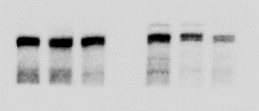






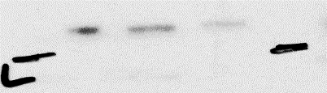


Supplementary Figure 2
A
B
Time (h)
0
9
24
Time (h)
0
9
24
Hsp70
Hsp70
ATM
ATM
ATR
ATR
cMet
cMet
EGFR
EGFR
GAPDH
GAPDH
SF2. A sub-cytotoxic concentration of AT13387 promotes selective inhibition of the DNA repair process. Several DNA repair associated proteins were significantly altered as observed in TMT-LC-MS/MS studies performed using UMSCC74B cells as shown in Figure 1. To further validate these findings across the cell lines, MiaPaCa-2, and SCCVII cells were treated with 100 nM AT13387 for 24 hours, and whole-cell lysates were prepared. The change in the indicated proteins was confirmed by immunoblotting (n=3) in (A) MiaPaCa-2 and (B) SCCVII cells.

Slide 3
Supplementary Figure 3
A
1
B
Cell line | 30 nM → 24h, RT, washed → cell survival (ER)
UMSCC1 | 1.15
UMSCC11B | 1.14
UMSCC29 | 1.2
SCCVII | 1.2
0.1
Surviving Fraction
0.01
Radiation
AT13387 (30 nM) + RT (ER = 1.14)
AT13387 (100 nM) + RT (ER= 2.87)
0.001
0
2
4
6
8
C
Radiation (Gy)
Cell lines | IC₅₀ for 17-AAG (drug washed after 24 h) | 100 nM 17-AAG → 24h, RT, washed → cell survival (ER)
UMSCC74B | 2.29 nM | 1.3
SCCVII | 22.86 nM | 1.4
MiaPaCa-2 | < 3 nM | 1.13
SF3. Effect of AT13387 or 17-AAG concentration on radiosensitization.
24 hours after AT13387 (30 nM) or 17-AAG treatment cells were irradiated (0-8 Gy), washed, trypsinized, and replated for colony formation. About 10-days later colonies with ~50 cells were fixed, stained using crystal violet solution, and counted. Resulting data are tabulated. Representative data from UMSCC74B is shown in Panel A. Effect of 30 nM AT13387 on dose enhancement ratio is tabulated in Panel B. Effect of 17-AAG on cytotoxicity and radiosensitization was determined in 3 cancer cell lines using a similar method, and resulting data are tabulated in Panel C.

Slide 4
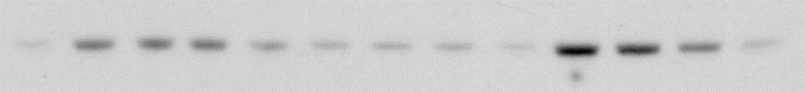
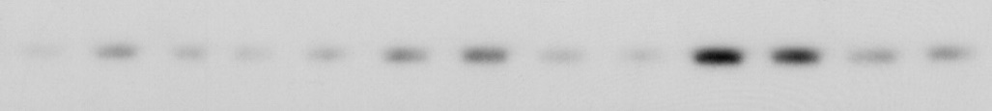
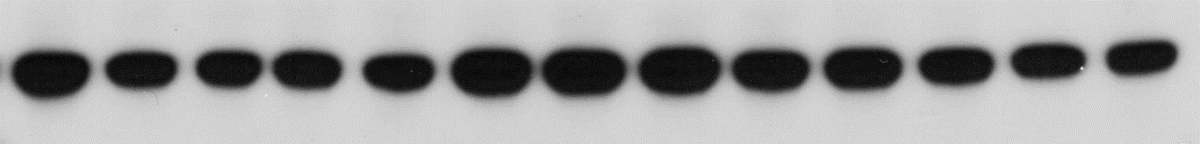
Supplementary Figure 4
AT13387 (24h)
RT (2Gy)
AT13387 (24h) → RT (2Gy)
0
0.5
2
6
24
0.5
2
6
24
0.5
2
6
24
Hsp70
γH2Ax
GAPDH
SF4. Effect of AT13387, RT, and combination on Hsp70 and γH2Ax. SCCVII cells were treated with AT13387 (100 nM) for 24 hours, Radiation (2 Gy) or a combination of AT13387 and radiation. Cells were harvested at 0.5, 2, 6, 24 hours following radiation. Cell lysates were resolved on SDS-PAGE. Changes in Hsp70 and γH2Ax protein levels were assessed by immunoblotting (n=3). GAPDH was used as a loading control.

Slide 5
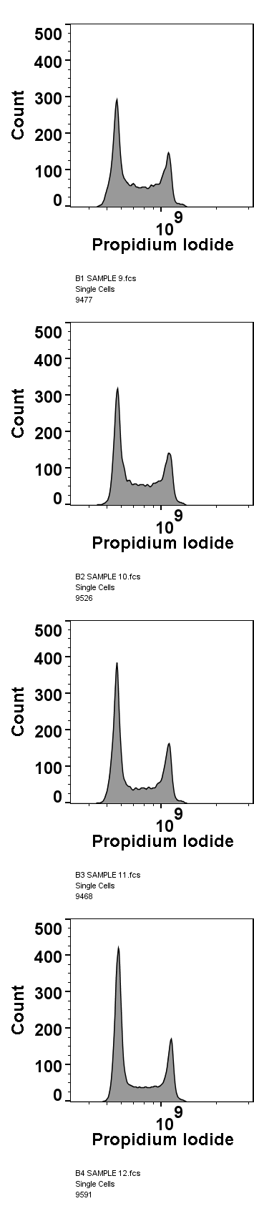
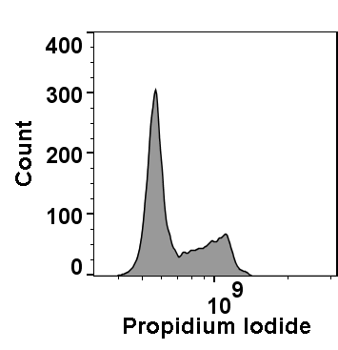
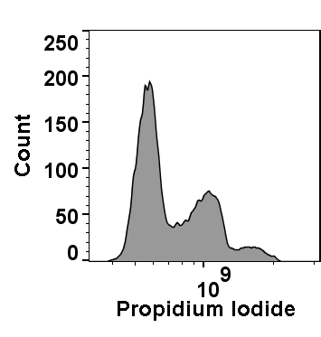

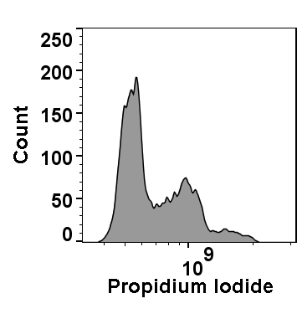
Supplementary Figure 5
A
UMSCC74B
SCCVII
MIAPaCa-2
Control
AT13387 (100 nM)
 |  | % G₁ | % S | % G₂/M
UMSCC74B | Control | 36.7 ± 0.9 | 49.2 ± 0.2 | 14.05 ± 0.9
 | AT13387 | 47.7* ± 1 | 35.5 ± 0.6 | 16.8 ± 0.6
SCCVII | Control | 56.4 ± 2.8 | 28.6 ± 5 | 15 ± 2.3
 | AT13387 | 54.9 ± 0.6 | 31.4 ± 1.3 | 13.7 ± 0.9
MIA PaCa-2 | Control | 50.2 ± 1.5 | 29.4 ± 1.1 | 20.4 ± 2.6
 | AT13387 | 47.7 ± 0.9 | 28.2 ± 0.2 | 24.1 ± 0.7
B
SF5. Effect of AT13387 on cell cycle. Cells were treated with 100 nM AT13387 for 24 hours, fixed and stained with propidium iodide, and cell cycle distribution of 10,000 gated cells was analyzed by flow cytometry. A. Representative histograms are shown. Each experiment was performed three times. B. The effect of treatment on cell cycle redistribution was tabulated, and significance was measured using Student’s unpaired t-test. UMSCC74B (TP53 wt, KRAS mt) cells showed significant (p=0.0014) G₁ arrest as compared to controls. This treatment caused a minimal effect on either S or G₂/M phase in all the three cell lines.

Slide 6
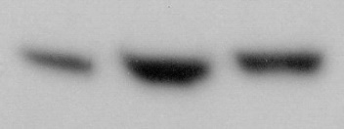
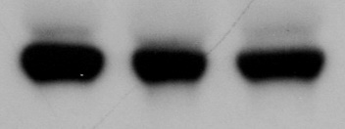
Supplementary Figure 6
Time (h)
0
2
24
Hsp70
1
3
2.2
GAPDH
SF6. Effect of AT13387 treatment on Hsp70 protein expression in the peripheral blood mononuclear cells (PBMCs). Mice were treated with 30 mg/kg dose of AT13387 via intraperitoneal injection. Blood was collected before or 2 and 24-hours after treatment. PBMCs were isolated from whole blood, and change in the Hsp70 protein level was assessed by immunoblotting. GAPDH was used as a loading control.

Slide 7
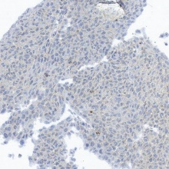
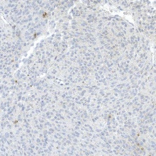
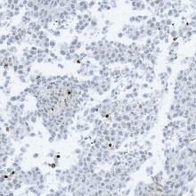
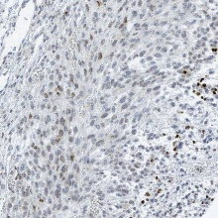
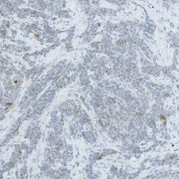
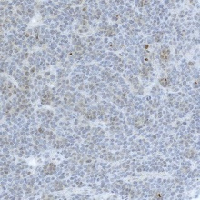
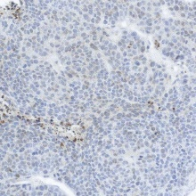
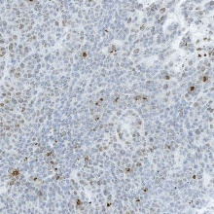
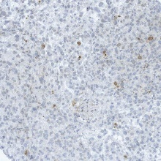
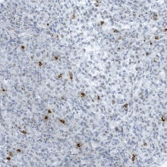
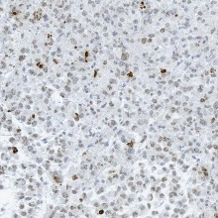
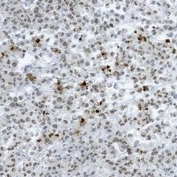
Supplementary Figure 7
Control
AT13387
RT
AT13387+RT
UMSCC74B
SCCVII
MiaPca2
SF7: Effect of AT13387, RT, and combination treatment on γH2Ax levels in vivo. Mice bearing either UMSCC74B, SCCVII, or MiaPca-2 tumors were treated with a 30 mg/kg, IP dose of AT13387. One day after treatment, tumors were subjected to irradiation (2 Gy). 6 hours post-radiation all the mice were euthanized, and the effects of treatment on γH2Ax levels were determined by comparing the percent positive cells in five random fields. One-way ANOVA was performed, and resulting values are shown. * P<0.05, ** P<0.001, *** P<0.0001

Slide 8
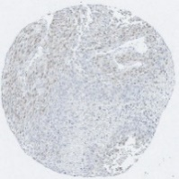
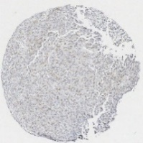
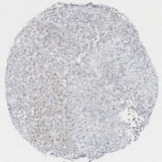
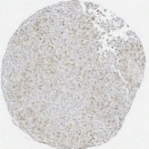
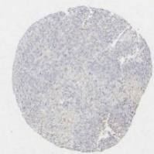
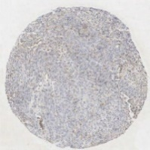
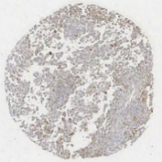
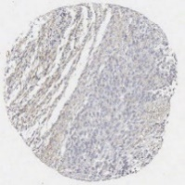
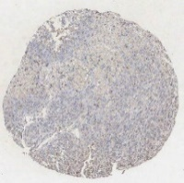
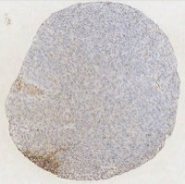
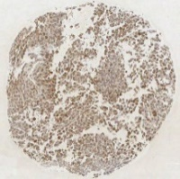
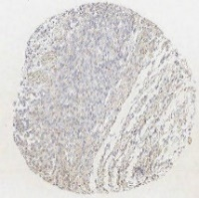
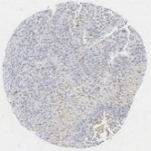
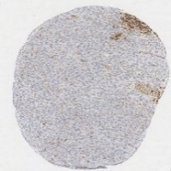
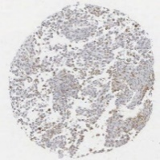
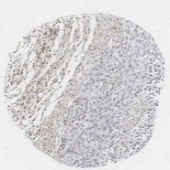
Supplementary Figure 8
AT13387 (24 h)
Radiation
Samples harvested (6 h)
A. UMSCC74B
Control
AT 24 h
RT 6 h
AT 24 h + RT 6 h
Rad51
pChk1
pChk2
pATR
pATM
SF8: Effect of AT13387, RT, and combination treatment on DNA damage repair markers in vivo. Mice bearing either UMSCC74B (A), SCCVII (B), or MiaPca-2 (C) tumors were treated with a 30 mg/kg, IP dose of AT13387 (AT). One day after treatment (as shown in the schema) tumors were subjected to irradiation (2 Gy). 6 hours post-radiation (RT) all the mice were euthanized. Tumors were harvested at the time point indicated. From these tumor tissue samples TMAs (Tissue microarrays) was constructed and immunostaining was performed. The effect of treatment on RAD51, pChk1, pChk2, pATR, and pATM was assessed by immunohistochemical analysis on 0-5 scale and the average values are tabulated (D). hours: h

Slide 9
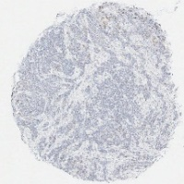
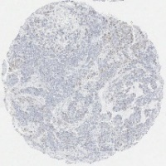
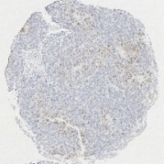
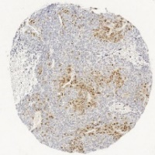
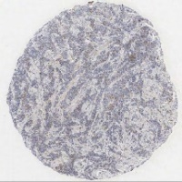
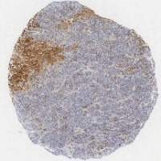
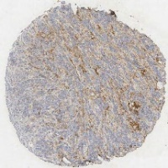
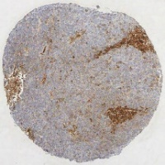
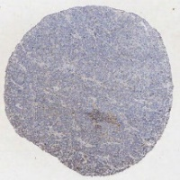











B. SCCVII
Control
AT 24h
RT 6h
AT 24 h + RT 6h
Rad51
pChk1
pChk2
pATR
pATM

Slide 10




















C. MiaPaCa-2
Control
AT 24h
RT 6h
AT 24 h + RT 6h
Rad51
pChk1
pChk2
pATR
pATM

Slide 11
D. IHC Scores (0-5 scale), n=3
UMSCC74B | Control | AT13387 | RT | AT+RT
Rad51 | 2±0.60 | 1.8±1.23 | 2.5±1.19 | 2.84±1.16
pChk1 | 0.83±0.93 | 1.8±0.79 | 1.25±0.88 | 1.77±1.30
pChk2 | 2.17±1.64 | 3.4±1.27 | 4±1.30 | 2.46±0.88
pATR | 1.33±1.2 | 2.4±0.84 | 1.5±1.20 | 2.24±1.19
pATM | 1±1.20 | 1.4±0.52 | 1±1.06 | 2±1.16
SCCVII | Control | AT13387 | RT | AT+RT
Rad51 | 2±0.63 | 2.25±0.88 | 2.5±0.79 | 3.16±0.38
pChk1 | 1.5±1.03 | 1.5±0.53 | 2.16±0.71 | 2.33±0.49
pChk2 | 1.16±0.70 | 2.25±0.88 | 2±0.85 | 3.34±1.24
pATR | 1.83±0.75 | 1.34±0.51 | 1.5±1.16 | 2.84±0.71
pATM | 0.84±0.40 | 1.5±0.53 | 1.83±0.71 | 1.84±0.72
MiaPaCa-2 | Control | AT13387 | RT | AT+RT
Rad51 | 1±0.73 | 0.33±0.51 | 2.17±1.1 | 2.16±1.11
pChk1 | 0.87±1.08 | 3.5±0.57 | 1.67±0.51 | 3.34±1.55
pChk2 | 3±1.40 | 3±1.15 | 4.67±0.78 | 4±1.20
pATR | 1.75±1.23 | 4.5±0.57 | 3.5±1.67 | 3.67±1.43
pATM | 0.75±0.1 | 3.5±0.57 | 1.33±0.51 | 2.84±1.64

Slide 12
Supplementary Figure 9
100
J
75
J
J
J
% viable cells
50
25
J
J
0
J
1
10
100
1000
10000
AT13387 (nM)
SF9: Effect of AT13387 on immortalized Keratinocytes. MTT assay showing dose dependent inhibition of keratinocytes growth after 24 hours of AT13387 treatment. Briefly, viable Keratinocytes (2000/well) were seeded in 96-well microplates and treated with serial diluted ( 0-3 µM) AT13387 for 24 hours. A yellow colored MTT (3-(4,5-dimethylthiazol-2-yl)-2,5-diphenyltetrazolium bromide) solution (Sigma-Aldrich) was added to cells and incubated for 4 hours in 37°C. Living cells reduce the yellow tetrazole into purple color insoluble formazan. The insoluble formazan crystals were dissolved using DMSO and optical densities (OD) of the products were measured at absorbance 550 nm. The percentage of viable cells compared to control wells was calculated.

Slide 13
Supplementary Figure 10
A
B
100
J
100
J
J
J
J
75
J
J
J
75
J
J
J
J
% γH2Ax positive cells
% γH2Ax positive cells
J
J
J
50
50
25
J
J
25
J
J
0
J
0
J
J
J
J
0
10
100
2000
0
10
100
2000
Time (min)
Time (min)
SF10: Effect of AT13387 treatment on radiation-induced γH2Ax foci formation. Cells were treated with AT13387 (100 nM), radiation (2 Gy), or a combination as described in Methods. UMSCC74B and SCCVII cells were fixed at different time points after irradiation. γH2Ax foci were visualized by immunofluorescence staining and the nucleus was stained with DAPI. Images were captured, cells with >10 γH2Ax foci were scored, and the percentage of positive cells is plotted as a function of time. Shown here are the average values of γH2Ax positive UMSCC74B (A) and SCCVII (B) cells.

Slide 14
Supplementary Figure 11
100
10
Bound Steroid (% relative to the
condition without AT13387)
1
0.1
0
1
2
3
4
5
6
7
8
9
10
AT13387 (µM)
SF11. Effect of AT13387 on Glucocorticoid Receptor Re-activation. Effect of AT13387 on Hsp90 was assessed in the assay system where steroid binding cleft of glucocorticoid receptor (GR) is converted to steroid-binding conformation in an Hsp90-dependent manner as described previously (1). Fifty μl of cytosol of Sf9 cells baculovirally infected for expression of mouse GR was immunoadsorbed for 2 h with FiGR mouse ascites. Immunoadsorbed GRs were stripped for 2 h with 0.5 M NaCl and washed pellets were incubated for 20 min at 30 ºC with rabbit reticulocyte lysate in the presence of an ATP-regenerating system plus indicated concentrations of AT13387. All the incubation mixtures contained DMSO at a final concentration of 0.1% (v/v). Immunopellets of GRs were washed twice with TEGM buffer and incubated overnight on ice with 50 nM [³H]dexamethasone in HEM buffer to assay the steroid-binding activity. The effect of AT13387 from two independent experiments marked as red and blue lines are expressed on the y-axis as a percentage of the steroid-binding activity relative to that without AT13387.
1. Morishima Y, Mehta RK, Yoshimura M, Lau M, Southworth DR, Lawrence TS, Pratt WB, Nyati MK, Osawa Y: Chaperone activity and dimerization properties of Hsp90α and Hsp90β in glucocorticoid receptor activation by the multiprotein Hsp90/Hsp70-dependent chaperone machinery. Mol Pharmacol 94 (3): 984-991, 2018.

