Slide 1
_{Supplementary Material}
Supplementary Figures 1-8

Slide 2
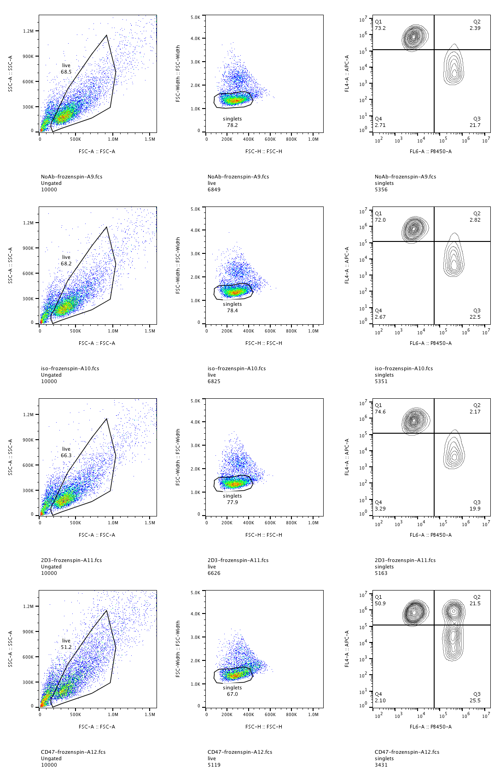
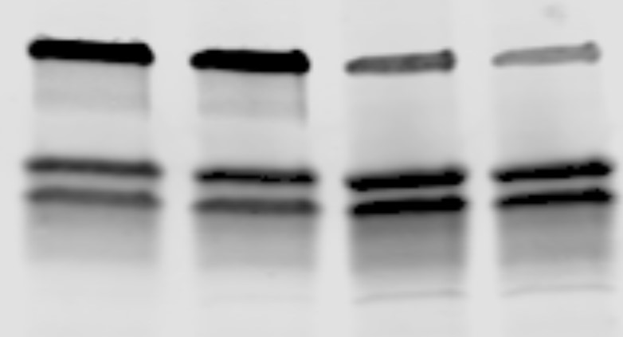
A.
B.
Ptpn6^{+/+}
Cx3cr1-Cre
Ptpn6^{fl/fl}
Cx3cr1-Cre
Isotype control
α-CD47
Shp1
Shp1/Erk
(%of control)
Erk1/2
Target cell
Ptpn6^{+/+} Cx3cr1-Cre
Ptpn6^{fl/fl} Cx3cr1-Cre
Mφ (YFP+)
C.
Isotype Ab
D.
Ptpn6^{+/+} Cx3cr1-Cre
CD47 Ab
Ptpn6^{fl/fl} Cx3cr1-Cre
DLD1
Raji
MC38
CD47 MFI
CD206 MFI
M0
M2
E.
F.
NT siRNA
NT siRNA
PTPN6 siRNA
PTPN6 siRNA
CD206
(Average intensity x10³)
Cytokine Secretion
(pg/ml)
G.
IL12p70
TNFα
IL-6
IL-10
Ptpn6^{+/+} Cx3cr1-Cre
Ptpn6^{fl/fl} Cx3cr1-Cre
Cytokine Secretion
(relative to control)
IL12p70
TNFα
IL-6
IL-10
IL-1β

Slide 4
***
***
Ptpn6^{fl/fl}
Ptpn6^{fl/fl}ERT2-cre
Shp1/Erk (% of control)
female
male

Slide 5
A.
B.
Ptpn6^{fl/fl}
Ptpn6^{fl/fl}ERT2-cre
Body weight (% of initial)
# splenocytes
Time (days)
PMNs
Ly6c^{hi}
Ly6c^{lo}

Slide 6
A.
Ptpn6^{fl/fl}
Ptpn6^{fl/fl}ERT2-cre
B.
C.
% of CD45⁺ cells
Body weight (% of initial)
Ptpn6^{fl/fl}
Ptpn6^{fl/fl}ERT2-cre
CD11b⁺
cells
αβ T cells
Days post implantation

Slide 7
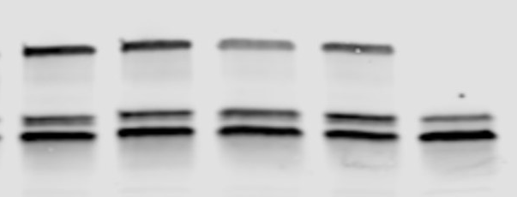
A.
E0771
B.
MC38
% of CD45⁺ cells
% of CD45⁺ cells
Ptpn6^{fl/fl}
Ptpn6^{fl/fl}ERT2-cre
CD11b⁺
cells
αβ T cells
CD11b⁺
cells
αβ T cells
C.
D.
Tumor weight (g)
Body weight (% of initial)
Days post implantation
E.
F.
MC38 tumor lysate
MC38 (in vitro)
Ptpn6^{fl/fl}
Ptpn6^{fl/fl}
ERT2-cre
Body weight (% of initial)
Shp1
Erk1/2
Days post implantation
G.
H.
I.
% of CD45⁺ cells
M1/M2 ratio
CD8⁺ T cell/Treg ratio
M1
M2

Slide 9
A.
E0771 Tumors
Isotype control
Anti-PD1
Tumor volume (mm³)
Days post implantation
B.
MC38 Tumors
Isotype control
Anti-PD1
Tumor Volume (mm³)
Days post-implantation
C.
MC38 Tumors
Isotype control
Anti-CD47
Tumor Volume (mm³)
Days post-implantation

Slide 11
A.
B.
CD8⁺ T cells
Tumor volume (mm³)
Ptpn6^{fl/fl}
Ptpn6^{fl/fl}dLck-cre
CD44
Days post implantation

Slide 12
A.
SSC-A
FSC-H
SSC-H
CD45
CD45
FSC-A
FSC-A
Aqua
TCR𝛃/B220
CD11b
Ly6c
F4/80
MHCII
MHCII
B.
Ly6g
FSC-A
F4/80
CD11c
SSC-A
FSC-H
CD45
NK1.1
B220
GL3
FSC-A
FSC-A
Aqua
CD3
CD11b
CD3
TCR𝛃
CD8
CD25
CD8
CD4
CD3
CD4
FoxP3
CD44
CD44

