Slide 1
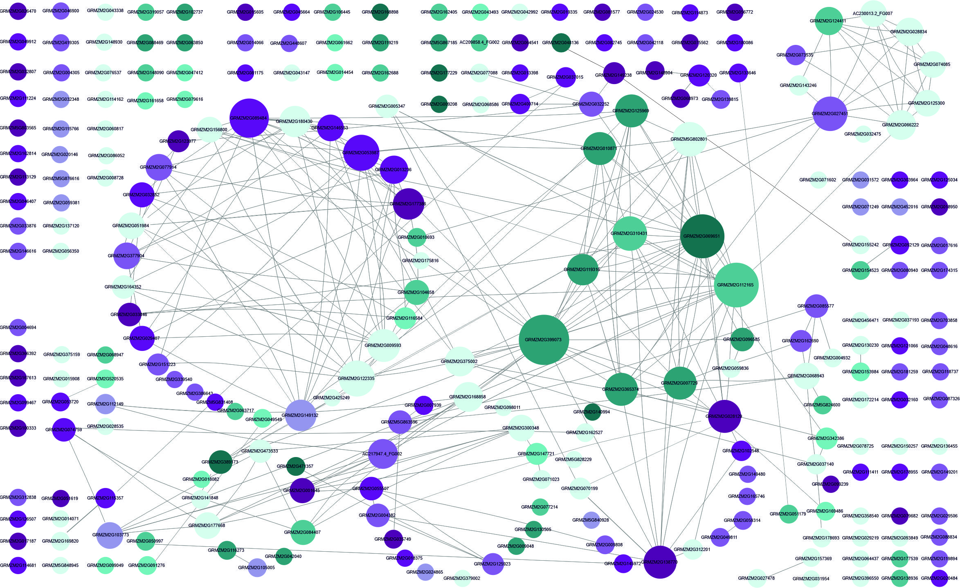
Other
Stress-responsive
Transcription
Translation
Protein degradation
Kinases, phosphatases
Lipids
Heat Shock
Proteins
Carbohydrates
Secondary metabolism
Chloroplast
Mitochondrium
Transport
Growth regulators
Redox balance
Membranes
Notes:
Fig. S2. Interactive version of Fig. 2. showing functional classification and interactions of maize genes responding to severe cold. To enable interactivity, PowerPoint presentation must be activated. When the gene symbol is pointed at with the cursor, gene GRMZM number, gene description and its rank (number of datasets reporting it) will pop up. Additionally, three main parameters provided by Cystoscape will appear: Degree (number of partners), Betweenness Centrality (a measure of centrality in a graph based on shortest paths) and Clustering Coefficient (a measure of the degree to which nodes in a graph tend to cluster together). csDEGs (Table S3; see text for definition) were assigned function basing on gene description and available characteristics (Gramene, MaizeGDB) and grouped manually into categories according to main function or organellar localization. Interactions between genes were found using Cytoscape v. 3.7.1. (Shannon et al., 2003). Genes are represented by circles with GRMZM numbers. The size of the circle is proportional to the number of gene partners (interactors) and interactions are indicated by lines aimed at the circle centre. Cyan marks down-regulated genes and magenta – up-regulated ones. The intensity of colouring is proportional to the number of datasets reporting the gene as changing expression in severe cold. Light blue depicts genes showing inconsistent behaviour in different studies (i.e., down-regulated in one or more study and up-regulated in another study(ies)). Orange background marks genes changing also in response to severe cold and listed in Supplementary Materials, Table S6.

