Slide 1
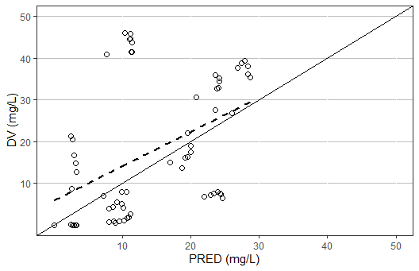
Figure Ia
Notes:
Figure 2a

Slide 2
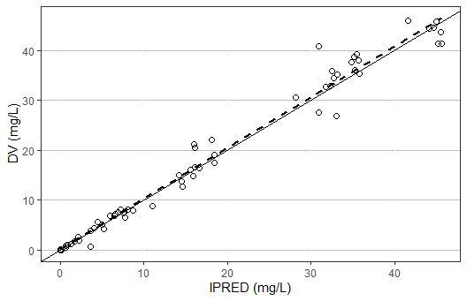
Figure Ib
Notes:
Figure 2b

Slide 3
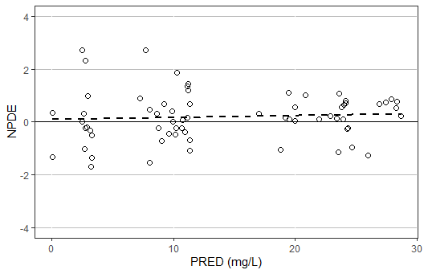
Figure Ic
C
Notes:
Figure 2c

Slide 4
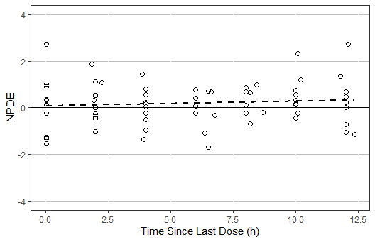
Figure Id
D
Notes:
Figure 2d

