Slide 1
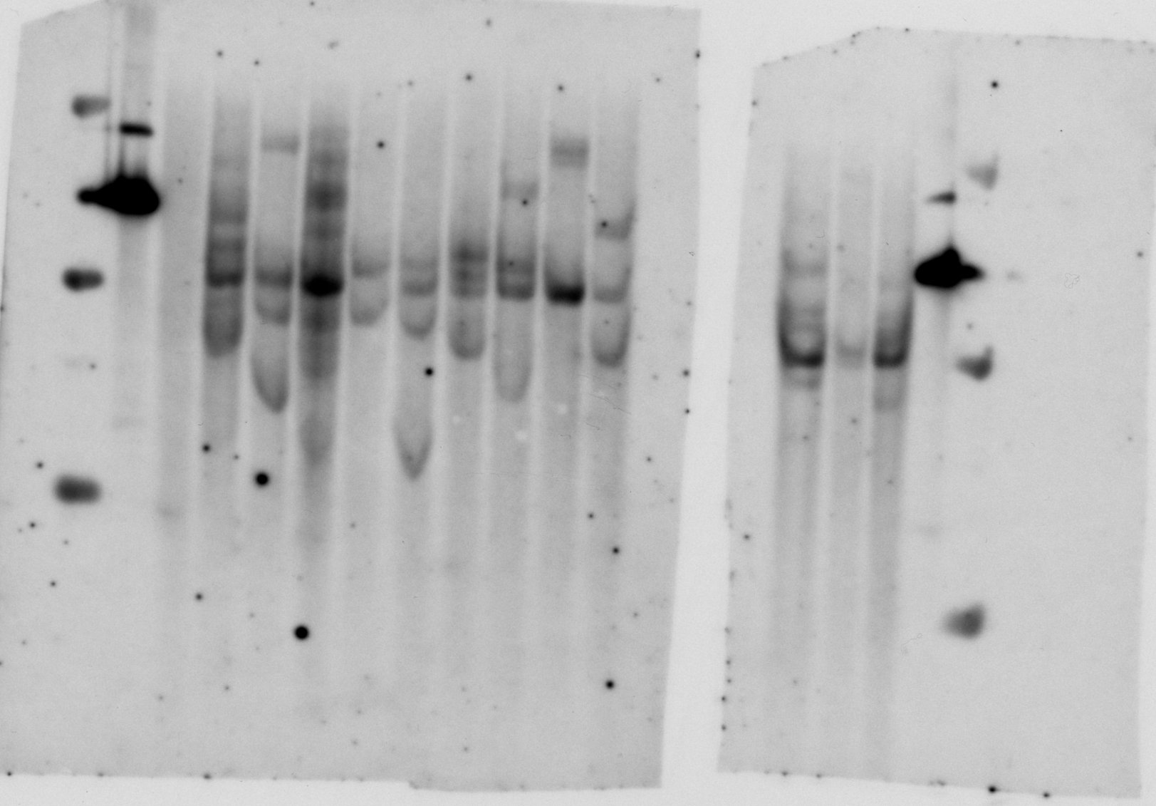
The raw gels data
Molecular analysis of transgenic events of emmer wheat and Timophefeev’s wheat
M
P
WT
pm-3
Pm-4
Pi-5b
Pi-9a
Pi-18
Pi-20
Pi-31
Pi-37
Pi-60
Pm-6
Pi-46
Pi-81b
P
M
The original blot presented in Fig. 2 (Right and Center)

Slide 2
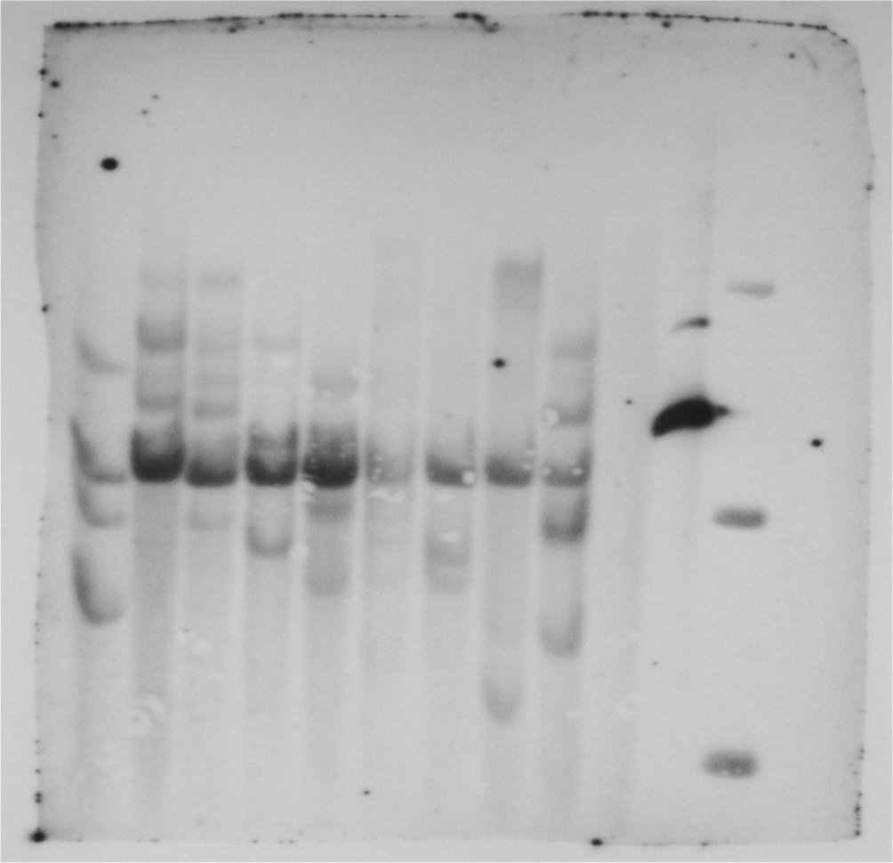
Pi-102P
Pi-98b
Pi-91
Pi-85
Pi-40A
Pi-36
Pi-33
Pi-28
Pi-103
WT
P
M
The original blot presented in Fig. 2 (Left)

Slide 3
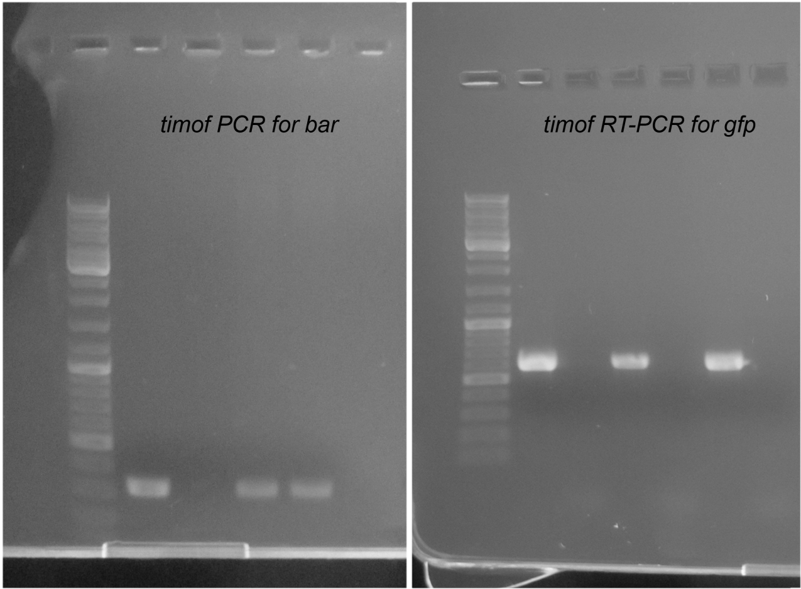
M P WT Tw1 Tw2
M P WT Tw1 Tw2
+ - + -
The original gels presented in Fig. 4h

Slide 4
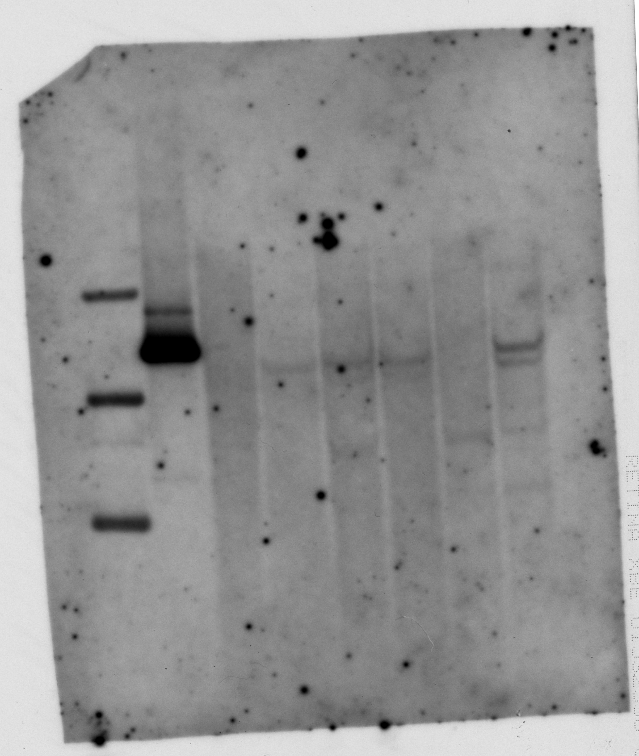
M
P
WT
T0 Tw1
T1 Tw2a
T1 Tw2b
T1 Tw2c
T0 Tw2
The original blot presented in Fig. 4i

