Slide 1
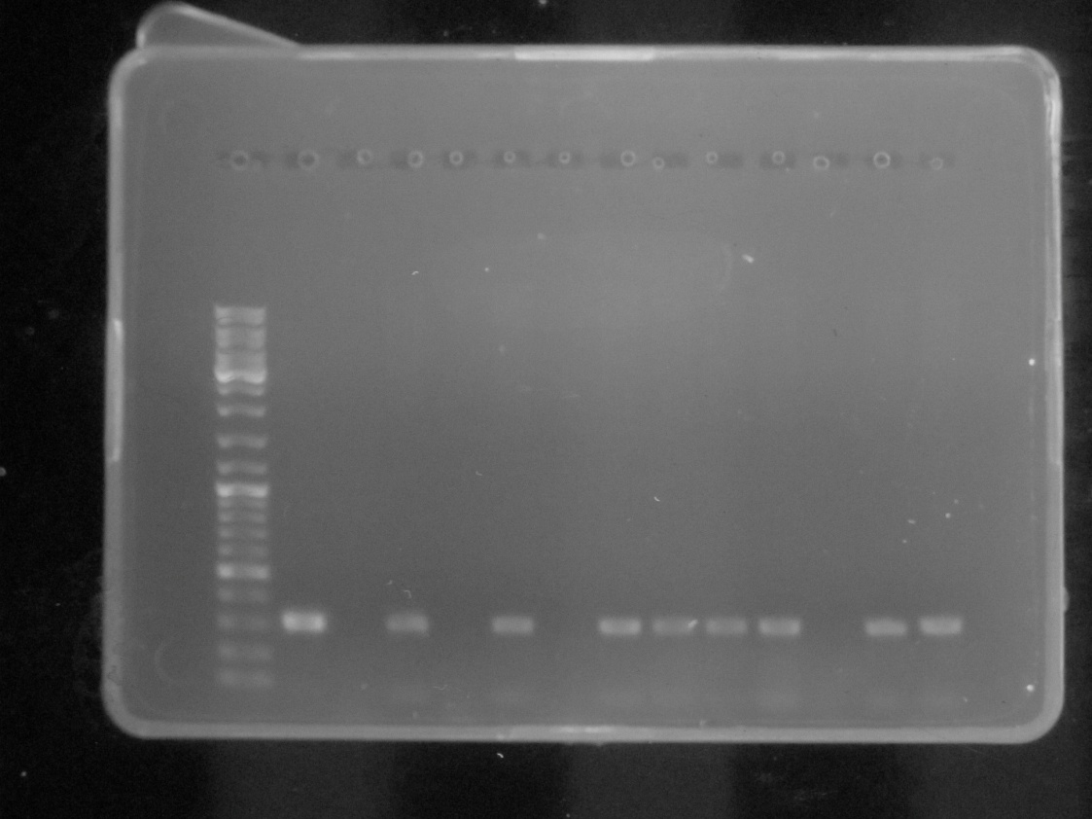
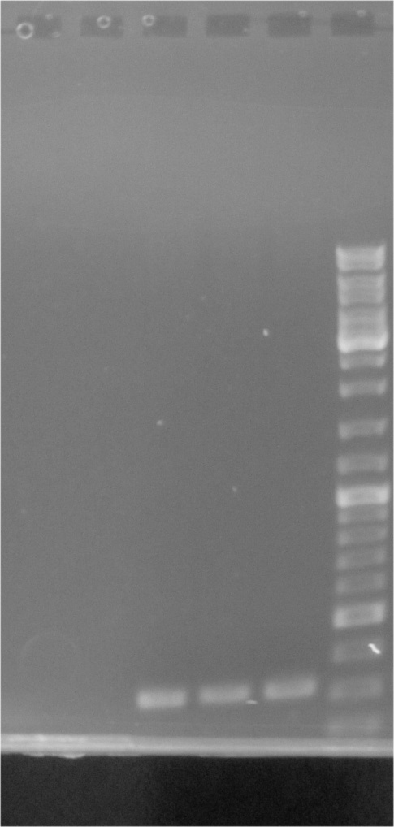
The raw gels data
Molecular analysis of transgenic events of emmer wheat (PCR)
M
P
WT
Pi-1
Pi-2
Pi-3
Pi-4a
Pi-4b
Pi-5b
Pi-6
Pi-7
Pi-8
Pi-9a
Pi-10
Pi-11
Pi-12
Pi-13
M
The original gels used in Figure S1.b

Slide 2
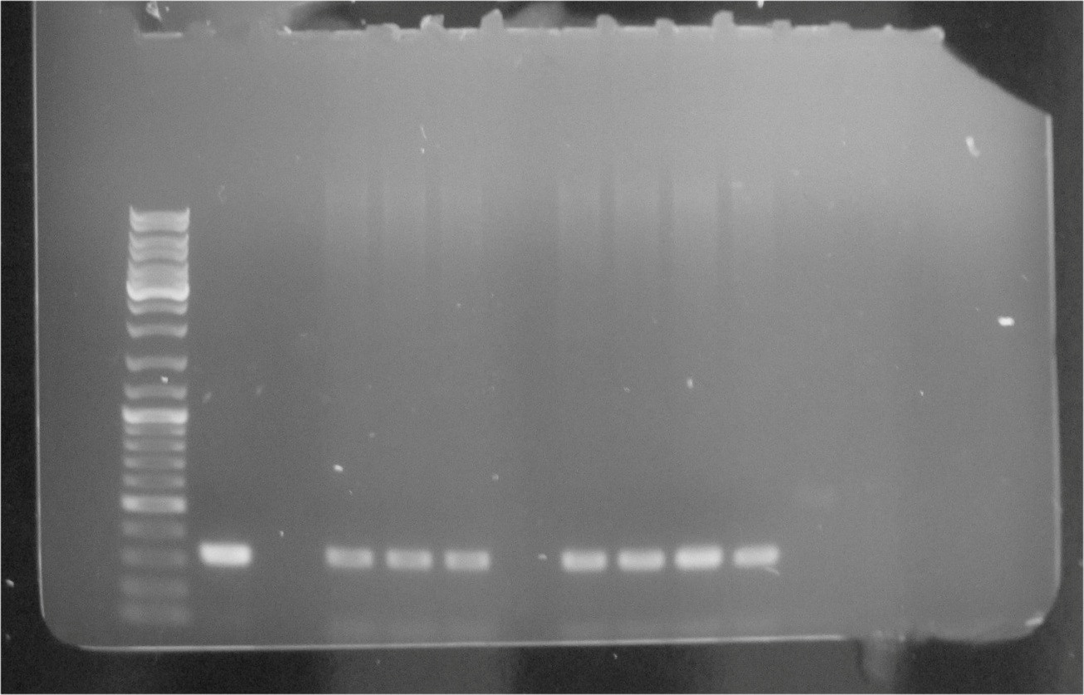
The raw gels data
Molecular analysis of transgenic events of emmer wheat (PCR)
M
P
WT
Pi-79
Pi-80
Pi-81
Pi-82
Pi-83
Pi-84
Pi-85
Pi-85
The original gels used in Figure S1.b

Slide 3
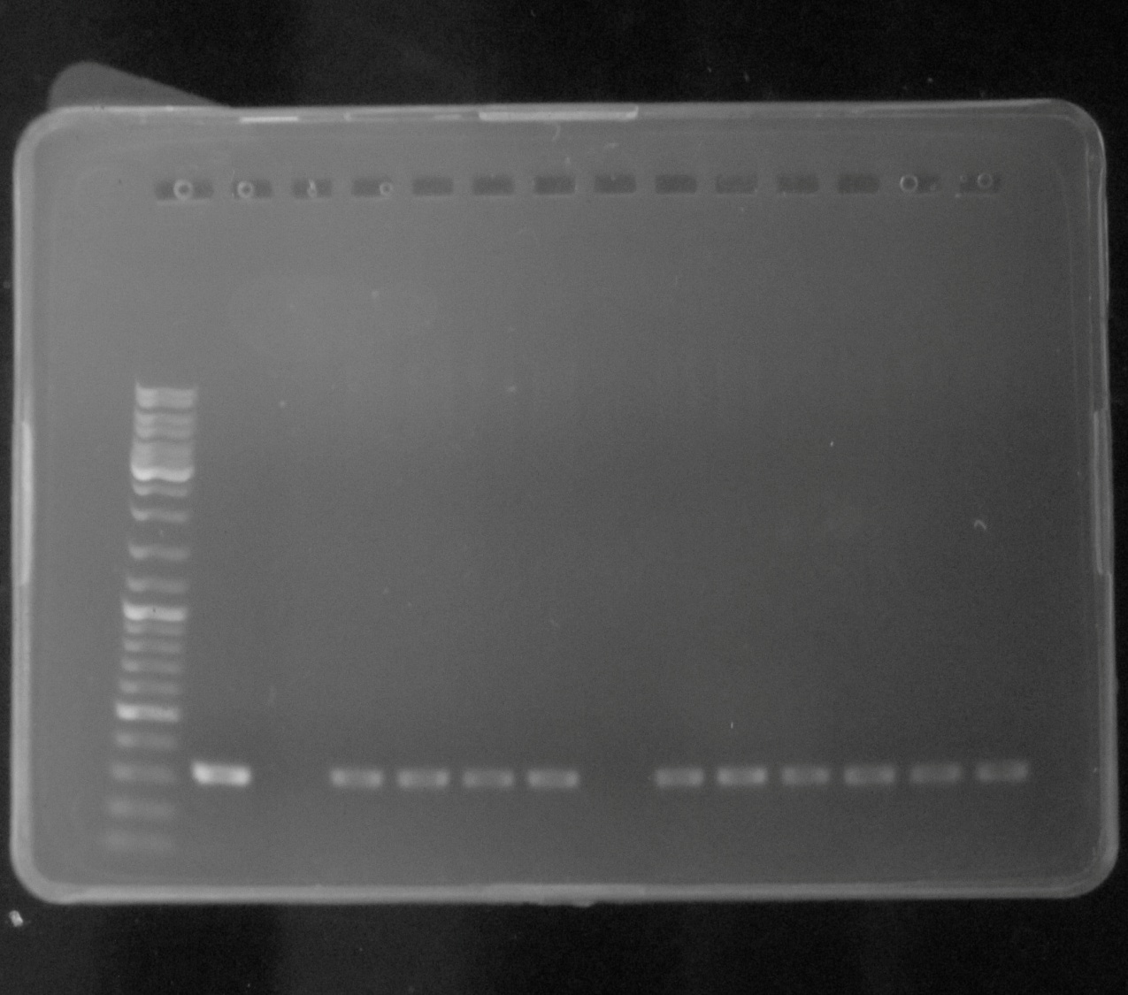
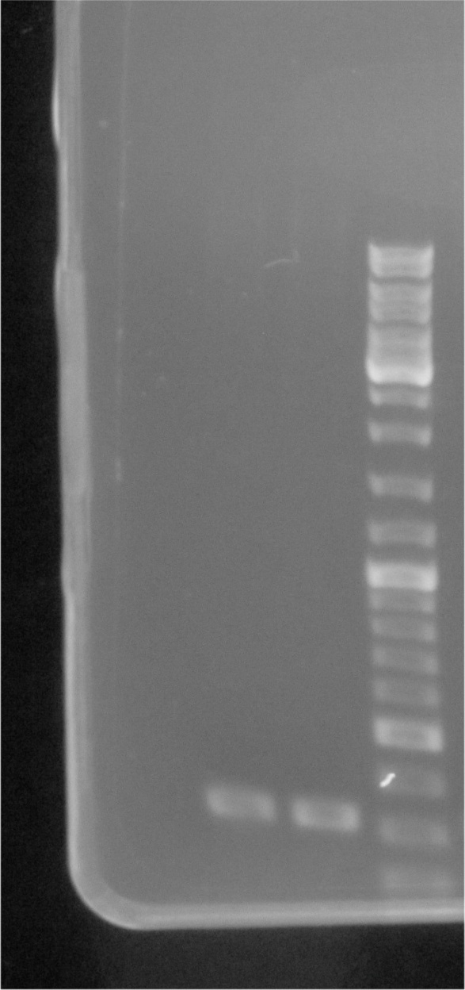
The raw gels data
Molecular analysis of transgenic events of emmer wheat (PCR)
M
WT
Pi-106A
Pi-109
Pi-110
Pi-111
Pi-114
Pi-115
Pi-116
PM-1
PM-2
Pm-3
Pm-4
PM-5
Pm-6
M
The original gels used in Figure S1.b

Slide 4
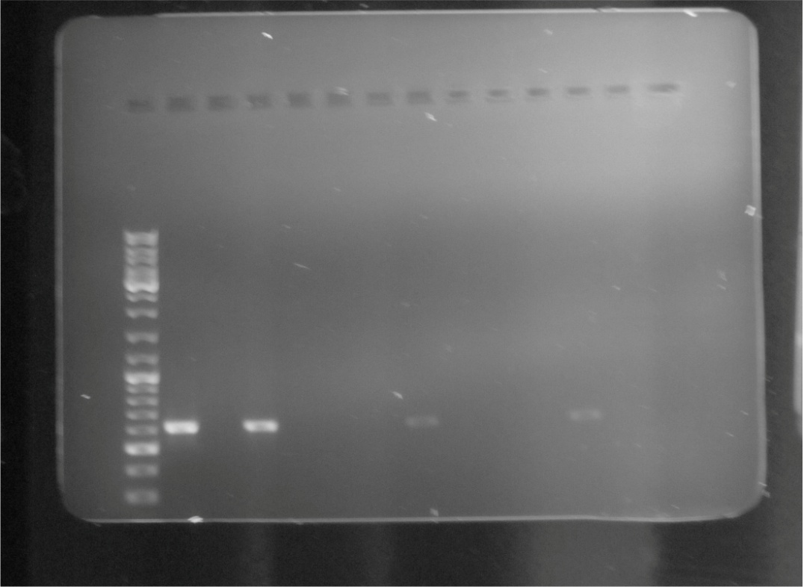
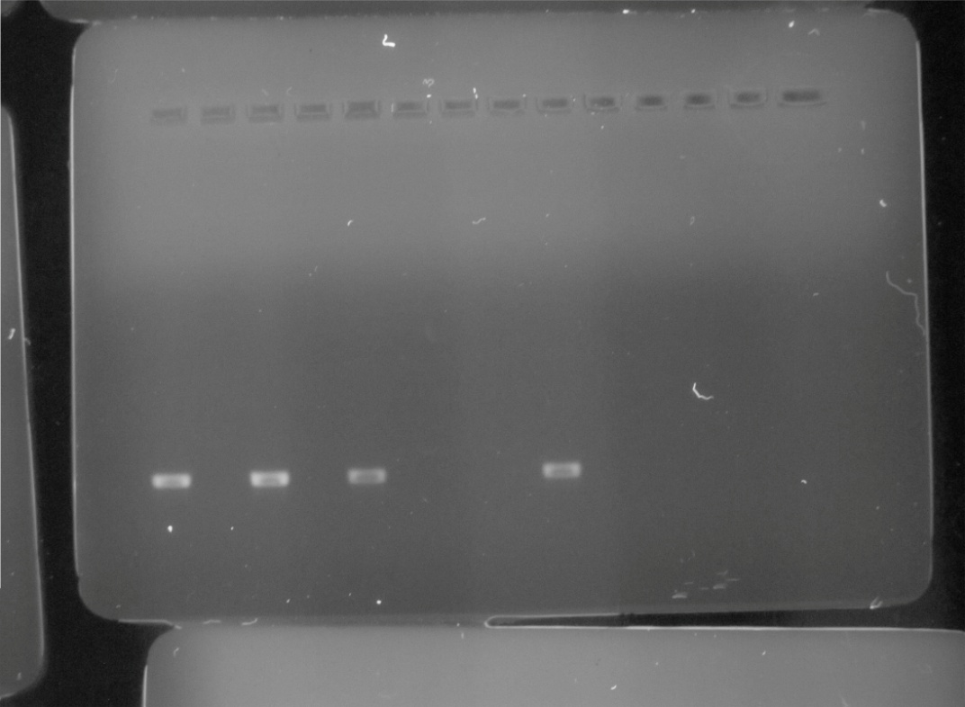
The raw gels data
Molecular analysis of transgenic events of emmer wheat (RT-PCR)
M
P
WT
+ Pi-1
Pi-1
+ Pi-2
Pi-2
+ Pi-3
Pi-3
+ Pi-4a
Pi-4a
+ Pi-4b
Pi-4b
+ Pi-5b
Pi-5b
+ Pi-6
Pi-6
+ Pi-7
Pi-7
+ Pi-8
Pi-8
+ Pi-9a
Pi-9a
-
-
-
-
-
-
-
-
-
-
The original gels used in Figure S1.c

Slide 5
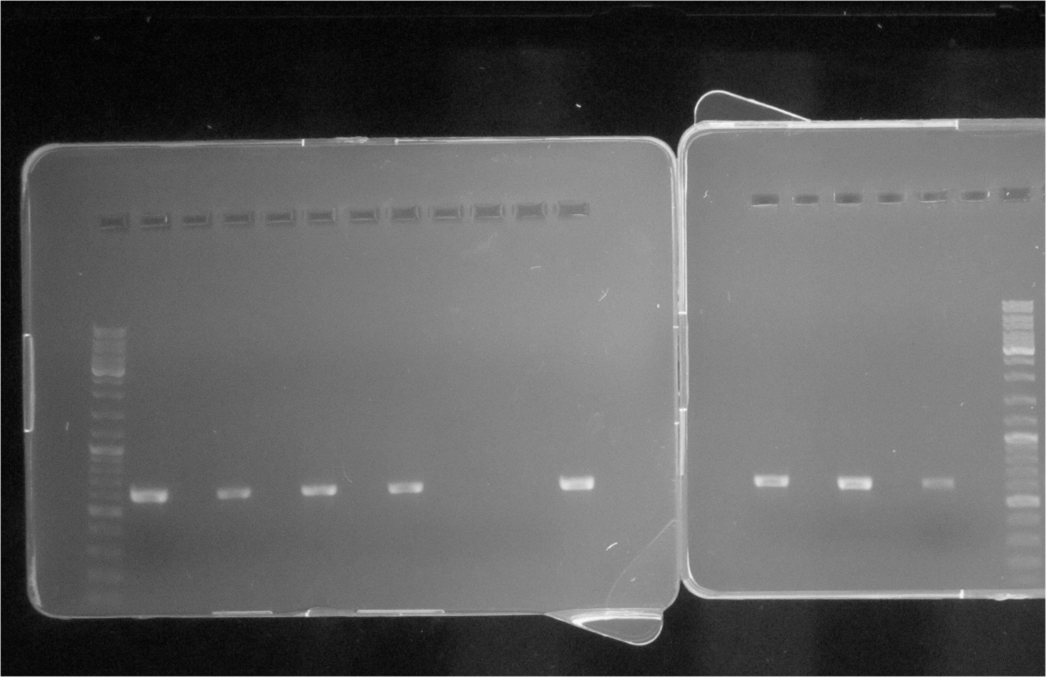
The raw gels data
Molecular analysis of transgenic events of emmer wheat (RT-PCR)
M
P
WT
+ Pi-79
Pi-79
+ Pi-80
Pi-80
+ Pi-81
Pi-81
+ Pi-82
Pi-82
P
+ Pi-83
Pi-83
+ Pi-84
Pi-84
+ Pi-85
Pi-85
M
-
-
-
-
-
-
-
The original gels used in Figure S1.c

Slide 6
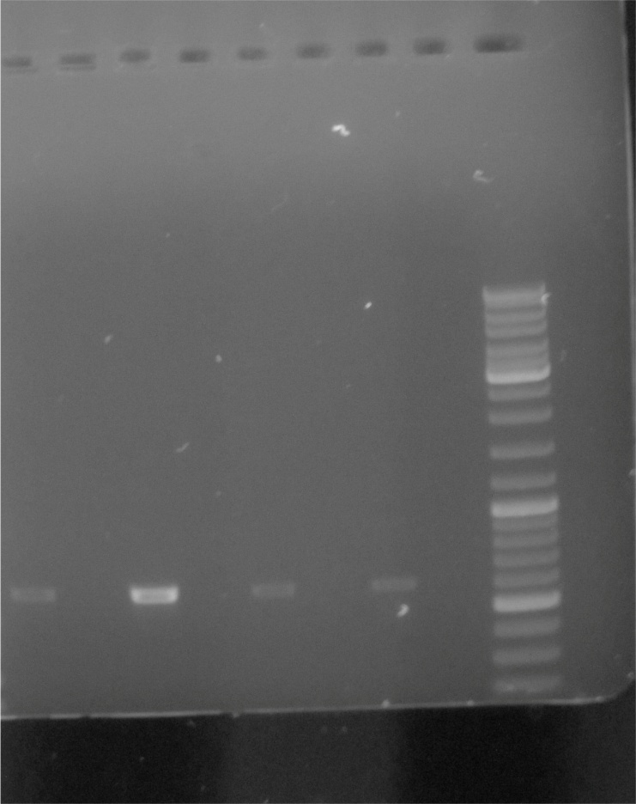
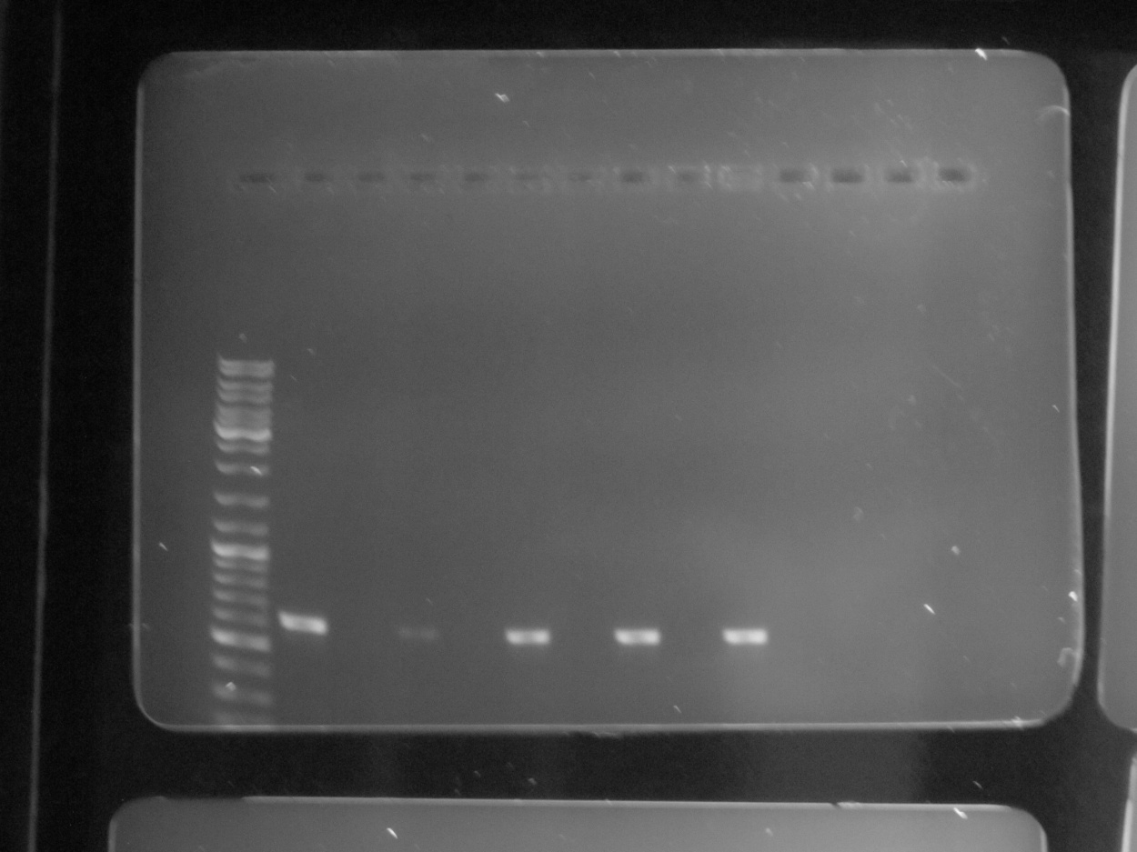
The raw gels data
Molecular analysis of transgenic events of emmer wheat (RT-PCR)
+ Pi-10
Pi-10
+ Pi-11
Pi-11
+ Pi-12
Pi-12
+ Pi-13
Pi-13
M
M
P
WT
+ Pi-106
Pi-106
+ Pi-109
Pi-109
+ Pi-110
Pi-110
+ Pi-111
Pi-111
+ P-114
P-114
-
-
-
-
-
-
-
-
-
The original gels presented in Figure S1.c

Slide 7
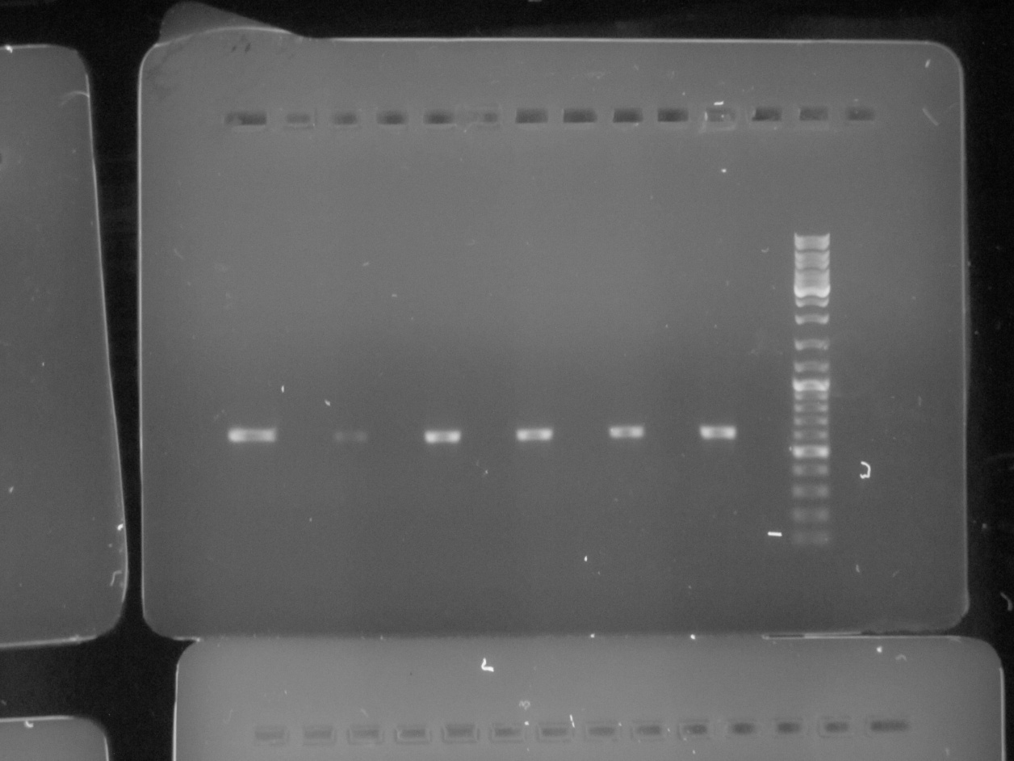
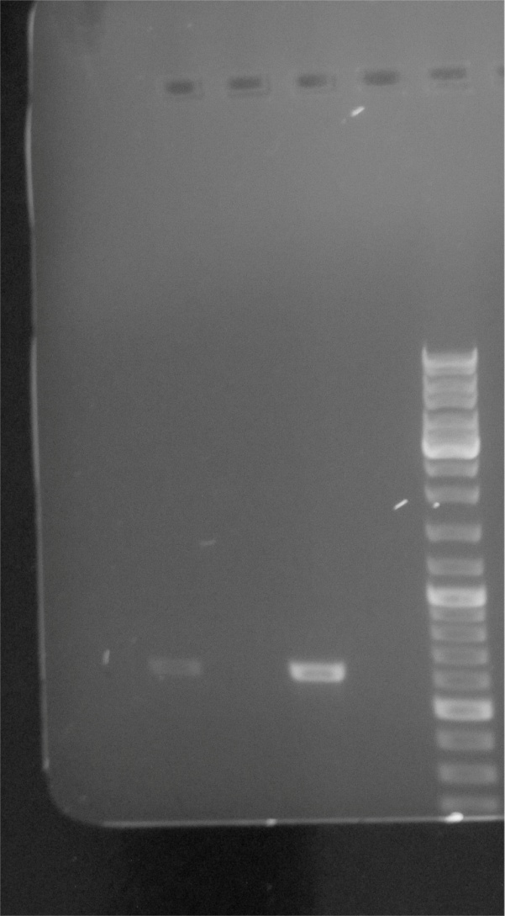
The raw gels data
Molecular analysis of transgenic events of emmer wheat (RT-PCR)
+ PM-1
PM-1
+ PM-2
PM-2
+ PM-3
PM-3
+ PM-4
PM-4
+ PM-5
PM-5
+ PM-6
PM-6
M
+ Pi-115
Pi-115
+ Pi-116
Pi-116
M
-
-
-
-
-
-
-
-
The original gels presented in Figure S1.c

