Slide 1
a
b
S1 Fig
0.7
45
0.6
40
0.5
35
0.4
SPAD value
SPAD value
30
0.3
25
0.2
20
0.1
15
0.0
1DCF
1DCS
30DCF
30DCS
RDCF
RDCS
c
d
120
200
115
110
Grain number
105
150
Days to flowering
100
100
95
90
Notes:
Fig. S1 Box plot analysis of a) 1DCF, 1DCS, 30DCF and 30DCS b) RDCF and RDCS c) grain number per panicle d) days to flowering (days) e) plant height (cm) f) number of tillers g) panicle length (cm) h) test weight i) grain yield (kg h⁻) data for two season in BC₂F₄ population.

Slide 2
S1 Fig
e
f
120
16
110
14
100
12
90
Number of tillers
Plant Height (cm)
10
80
70
8
60
g
h
25
24
24
22
23
20
Test weight (g)
22
18
Panicle length (cm)
16
21
20
14
19
12
e
8000
7000
6000
Grain yield (g)
5000
4000
3000

Slide 3
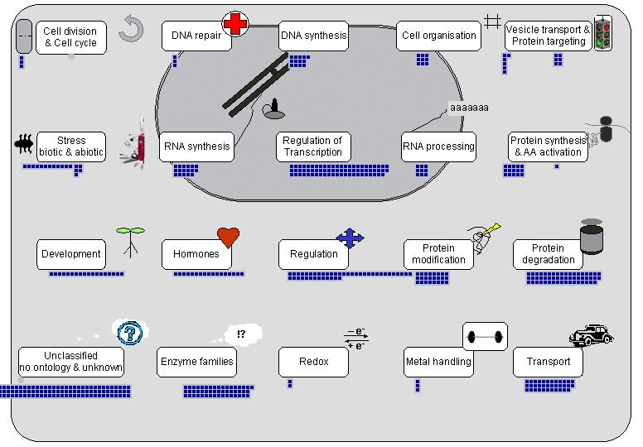
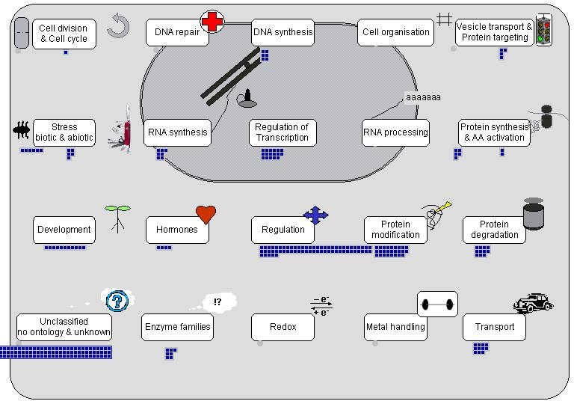
S2 Fig
Genomic region 1.1 (id1000027 - id1001973)
Genomic region 1.2 (id1021344 -id1012929)
Notes:
Fig. S2 Functional annotation and categorization of genes present within QTLs region. Genomic region 1.1 (id1000027-id1001973 ), Genomic region 1.2 (id1021344-id1012929 ), Genomic region 2.2 (id2006486-id2007213), Genomic region 3.1 (id3000757-id3000946), Genomic region 3.2 (id3010173-id3012786 ), Genomic region 5.1 (id5007323-id5013100 ), Genomic region 6.1 (id6015035-id6011613), Genomic region 7.1 (id7002907-id7003043), Genomic region 10.2 (id10001636-id10002779 ), Genomic region 10.3 (id10003620-id10004477).

Slide 4
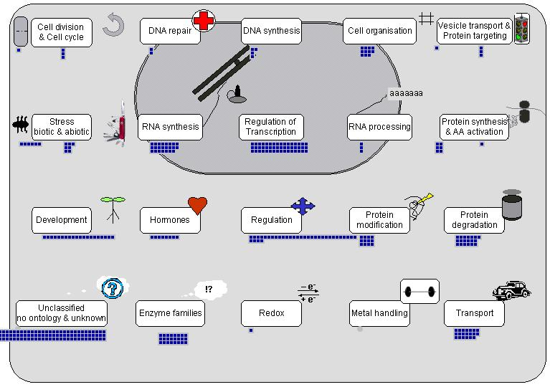
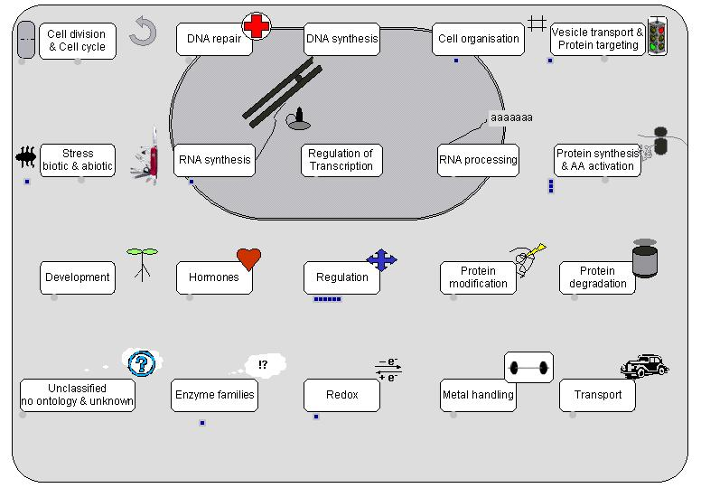
S2 Fig
Genomic region 2.2 (id2006486 - id2007213)
Genomic region 3.1 (id3000757 - id3000946)

Slide 5

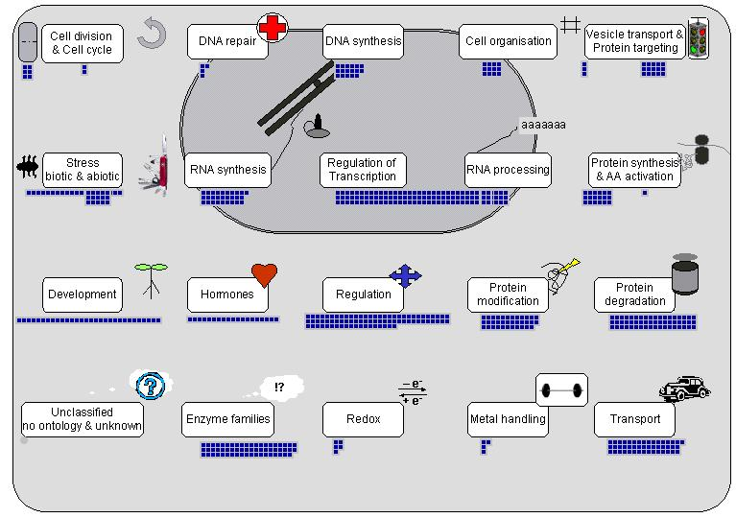
S2 Fig
Genomic region 3.2 (id3010173 - id3012786)
Genomic region 5.1 (id5007323 - id5013100)

Slide 6
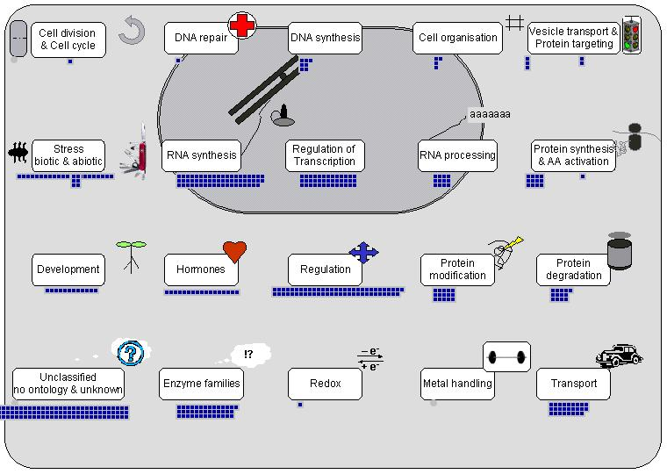
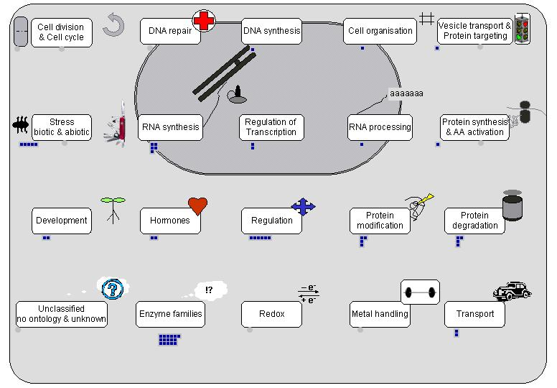
S2 Fig
Genomic region 6.1 (id6015035 - id6011613)
Genomic region 7.1 (id7002907 - id7003043)

Slide 7
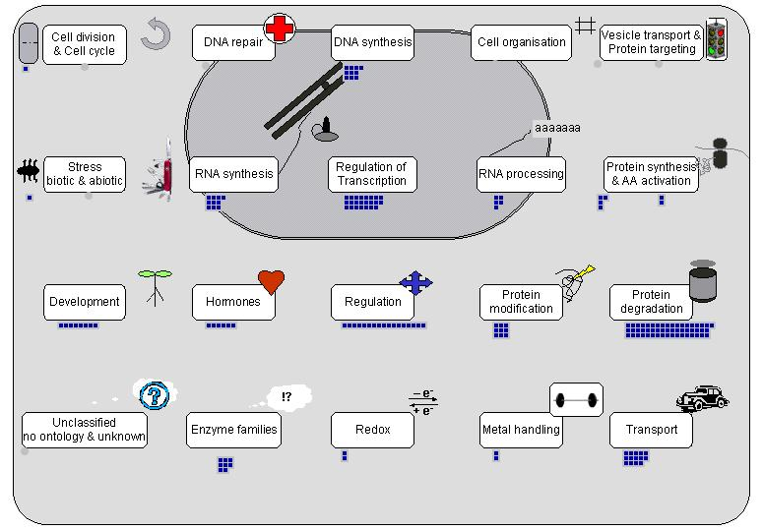
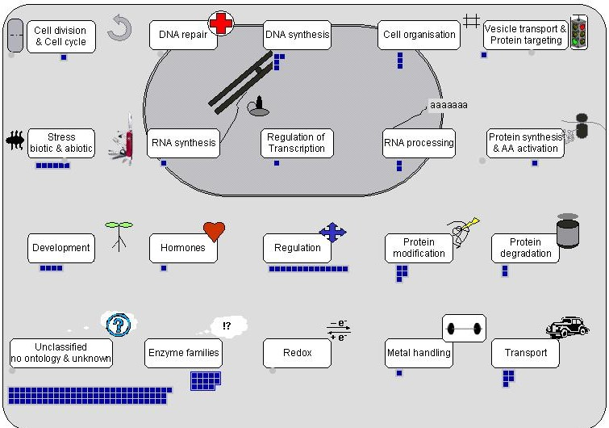
S2 Fig
Genomic region 10.2 (id10001636-id10002779)
Genomic region 10.3 (id10003620- id10004477)

