Slide 1
Cardiac sequelae of novel coronavirus disease 2019 (COVID-19): a clinical case series
April 2020
EHJ-CR-D-20-00308

Slide 2
Introduction
The pandemic of novel coronavirus disease 2019 (COVID-19) caused by severe acute respiratory syndrome coronavirus 2 (SARS-CoV-2) has been rapidly spreading worldwide, exhausting resources across health systems
First appearing in Wuhan, China, it commonly manifested with respiratory symptoms of cough, dyspnea, fever, chills, and myalgias ^{1,2}
Individuals with history of cardiovascular disease are predisposed to infection and are at increased risk of adverse outcomes ³
Previous beta-coronavirus infections, such as severe acute respiratory syndrome, were associated with tachyarrhythmias and heart failure ⁴
Cardiac manifestations of COVID-19 were later reported, typically from viral myocarditis and treatment side effects ⁵
Given the increased incidence and saturation of resources COVID-19 has had indirect effects on care, impacting timing and optimal treatment of acute cardiovascular disease
The objective of this clinical case series is to highlight cardiac complications of COVID-19

Slide 3
Case Presentation 1
History and Examination Findings
67-year-old Caucasian female with a history of non-ischemic dilated cardiomyopathy with recovered ejection fraction (EF), hypertension, and known diagnosis of COVID-19 one week prior, presented with progressive dyspnea on exertion, orthopnea, and productive cough
In the ED, she was afebrile, tachycardic, and tachypneic with bilateral crackles on auscultation, and muffled heart sounds; no murmurs or palpable thrill was appreciated

Slide 4
Case Presentation 1
Investigations
Lymphopenic (0.9 K/uL; normal 1.0-4.8 K/uL)
Elevated inflammatory markers
    C-Reactive Protein (15.1 mg/dL; normal < 5.0 mg/dL)
    D-Dimer (6.52 ug/mL FEU; normal < 5.0 ug/mL)
    Ferritin (509 ng/mL; normal 12-300 ng/mL)
High sensitivity troponin I (hs-cTnI) levels were initially 1,865 ng/L (normal < 19 ng/L)
    Peaked at 2,410 ng/L
Brain natriuretic peptide (BNP) level of 54 pg/mL (normal < 50 pg/mL)
ECG showed normal sinus rhythm
Chest radiograph (CXR) was significant enlargement of the cardiac silhouette

Slide 5
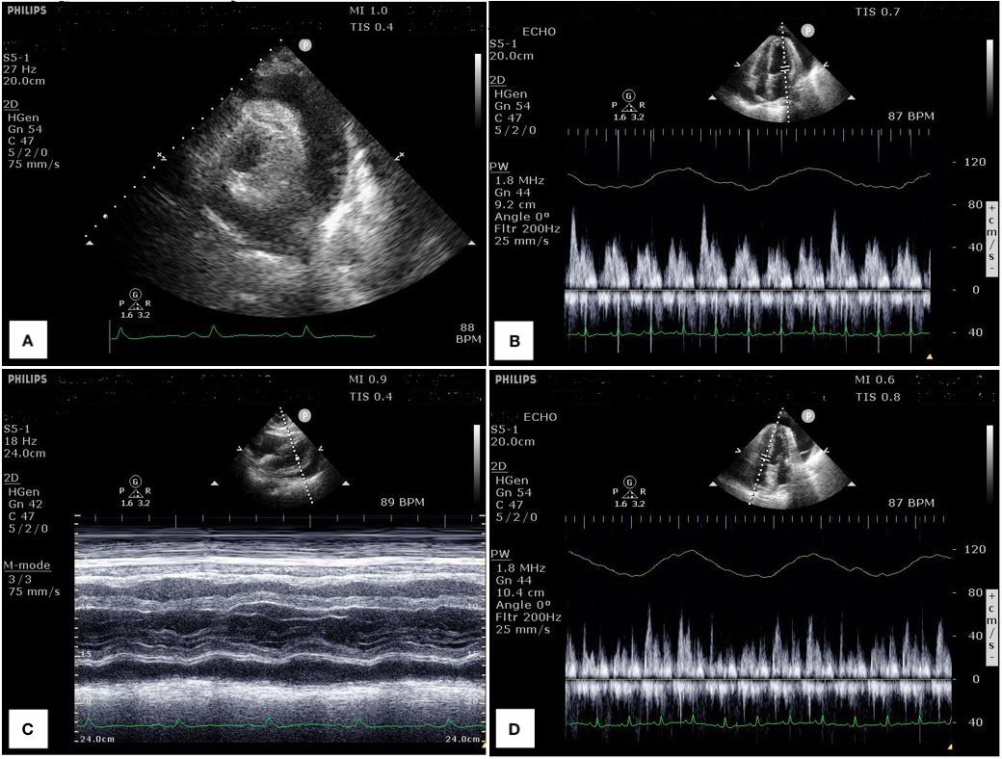
Case Presentation 1
Investigations
Transthoracic echocardiography:
A demonstrates parasternal short axis with circumferential effusion
B demonstrates mitral inflow view, with over 25% reduction in inflow velocity with respiration
C demonstrates subcostal view with M-mode highlighting the effusion with variation in myocardium during systole
D demonstrates tricuspid inflow view, with over 40% reduction in inflow velocity with respiration

Slide 6
Case Presentation 1
Management
Pericardiocentesis and pericardial drain placement
Fluid studies:
    Elevated WBC to 10,973/cu mm (83% neutrophils, 14% lymphocytes) and elevated LDH (1,697 IU/L; normal 50-150 IU/L)
Initiated on colchicine, hydrocortisone, and hydroxychloroquine
Serial TTEs during admission demonstrated new apical and periapical hypokinesis, with resolution of the effusion
Follow-up TTE three weeks post-discharge demonstrated resolution of the wall motion abnormalities with return to baseline EF of 63%

Slide 7
Case Presentation 2
History and Examination Findings
46-year-old African American male with a history of type 2 diabetes and obesity presented with persistent fevers
In the ED he was febrile to 102.8 °F and hypoxic requiring supplemental oxygen; he subsequently decompensated due to acute hypoxic respiratory failure and required intubation. Physical examination demonstrated tachypnea and tachycardia, diminished breath sounds bilaterally, and normal S1 and S2 heart sounds; no murmurs or palpable thrill were appreciated
On day 6, had multiple episodes of non-sustained ventricular tachycardia followed by a wide complex tachycardia that generated into asystole. Return of spontaneous circulation was achieved after cardiopulmonary resuscitation.

Slide 8
Case Presentation 2
Investigations
Lymphopenic (0.6 K/uL; normal 1.0-4.8 K/uL)
Normal hs-cTnI (<19 ng/L) and BNP (<50 pg/mL) on admission
SARS-CoV-2 testing was positive
Post-resuscitation hs-cTnI peaked at 6,639 ng/L
Post-resuscitation D-Dimer >20 ug/mL (normal < 5.0 ug/mL)
ECG on admission showed sinus tachycardia
CXR showed bilateral multifocal patchy opacities

Slide 9
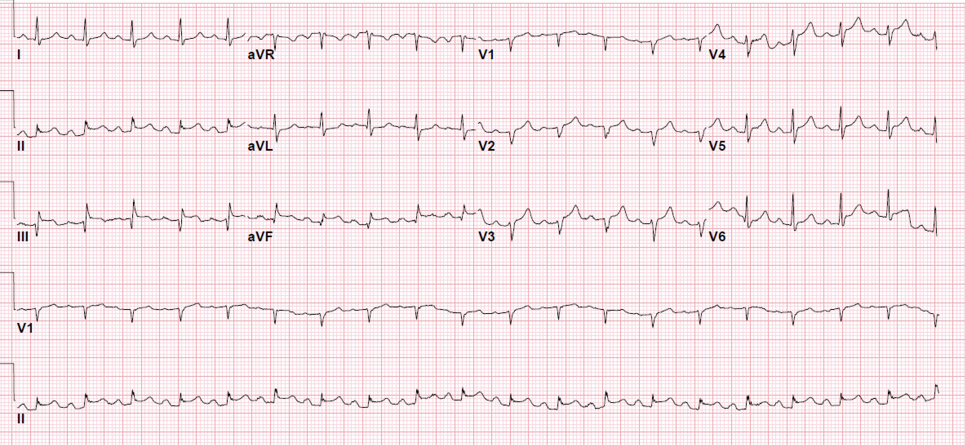
Case Presentation 2
Investigations
ECG demonstrated new ST elevations with PR depressions in the inferior leads and loss of early precordial R waves, with slight reciprocal ST segment depression in the high lateral lead aVL

Slide 10
Case Presentation 2
Management
Received full dose aspirin and was initiated on heparin infusion, without additional antiplatelet therapy
Due to hemodynamic instability, he was deemed too high risk for coronary angiography or thrombolytic therapy
Respiratory and renal function deteriorated resulting in hypoxic pulseless electrical activity arrest and death

Slide 11
Case Presentation 3
History and Examination Findings
76-year-old African American female with a history of obstructive sleep apnea and hypertension presented with diarrhea, myalgias, and shortness of breath
In the ED, she was febrile (101.3 °F) and hypoxemic and quickly decompensated requiring intubation. Physical examination demonstrated bilateral crackles with end expiratory rhonchi, and systolic murmur along the left sternal border unchanged with respiration
Day 4 of hospitalization, she developed sinus tachycardia and shock requiring norepinephrine infusion

Slide 12
Case Presentation 3
Investigations
Lymphopenic (0.5 K/uL; normal 1.0-4.8 K/uL)
Normal BNP (<50 ng/mL) and hs-cTnI (<19 ng/L) on admission
Elevated Inflammatory markers
    Peak Ferritin (922 ng/mL; normal 12-300 ng/mL)
    Peak C-reactive protein (9.7 mg/dL; normal < 5.0 mg/dL)
    Peak LDH (349 IU/L; normal 50-150 IU/L)
    Peak Creatinine Phosphokinase (374 IU/L; normal 39-308 IU/L)
Positive for SARS-CoV-2
ECG showed new early repolarization of lateral leads
Initial CXR showed bilateral patchy pulmonary opacities
Central venous oxygen saturation was decreased (55.5%)
Cardiac Index (CI) was 1.9 L/min/m²

Slide 13
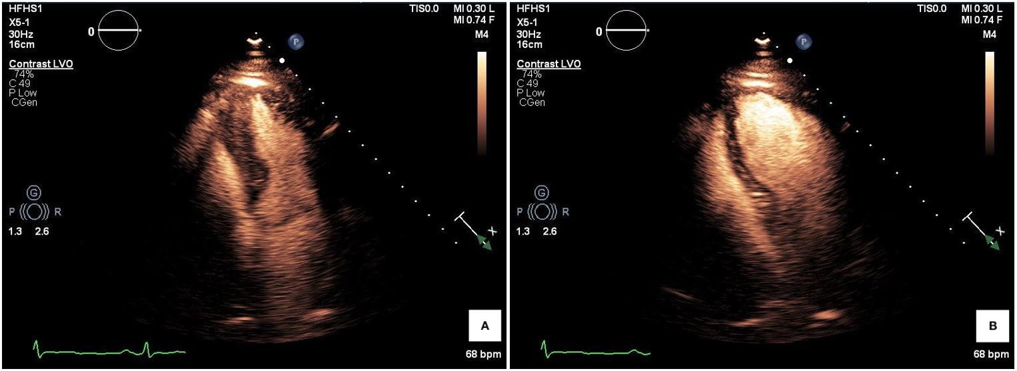
Case Presentation 3
Investigations
Transthoracic echocardiography:
A is the ballooning of the basal segment during systole, with contrast to demarcate the epicardium
B demonstrates return of apical segment during diastole

Slide 14
Case Presentation 3
Management
Coronary angiography deferred due to illness severity
Started on unfractionated heparin infusion
Cardiac index improved with pronation; thus, afterload reduction and inotropy were withheld.
Troponin levels normalized, with serial ECGs demonstrating resolution of lateral lead changes, CI remained >2.5 L/min/m²
Unfortunately, respiratory status worsened leading to cardiopulmonary arrest and death

Slide 15
Discussion
SARS-CoV-2 cardiac involvement as prevalent as respiratory involvement ^{6, 7}
    Systemic inflammatory effects driven by the virus through cytokine release and inflammatory cascade ^{3, 8}
      Can lead to pericarditis, myocarditis, vascular inflammation ^{9, 10}
  Stress from acute, severe illness can also lead to an excess catecholamine release resulting in stress induced cardiomyopathy
    Reverse Takotsubo cardiomyopathy (basilar wall hypokinesis), occurs in 1-25% of stress cardiomyopathies ¹¹
  Observational trends have shown severe cases of COVID-19 developing coagulopathies that can lead to microemboli ^{3, 12}
Limitations during COVID-19 Pandemic:
    National Personal Protective Equipment (PPE) shortage affecting timing of certain studies (e.g. coronary angiography, echocardiography)

Slide 16
Learning Points
Physician should maintain high clinical suspicion for cardiac complications from COVID-19 infection due to cytokine storm
Physicians can utilize cardiac testing and monitoring to optimally manage cardiac manifestations of COVID-19
Physicians should continue advocating for personal protective equipment to safely and effectively perform invasive cardiac interventions

Slide 17
References
Pneumonia of unknown cause—China. World Health Organization. 2020. https://www.who.int/csr/don/05-january-2020-pneumonia-of-unkown-cause-china/en/. Accessed March 30, 2020.
Novel coronavirus—China. World Health Organization. 2020. https://www.who.int/csr/don/12-january-2020-novel-coronavirus-china/en/. Accessed March 30, 2020.
Driggin E, Madhaven MV, Bikdeli B, Chuich T, Laracy J, Bondi-Zoccai G, Brown TS, Der Nigoghossian C, Zidar DA, Haythe J, Brodie D, Beckman JA, Kirtane AJ, Stone GW, Krumholz HM, Parikh SA. Cardiovascular considerations for patients, health care workers, and health systems during the Coronavirus Disease 2019 (COVID-19) pandemic. J Am Coll Cardiol [Internet]. 2020 March; doi:10.1016/j.jacc.2020.03.031
Yu CM, Wong RS, Wu EB, Kong SL, Yip GWK, Soo YOY, Chiu MLS, Chan YS, Hui D, Lee N, Wu A, Leung CB, Sung JJY. Cardiovascular complications of severe acute respiratory syndrome. Postgrad Med J. 2006;82(964):140-144.
Zeng JH, Liu Y, Yuan J, Wang F, Wu W, Li J, Wang L, Gao H, Wang Y, Dong C, Li Y, Xie X, Feng C, Liu L. First Case of COVID-19 Infection with Fulminant Myocarditis Complication: Case Report and Insights. Preprints [Internet]. 2020 March; doi:10.20944/preprints202003.0180.v1
Zheng YY, Ma YT, Zhang JY, Xie, X. COVID-19 and the cardiovascular system. Nat Rev Cardiol [Internet]. 2020 March; doi:10.1038/s41569-020-0360-5
Wang D, Hu B, Hu C, Zhu F, Liu X, Zhang J, Wang B, Xiang H, Cheng Z, Xiong Y, Zhao Y, Li Y, Wang X, Peng Z. Clinical characteristics of 138 hospitalized patients with 2019 novel coronavirus-infect pneumonia in Wuhan, China. JAMA [Internet]. 2020 Feb; doi:10.1001/jama.2020.1585
Channappanavar R, Perlman S. Pathogenic human coronavirus infections: causes and consequences of cytokine storm and immunopathology. Semin Immunopathol [Internet]. 2017;39(5):529–539. doi:10.1007/s00281-017-0629-x
Inciardi RM, Lupi L, Zaccone G, Italia L, Raffo M, Tomasoni D, Cani DS, Cerini M, Farina D, Gavazzi E, Maroldi R, Adamo M, Ammirati E, Sinagra G, Lombardi CM, Metra M. Cardiac involvement in a patient with coronavirus Disease 2019 (COVID-19). JAMA Cardiol [Internet]. 2020 March; doi:10.1001/jamacardio.2020.1096
Xu X, Yu C, Qu J, Zhang L, Jiang S, Huang D, Chen B, Zhang Z, Guan W, Ling Z, Jiang R, Hu T, Ding Y, Lin L, Gan Q, Luo L, Tang X, Liu J. Imaging and clinical features of patients with 2019 novel coronavirus SARS-CoV-2. Eur J Nucl Med Mol Imaging [Internet]. 2020 May; 47(5):1275–1280. Available from: doi:10.1007/s00259-020-04735-9
Awad HH, McNeal AR, Goyal H. Reverse Takotsubo cardiomyopathy: a comprehensive review. Ann Transl Med. 2018 Dec; 6(23):460. Available from: doi: 10.21037/atm.2018.11.08
Clerkin KJ, Fried JA, Raikhelkar J, Sayer G, Griffin JM, Masoumi A, Jain SS, Burkhoff D, Kumaraiah D, Rabbani L, Schwartz A, Uriel N. Coronavirus Disease 2019 (COVID-19) and cardiovascular disease. Circulation [Internet]. 2020 March; doi:10.1161/CIRCULATIONAHA.120.046941

