Slide 1
COVID-19 treatment with lopinavir-ritonavir resulting in sick sinus syndrome: a case report.
May 2020
EHJ-CR-D-20-00382

Slide 2
Introduction
Current evidence for treatment of COVID-19 patients is inconclusive and there are no approved treatments against it.
COVID-19 pandemic is the most serious global public health crisis of the century.
Investigational treatments are being used despite limited safety data (1).
Besides being at higher risk of complications with COVID- 19 infection, patients with underlying cardiovascular disease are more likely to develop cardiac related side effects of treatment (2,3).

Slide 3
Case Presentation
History and Examination Findings
A 67-year-old Chinese man presented with a one-week history of fever and cough.
He has past medical history of hypertension, hyperlipidemia, gout and stable ischemic heart disease.
His chronic medications prior to admission were:
Clopidogrel 75 mg OM
Rosuvastatin 20 mg ON
Bisoprolol 2.5 mg OM
Omeprazole 40 mg OM
Cozaar (amlodipine 5 mg/losartan 50 mg) 1 tab OM
Clinical examination was unremarkable.
Vitals : T 38°C , BP 120/80 mmHg, HR 89 beats/min, SPO2 98% on room air

Slide 4
Case Presentation
Initial investigations
Blood tests with reference ranges
Hb 18.5 g/dL (13.1-16.6 g/dL)
WBC 3.82 x 10⁹ /L (3.84-10.01 x10⁹ /L)
Platelets 137 x 10⁹ /L (164-387 x 10⁹ /L)
Na 136 mmol/L (135-145 mmol/L)
K 3.2 mmol/L (3.5-5 mmol/L)
Cr 75 µmol/L (60-107 µmol/L)
CRP 16 mg/ml (0-10 mg/ml)
Ferritin 410 µg/L (20-300 µg/L)
Hs Trop I 23.1 ng/L (<17.5 ng/L)
Figure 1. Normal chest radiograph.

Slide 5
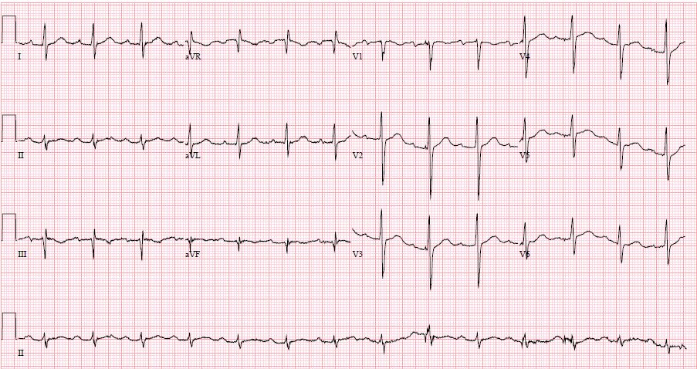
Case Presentation
Initial ECG
Figure 2. Electrocardiogram done on admission. Normal sinus rhythm with first degree atrioventricular block.

Slide 6
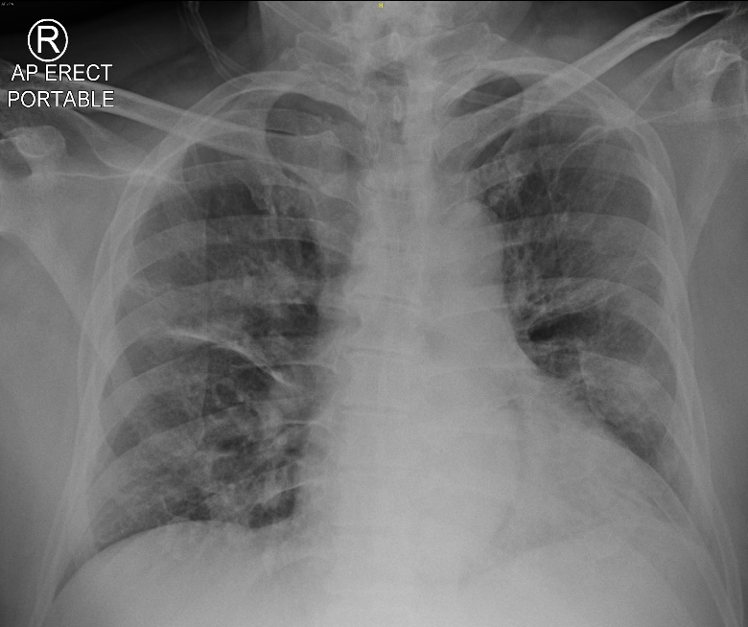
Case Presentation subsequent events and management
On the third day, he developed mild haemoptysis, wheeze with oxygen saturations of 93-95% on room air and required supplemental oxygen 2L nasal prongs.
Bisoprolol was stopped.
He had persistent fever and worsening inflammatory markers:
CRP 16 → 54 mg/ml
Ferritin 410 mcg/L → 1289 mcg/L
ID team was consulted and he was initiated on lopinavir-ritonavir.
Transferred to ICU and required intubation.
Figure 3. Development of bilateral consolidations.

Slide 7
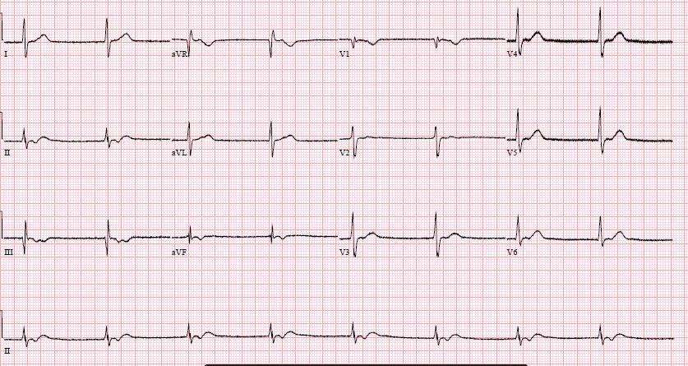
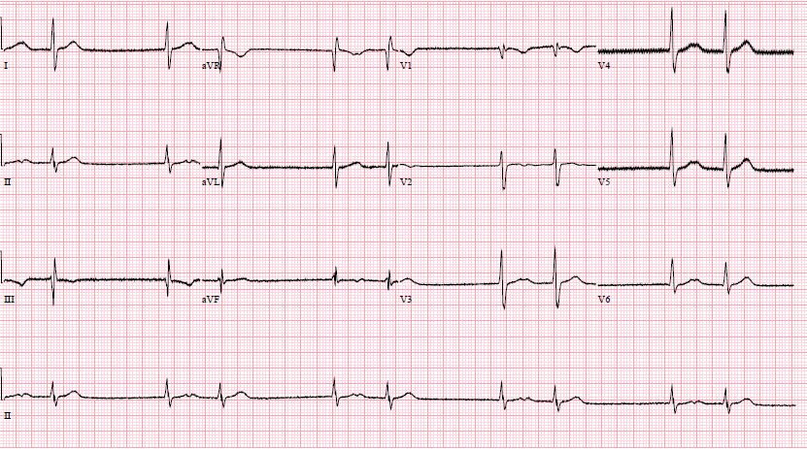
Case Presentation subsequent events and management
Developed recurrent episodes of bradyarrhythmia.
Bisoprolol was already discontinued prior to development.
Electrolytes were corrected. Renal function and thyroid function were normal.
Figure 4.Junctional rhythm.
Figure 5.Escape-capture bigeminy.

Slide 8
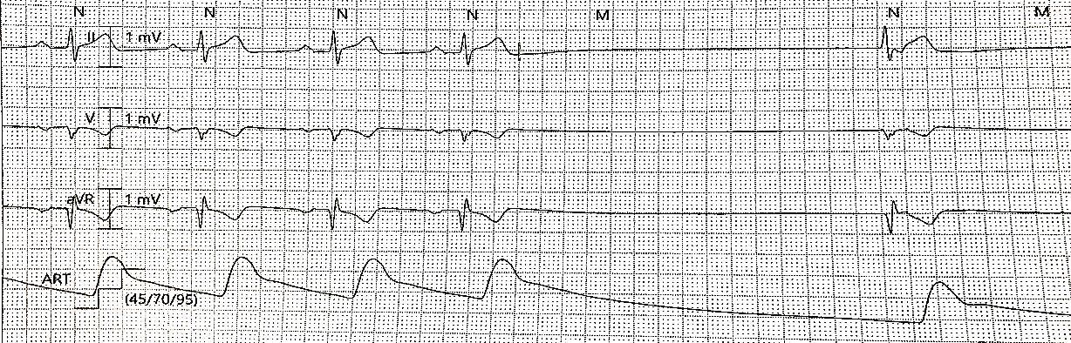
Case Presentation subsequent events and management
No other obvious reversible factors that could have resulted in the bradyarrhythmia were found.
Repeat Hs-Trop I was only mildly elevated at 33.6 ng/l. Transthoracic echocardiogram showed normal LVEF.
He eventually developed sinus arrest of 3.2 seconds with junctional escape. (>72hrs after discontinuing bisoprolol) He was started on low dose dopamine infusion
Multidisciplinary team discussion among intensivist, ID physician and cardiologist was conducted. The impression was that the most likely culprit was lopinavir-ritonavir, which was stopped.
Within 48 hours, bradyarrhythmia resolved.
Figure 6.
Sinus arrest with junctional escape.

Slide 9
Discussion
Lopinavir-ritonavir is a combination drug of a protease inhibitor combined with a CYP3A4 inhibitor used for the treatment of human immunodeficiency virus (HIV-1). It has also been shown to have some efficacy in treating SARS in 2004 (4).
A recent study with some limitations has shown no benefit in time to clinical improvement with 14-day treatment of lopinavir-ritonavir compared to standard of care. Side effects were mainly gastrointestinal related (5).
There have only been a small number of case reports on lopinavir-ritonavir induced bradyarrhythmia in patients on treatment for HIV-1 (6,7).
In this case, COVID-19 infection resulted in intrinsic bradyarrhythmia vs lopinavir-ritonavir induced bradyarrhythmia.

Slide 10
Learning points
Lopinavir-ritonavir is an anti-viral drug used to treat HIV and had some prior evidence in the treatment of SARS. Current efficacy and safety evidence for use in COVID-19 patients are limited. Those with underlying cardiovascular disease may be more prone to cardiac side effects of lopinavir-ritonavir, such as bradyarrhythmia and require closer monitoring.
It is important to counsel the patient on risks and benefits and acknowledge the shortfalls when using investigational therapy for COVID-19.

Slide 11
References
(1) Sanders JM, Monogue ML, Jodlowski TZ, Cutrell JB. Pharmacologic Treatments for Coronavirus Disease 2019 (COVID-19): A Review. JAMA.
Published online April 13, 2020. doi:10.1001/jama.2020.6019
(2) Kang Y, Chen T, Mui D, Ferrari V, Jagasia D, Crosbie MS, Chen Y, Han Y. Cardiovascular manifestations and treatment considerations in covid-19.Heart Published Online First: 30 April 2020. doi: 10.1136/heartjnl-2020-317056
(3) Wang D, Hu B, Hu C, Zhu F, Liu X, Zhang J, Wang B, Xiang H, Cheng Z, Xiong Y, Zhao Y, Li Y, Wang X, Peng Z. Clinical Characteristics of 138 Hospitalized Patients With 2019 Novel Coronavirus-Infected Pneumonia in Wuhan, China. JAMA. 2020 Feb 7;323(11):1061–9. doi:10.1001/jama.2020.1585
(4) Chu CM, Cheng VCC, Hung IFN, Wong MML, Chan KH, Chan KS, Kao RTY, Poon LLM, Wong CLP, Guan Y, Peiris HSN, Yuen KYY. Role of lopinavir/ritonavir in the treatment of SARS: initial virological and clinical findings. ﻿Thorax. 2004;59(3):252-256. doi:10.1136/thorax.2003.012658﻿
(5) Cao B, Wang Y, Wen D, Liu W, Wang J, Fan G, Ruan L, Song B, Cai Y, Wei M, Li X, Xia J, Chen N, Xiang J, Yu T, Bai T, Xie X, Zhang L, Li C, Yuan Y, Chen H, Li H, Huang H, Tu S, Gong F, Liu Y, Wei Y, Dong C, Zhou F, Gu X, Xu J. A Trial of lopinavir-ritonavir in adults hospitalized with severe Covid-19. N Engl J Med. 2020. https://doi.org/10.1056/NEJMoa2001282.
(6) Chaubey SK, Sinha AK, Phillips E, Russell DB, Falhammar H. Transient cardiac arrhythmias related to lopinavir/ritonavir in two patients with HIV infection. Sex Health. 2009 Sep;6(3):254-7. doi: 10.1071/SH09005.
(7) Kikuchi Y, Genka I, Ishizaki A, Sunagawa K, Yasuoka A, Oka S. Serious bradyarrhythmia that was possibly induced by lopinavir-ritonavir in 2 patients with acquired immunodeficiency syndrome. Clin Infect Dis 2002; 35 488–90. doi: 10.1086/341975

